Slide 1
S8
Goran Šimić
Neurobiološka podloga emocija
5. I. 2023.

Slide 2
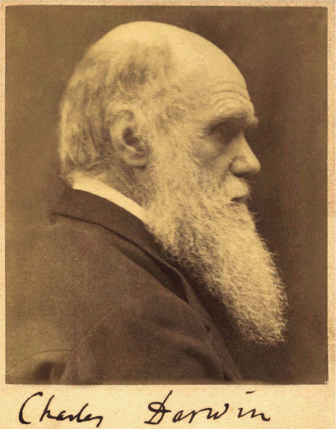
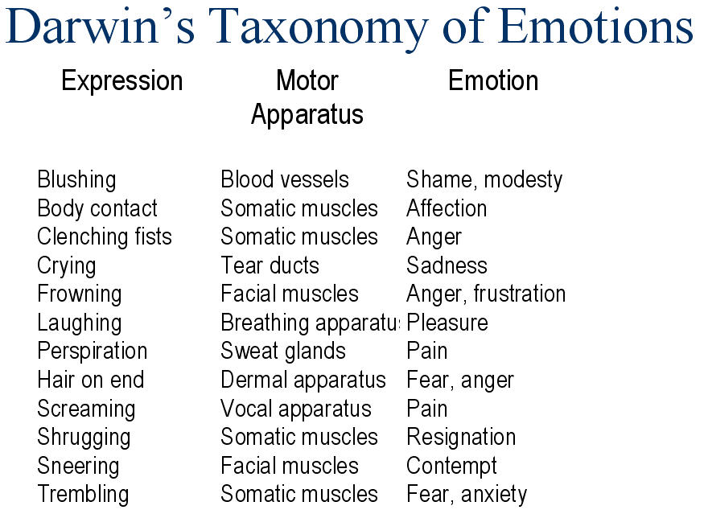
Darwin investigated the evolution of emotional responses and facial expressions, and suggested that emotions allow an organism to make adaptive responses to stimuli in the environment.
Darwin C (1872) The expression of emotions in man and animals.

Slide 3
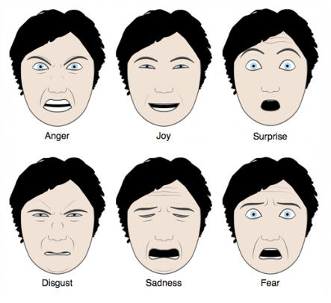
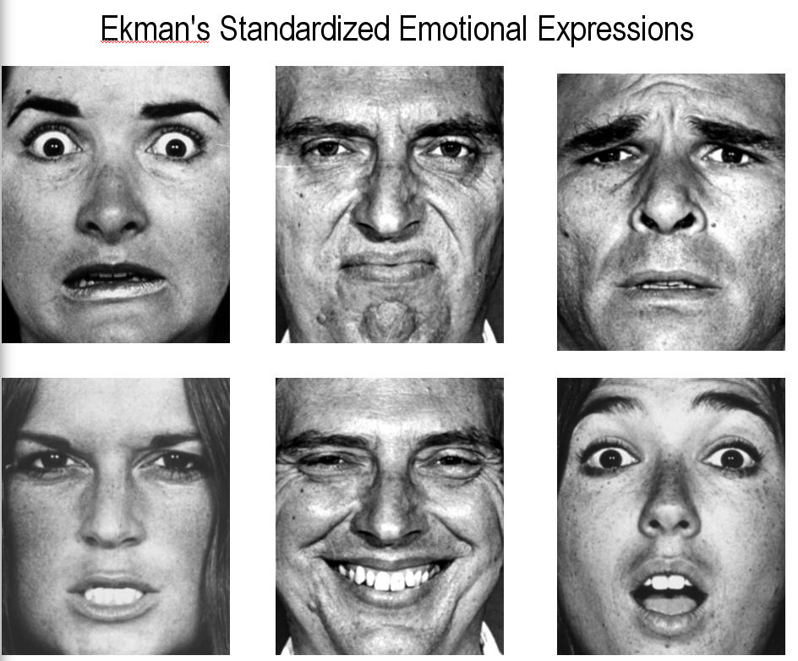
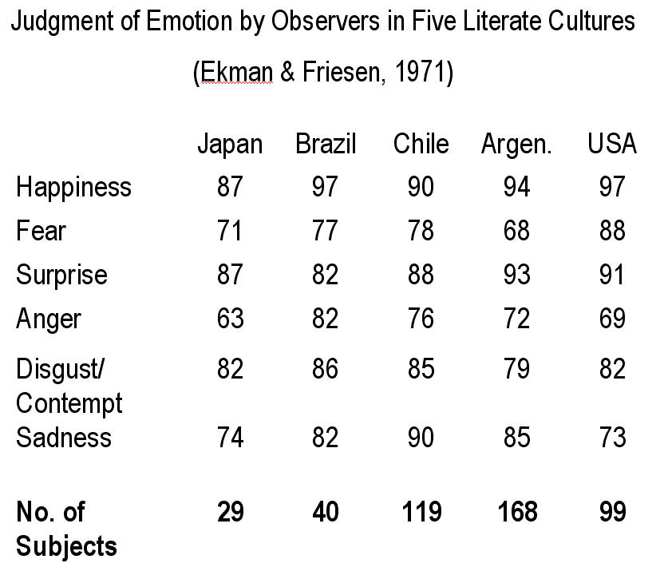
A basic palette of emotions
Ekman defined 6 basic emotions since they are cross-culturally recognized regardless of experience.
Ekman P, Friesen WV (1971) Constants across culture in the face and emotion. J Pers Soc Psychol 17: 124-129.

Slide 4
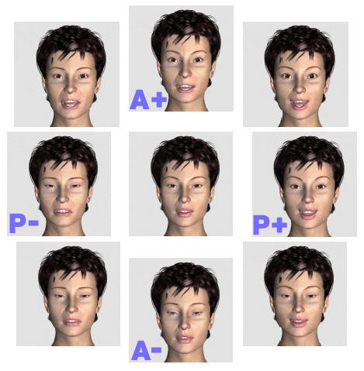
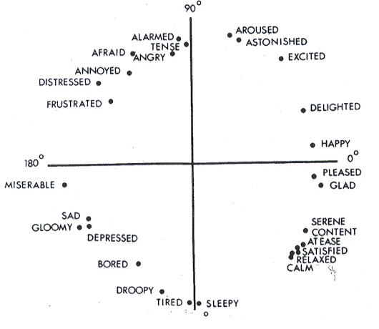
Emotional dimensions
Emotions are not discrete; rather they are having dimensions (e.g. low to high arousal, pleasant vs. unpleasant valence, approach vs. avoidance...)
Russell PA (1971) A circumplex model of affect. J Pers Soc Psychol 39: 1161-1178.

Slide 5
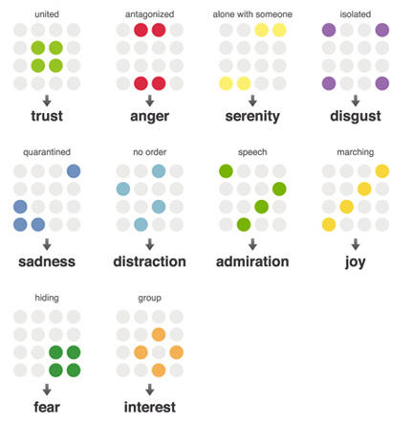
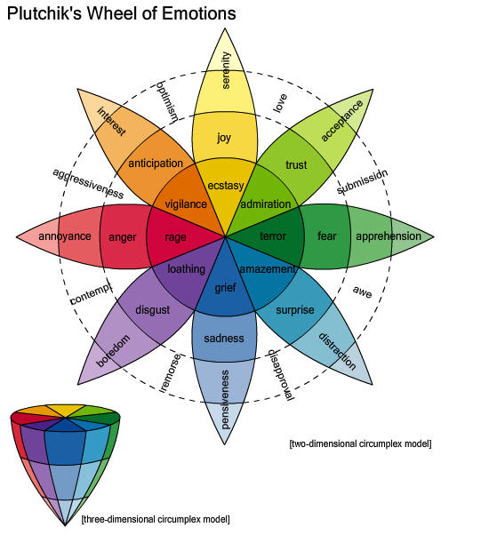
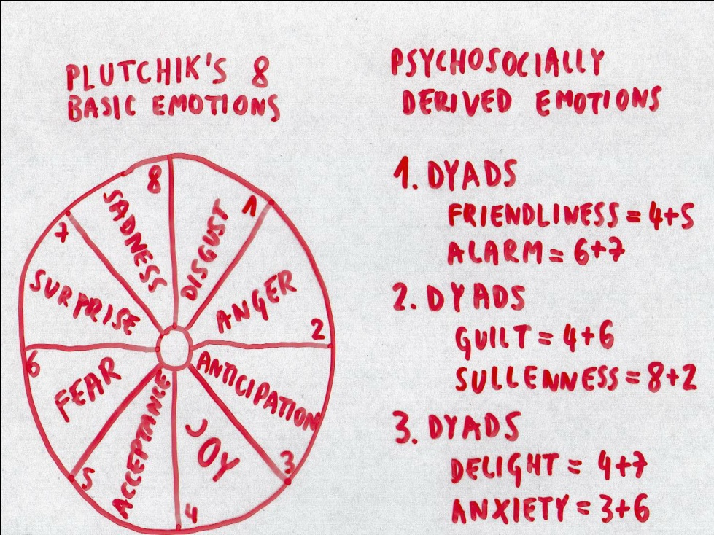
Emotional dimensions expanded
Plutchik R (1958) Outlines of a new theory of emotion. Trans NY Acad Sci 20: 394-403.

Slide 6
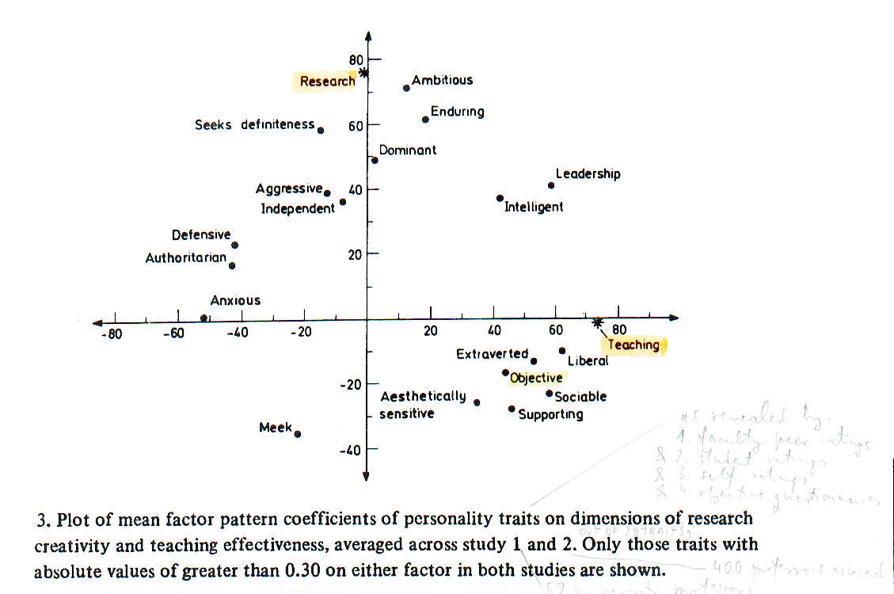
Personality traits of 452 university professors
Number of SCI citations
5-year students’ ratings
Personality traits of emotional nature may be life-long.

Slide 7
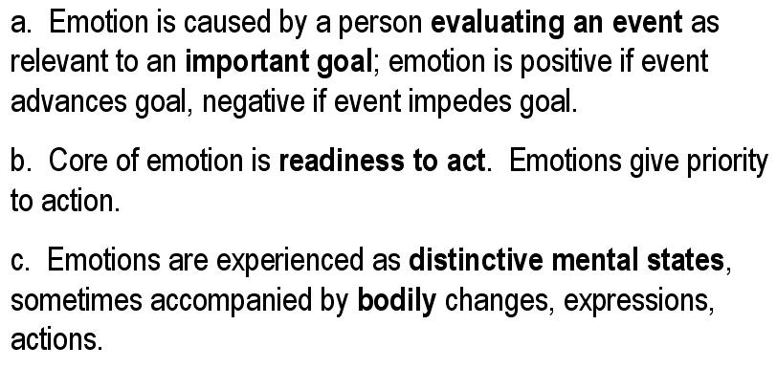
Definition of emotion
For many years, emotion remained an elusive scientific topic and was generally defined in opposition to cognition as that which moves us in some way, as is implied by the Latin root (movere, to move)

Slide 8
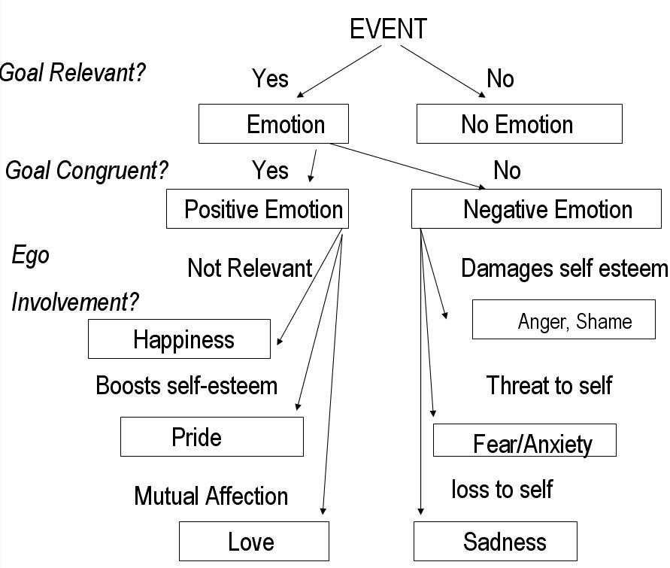
Emotions are related to goals

Slide 9
Emotions are complex affective states comprized of many components:
Autonomic (hormonal and visceral)
Cognitive (subjective feelings and thoughts)
Motor expression (face, body, voice)
Recognition of motor expression
Conscious perceptive awareness
Unconscious perception
Attention (external and internal)
Memories
Kolb B, Whishaw I (2008) Fundamentals of human neuropsychology.

Slide 10
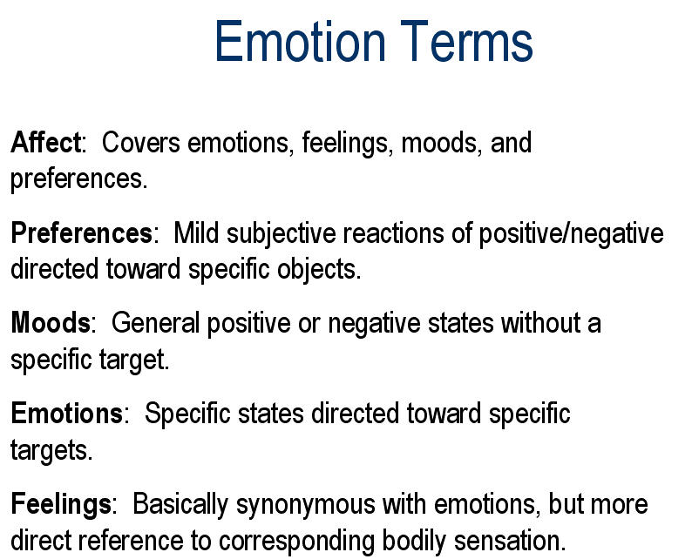

Slide 11
Theories and phases in research of emotions (simplified)
- Behaviorism 1950-75
B.F. Skinner (humans do not have minds)
- Cognitive revolution 1970-90
R. Sheppard, R. Lazarus, P. Elsworth, etc.
(humans have minds:
minds affect behavior (appraisal theory: thinking comes first))
- Emotional revolution 1990-today
R. Zajonc, J. Le Doux (humans have emotions:
emotions affect thinking and behavior)
(thinking and emotions are separate systems: emotions can come first)

Slide 12
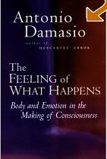
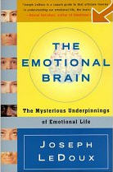
Major contemporary theories of emotion
Damasio’s SOMATIC MARKER HYPOTHESIS
emotion starts in the body
Le Doux’s COGNITIVE-EMOTIONAL THEORY
emotion starts in the brain
- Gainotti’s LATERALIZATION THEORY
Kolb B, Whishaw I (2008) Fundamentals of human neuropsychology.

Slide 13
Damasio’s SOMATIC MARKER HYPOTHESIS
- An emotion consists of a change in the body that, in turn, changes brain states in evaluation of a particular external event (since W. James, and C. G. Lange, 1890: “every emotion is tied to distinct body state” & “all emotions are developed from, or can be reduced to, physiologic reactions to stimuli”) )
- Accumulated evidence that amygdala represents the central “emotional computer” within the brain, which gives emotional (affective) tone to the input sensory information even before its conscious (cortical) processing (“emotional filter”)
- One of the most important specializations of amygdala is recognition of facial expressions (that convey information about identity, mood and intentions)
Kolb B, Whishaw I (2008) Fundamentals of human neuropsychology.

Slide 14
Damasio’s SOMATIC MARKER HYPOTHESIS
Key aspects:
- Emotion is fundamental to the survival of the individual within particular physical and social environment
- Emotion is a necessary experience to make rational decisions, especially in situations in which an individual faces risk, conflict or a potential partner
Kolb B, Whishaw I (2008) Fundamentals of human neuropsychology.

Slide 15
Le Doux’s COGNITIVE-EMOTIONAL THEORY
- All animals inherently detect and respond to danger, and the related neural activities in amygdala evolved to produce a feeling – in this case, fear (“emotions can precede thinking”) (since W. Cannon and P. Bard, 1890: “people feel emotions first and then act upon them”)
- Fear system includes both conscious (learning about dangerous stimuli for which evolution could not prepare us - fear conditioning keeps organism alive!) and unconscious fear responses
Damage to the hippocampal formation interferes with contextual fear associations
Panic disorder, PTSD, obsessive-compulsive disorder, anxiety and fobias are all examples of classical fear conditioning
Kolb B, Whishaw I (2008) Fundamentals of human neuropsychology.

Slide 16
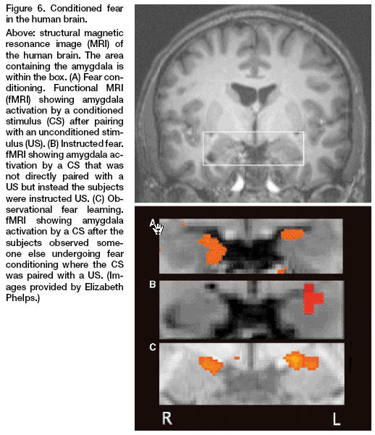
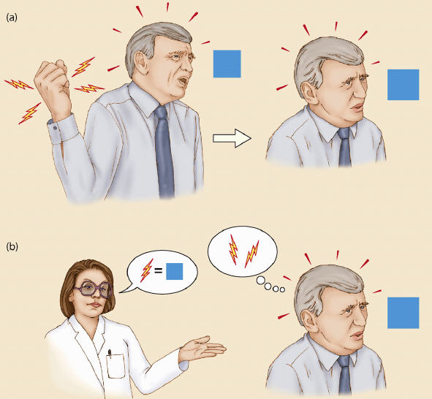
a) fear conditioning
b) instructed fear
c) observational fear learning
Three different ways by which humans can learn about the aversive
properties of an event. In all of them the activation of amygdala is seen.
Le Doux JE (2000) Emotion circuits in the brain. Annu Rev Neurosci 24: 155-184; Gazzaniga et al., 2002.

Slide 17
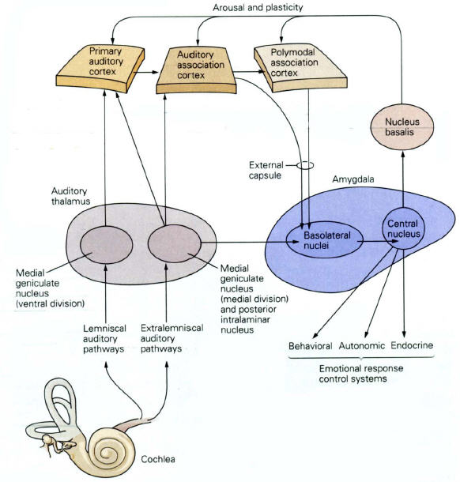
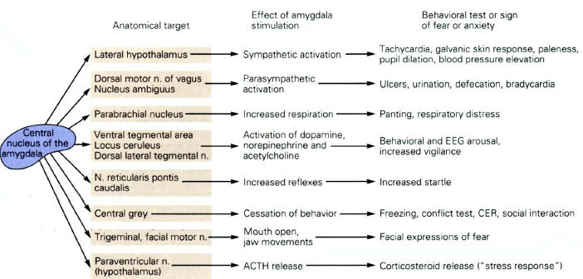
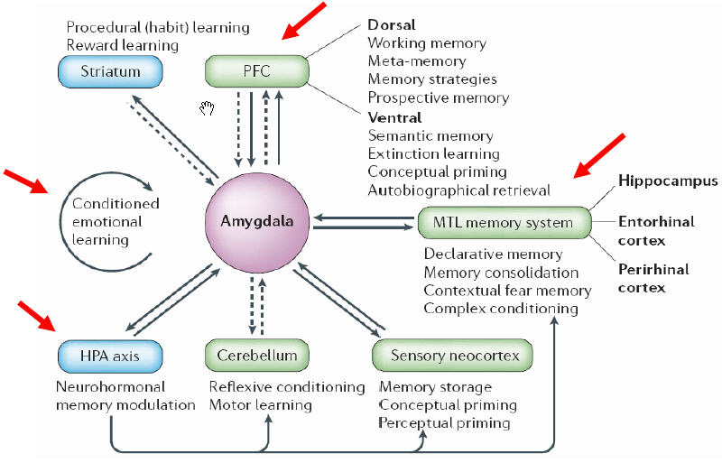
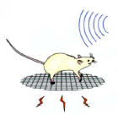
Auditory fear conditioning
Le Doux 1992; Davies 1992; Kandell 2000.

Slide 18
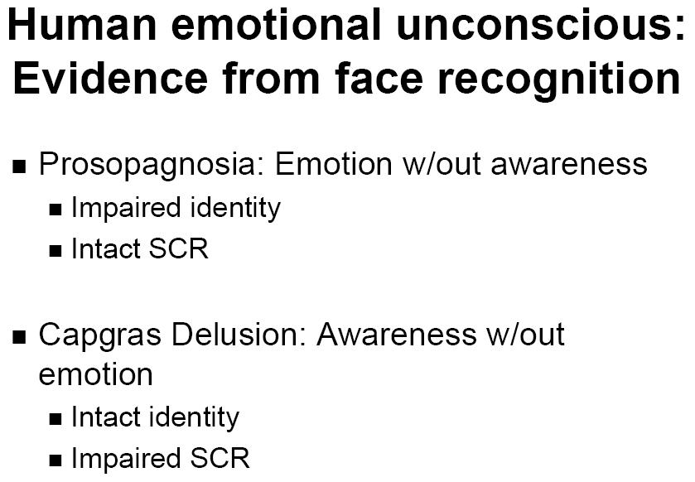

Slide 19
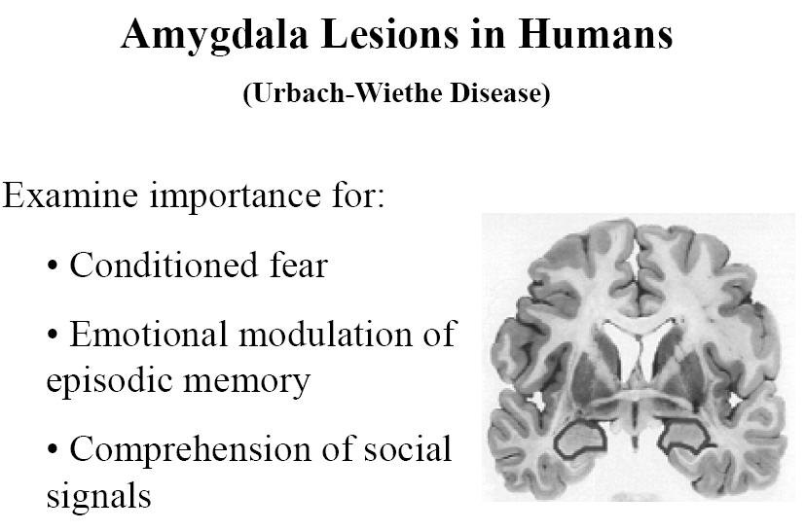
- Loss of fear 100%
- Oral examination of objects 98%
- Hypersexuality 79%
- Hypermetamorphosis 77%
- Visual agnosia 42%
- Bulimia 28%

Slide 20
Gainotti’s LATERALIZATION THEORY
Left-hemisphere lesions usually produce “catastrophic” reactions, such as fearfulness and depression
Right-hemisphere lesions produce larger effects, mostly “indifference” (flattening of mood)
The left amygdala plays a special role in generating (and recognizing) fear.
Kolb B, Whishaw I (2008) Fundamentals of human neuropsychology.

Slide 21
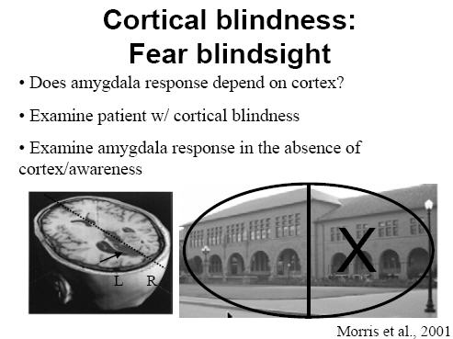

Slide 22
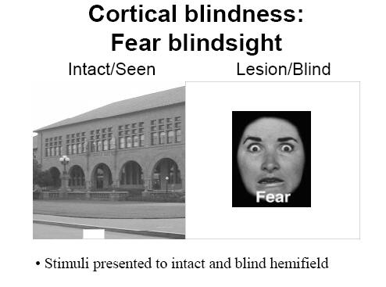

Slide 23
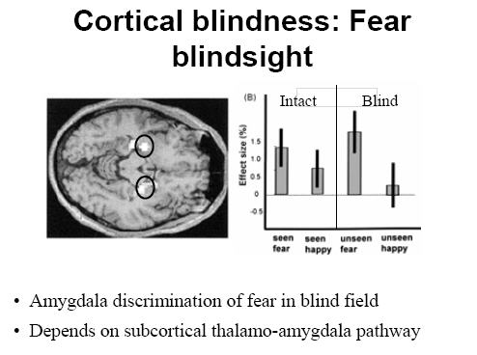

Slide 24
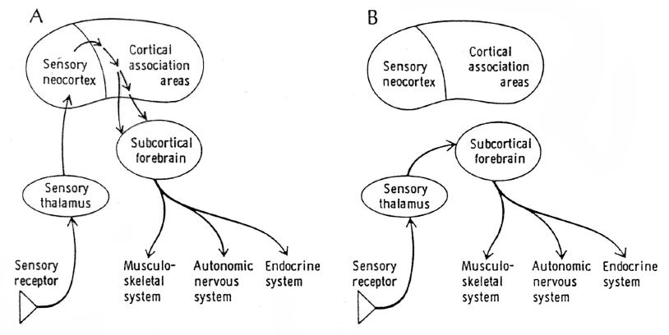
Concept of “high” and “low” road of emotional processing
“High road” is slower and conscious;
it depends on projections from OFC
to amygdala.
“Low road” is faster and unconscious;
it depends on projections from thalamus
to amygdala.
Decreased activity of OFC has been
documented in non-premeditated
murderers and schizophrenia
Le Doux JE (2000) Emotion circuits in the brain. Annu Rev Neurosci 24: 155-184.

Slide 25
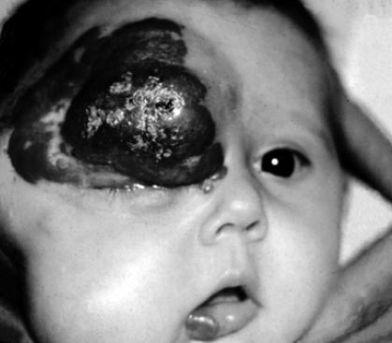
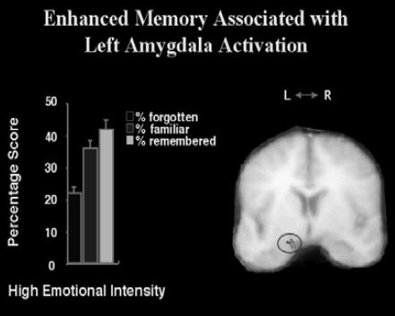
Emotions enhance retrieval of past experiences,

Slide 26
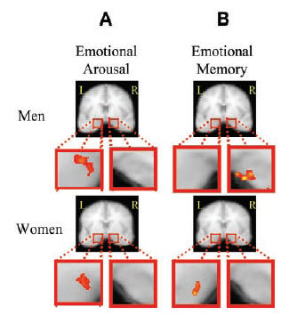
…, but there are huge sex differences
In recognition test 3 weeks after seeing pictures, they were remembered much better by women (activating signif. fewer structures and the left AMY) than men.
Canli et al. (2002) Sex differences in the neural basis of emotional memories. PNAS USA 99: 10789-10794.

Slide 27
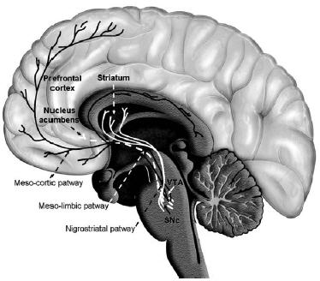



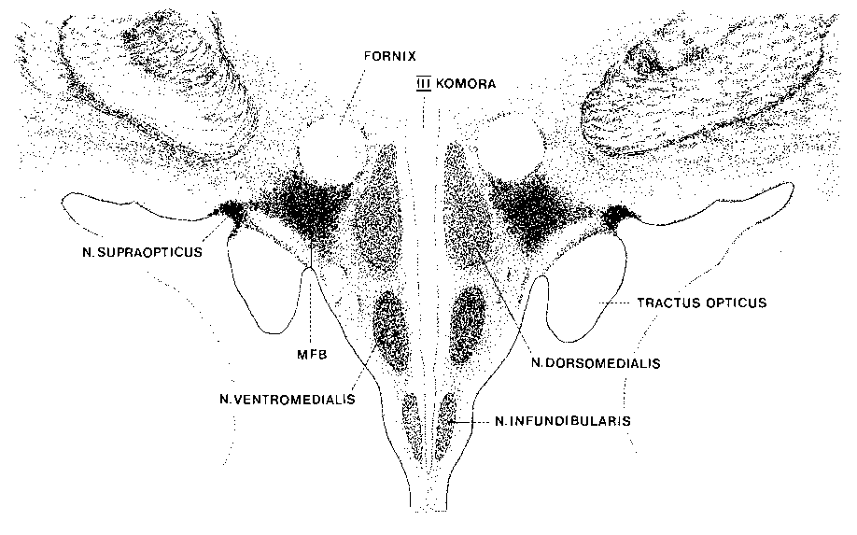
Mesocorticolimbic projections from VTA (A10)
The brain reward system is composed of dopaminergic projections from ventral tegmental area (VTA) to AMY and OFC (the so-called mesolimbic and mesocortical projections), which release dopamine at higher rate during pleasant experiences of eating food, having sex or bonding with a child (behavioral activation, step 1)

Slide 28
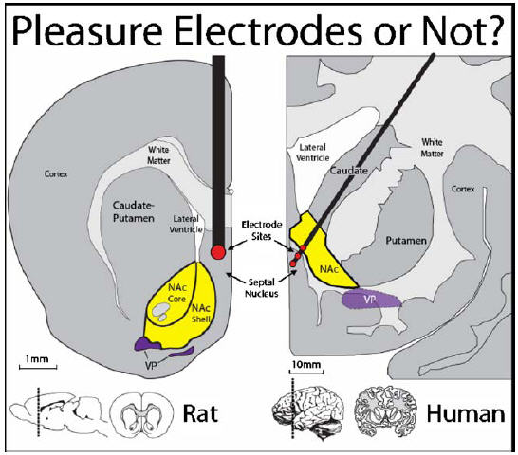
Olds et al. (1961)
Heath et al. (1972)
During a three-hour session, the gay subject, code-named B-19, electrically self-stimulated his reward circuitry some 1,500 times (Moan and Heath, 1972). He was experiencing an almost overwhelming euphoria and elation, and had to be disconnected, despite his vigorous protests. Dr Heath believed that ESB could be used to "cure" homosexuality.
Smith et al. (2008)
Moan, C.E., & Heath, R.G. Septal stimulation for the initiation of heterosexual activity in a homosexual male. Journal of Behavior Therapy and Experimental Psychiatry, 3, 23-30, 1972.

Slide 29
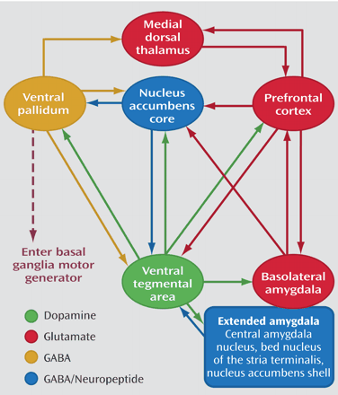
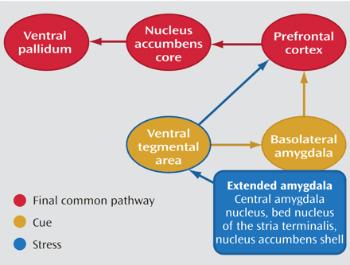
Normal circuitry
When a reward is greater than expected (such as in case of drugs like cocain, amphetamines, opioids, canabinoids, nicotine, partially alcohol), the firing of certain VTA DA neurons increases, which consequently increases the desire or motivation toward the reward in PFC (OFC). It is the PFC (OFC) glutamatergic projections that regulate activation of motor responses to “motivation-related events” through n. accumbens septi and thalamic motor nuclei, while blocking D1 receptors in PFC (OFC) prevents seeking for a drug.
Due to change in regulation of motivation circuit and pathological long-term changes in synaptic plasticity of OFC neurons that project to ventral striatum, in the last phase of dependence and drug abuse such patients are constantly looking for a drug.
Drug dependence
Arrias-Carrion and Poppel, Acta Neurobiol. Exp., 2007

Slide 30
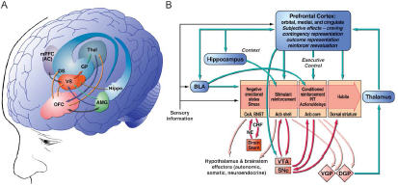
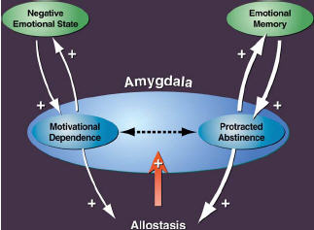
It should be always kept in mind that actual reward lies in the active processes of the brain that reacts to a stimulus rather than in stimulus itself.
Emotional states trigger relapse

Slide 31
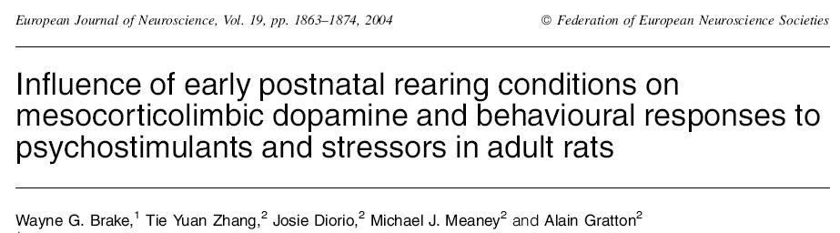
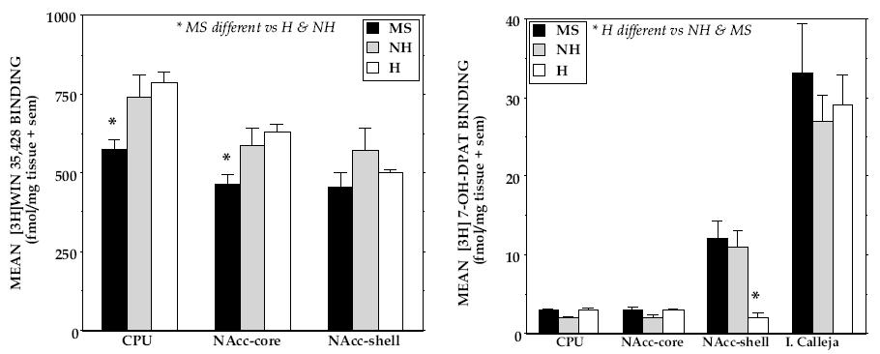

Slide 32
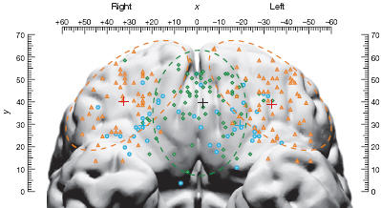
The role of OFC
Generally, activity in the medial OFC is related to the monitoring, learning and memory of the reward value of reinforcers (blue circles motivation-independent, green diamonds = motivation dependent), whereas lateral OFC activity is related to the evaluation of punishers (orange triangles) that can lead to a change in behavior
Similarly, a posterior-anterior distinction was shown, with more complex or abstract reinforcers (such as monetary gain and loss) being represented more anteriorly in OFC than less complex reinforcers such as taste
Kringelbach ML, Nature Rev. 2005.

Slide 33
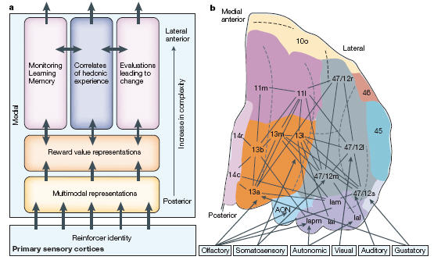
Computational model of the OFC
The reward value of a reinforcer is assigned in more anterior parts of the OFC,
and from here it can be used to influence subsequent behavior
Kringelbach ML et al., (2005) Nature Rev. Neurosci. 6: 691-702.

Slide 34
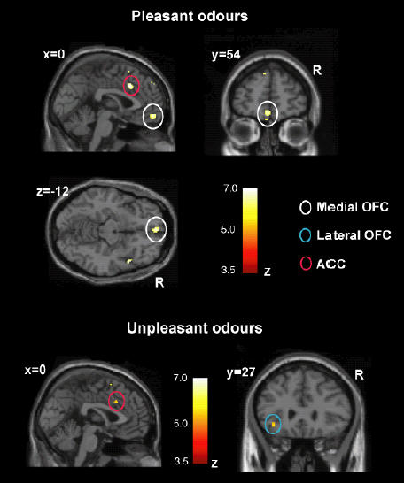
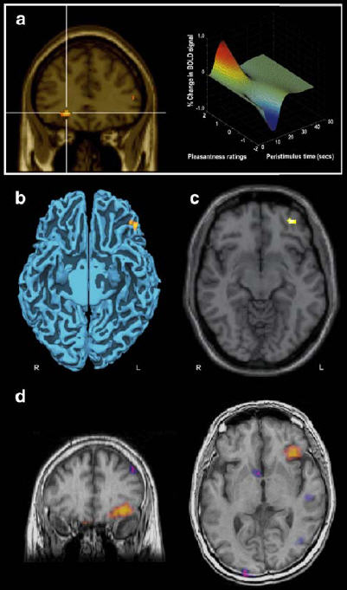
a. monosodium glutamate taste
b. a+ inosine monophosphate (umami)
c. Strawberry
d. Pain relief in a phantom limb patient

Slide 35
Smell of fear
Dogs and horses can smell fear in humans. Work by Denise Chen (Chen & Haviland-Jones, Physiology and Behaviour 1999; 68: 241-250) has demonstrated the ability of underarm odour to influence mood in others. Karl Grammer, in Vienna, has recently demonstrated that the smell of fear can be detected (by women) in the armpit secretions of people who watched a terrifying film (Ackerl, Atzmueller & Grammer, Neuroendocrinol Lett 2002; 23(2): 79-84). The implication of this work is that a chemical signal is secreted in sweat which communicates the emotion.

Slide 36
Menstrual synchrony and smell
Armpit swabs taken from donor women at a certain phase in their menstrual cycle and wiped on the upper lip of recipient women can advance or retard menstruation in the recipients depending upon the phase of the donor (Stern & McClintock, Nature (1998) 392, 177-179):
They found that odourless compounds from the armpits of women in the late follicular phase of their menstrual cycles accelerated the preovulatory surge of luteinizing hormone of recipient women and shortened their menstrual cycles. Axillary (underarm) compounds from the same donors which were collected later in the menstrual cycle (at ovulation) had the opposite effect: they delayed the luteinizing-hormone surge of the recipients and lengthened their menstrual cycles.
By showing in a fully controlled experiment that the timing of ovulation can be manipulated, this study provides definitive evidence of human pheromones.

Slide 37
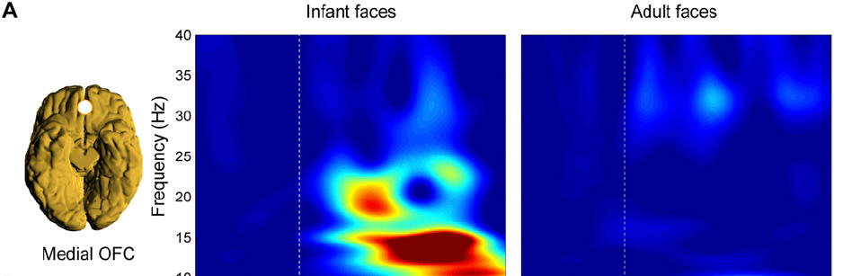
OFC is the site of “parental instinct”
The OFC is also relevant for “theory of mind” – basically thinking
about other people’s intentions and desires
Kringelbach et al. (2008) Plos One

Slide 38
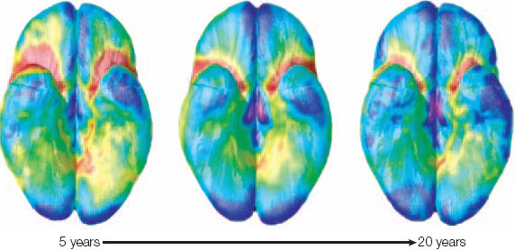
Average group map of the gray matter maturation index
The OFC matures late compared with other cortical areas
Gogtay N et al. (2004) PNAS USA 101:8174-8179.

Slide 39
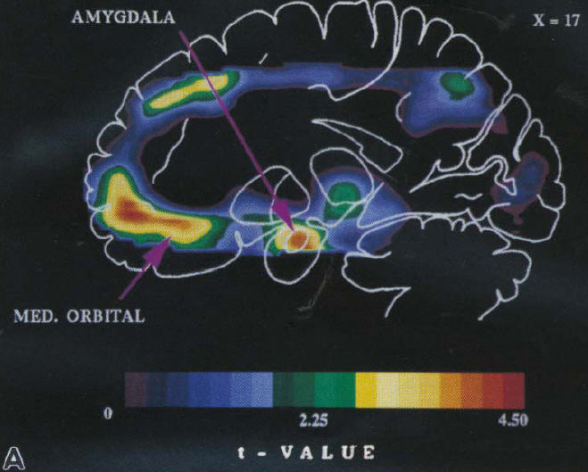
Increased activity (RBF) of left OFC and amygdala in depression
Price et al., 1996; Drevets, Curr. Opin. Neurobiol. 2001

Slide 40
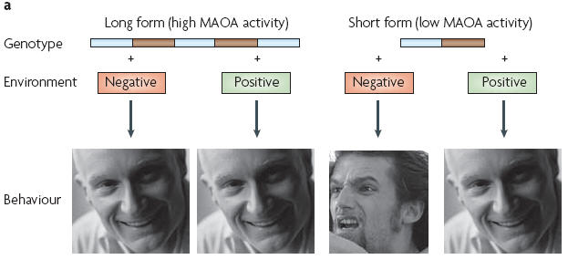
Emotions and gene – environment interactions
Data suggest that children carrying the short form of the MAOA promoter gene, which confers decreased MAOA activity, are more likely to develop conduct disorders and increased antisocial behaviour when exposed to abusive home environments. This environmental effect is less prevalent in individuals carrying the long form of the promoter
Slight modulation in 5-HT levels, turnover and metabolism, or in receptor type activation, density and binding activity affect aggressive behavior
Nelson and Trainor (2007) Nature Rev. Neurosci. 8: 536-546; Nelson and Chiavegatto (2001) TINS 24: 713-719.

Slide 41
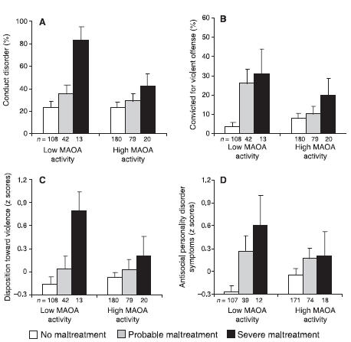
The association between childhood maltreatment and subsequent antisocial behavior as a function of MAOA activity.
Maltreated children with a genotype conferring high levels of MAOA expression were less likely to develop antisocial problems.
Caspi A et al., (2002) Science 297: 851-854.

Slide 42
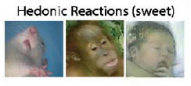



Are emotions universal and “born”, not “thought?”
Infant studies:
Blind / deaf : - same facial expressions and postures
Primate studies, e.g. of Frans de Waal:
“Peacemaking among primates”, 1989
“Good natured: The origins of right and wrong in humans and other animals”, 1996
“Natural conflict evolution”, 2000
“Chimpanzee politics: Power and sex among apes”, 2000 “Tree of origin: What primate behavior can tell us about human social evolution”, 2001
“Animal social complexity: Intelligence, culture and individualized societies”, 2003
“Our inner ape”, 2005
“The age of empathy: Nature’s lessons for a kinder society”, 2009
or Jane Goodall: “Emotional states of chimps are so obviously similar to ours that even an inexperienced observer can interpret the behavior.”

Slide 43












http://www.bushorchimp.com

Slide 44












http://www.bushorchimp.com

Slide 45


Laughter Smile

Slide 46


Emotions are not specified by a single facial cue, but multiple,
so that signal value is remarkably robust
Oster H (2003) Ann. N.Y. Acad Sci 1000: 197-204.

Slide 47

It has been recently shown that mothers with secure attachment show greater activation of medial OFC, ventral striatum and the oxytocin-associated hypothalamic regions, while insecure/dismissing mothers showed greater insular activation in response to their own infant’s sad faces (Strathearn et al., Neuropsychopharmacol., 2009).

Slide 48

Recognition of emotions

Slide 49
Recognition of emotions
Fake smile
Genuine smile

Slide 50
Attractiveness of men's faces in relation to women's phase of menstrual cycle
  In between-subjects studies on two groups of women of the same age, we show that women assess male's facial attractiveness differently in the follicular (F) and luteal (L) phases. In the high conception risk phase (F), women tended to give higher scores to male faces than when they were in the luteal phase. During the five first days of the cycle, i.e. when the estrogen level is still low, women assessed men's facial attractiveness relatively highly. We suggest that it is progesterone in the luteal phase that is responsible for lower attractiveness assigned then to male faces. We also tested which anthropometric facial traits or indices influence male attractiveness. We found that assessments of attractiveness were correlated only with mouth height (positively) and the angle between the middle of the mouth and the middle of the eyes (negatively).
        Danel D, Pawlowski B, Coll Antropol. 2006 Jun;30(2):285-9

Slide 51


Obje slike su računalski “uprosječene” slike 24 privlačna muška i 24 privlačna
ženska lica. “Uprosječene” slike privlačnih lica su privlačnije od uprosječenih
slika nasumce odabranih lica.
Perret et al. 1994

Slide 52

original
The degree of left/right face asymmetry
suggests the lower level of health, e.g.
- kromosomal anomalies
Down sy, cleft lip, fragile X,
skoliosis, etc. (Thornhill i Moeller, ’97)
- disease symptoms (Wayneforth, ’98)
- symptoms of anxiety, breathing difficulties,
pain syndromes, etc. (Shackleford & Larsen)
računalom povećana simetrija
Perret et al. 1999

Slide 53

…svodi se na izbor partnera koji može
nudi bolju zaštitu i prehranu potomstva (bolji lovac)
- jedan od najistaknutijih čimbenika je visina muškarca veća od prosječne (ali ne više od 195 cm)

Slide 54


Streeter & McBurney, ‘03

Slide 55


2006

Slide 56

In Alzheimer’s disease emotional changes usually precede cognitive changes!

Slide 57
Razvitak primarnih emocija
Novorođenčad negdje do 2-3 mj. ima bipolarne emocije:
neugodu, npr. zbog gorke hrane (plač, iritabilnost) i
ugodu (pažnja, interes)
Svih 6 primarnih emocija dijete izražava s oko 6 mj.
- ove emocije ostaju trajan dio repertoara ponašanja, samo se s vremenom mijenjaju okolnosti koje do njih dovode
između 6 i 10 tj. dijete počinje izražavati “socijalni smiješak”, koji s vremenom postaje sve učestaliji, a djeca se također sve češće smješe zbog zadovoljstva prilikom kontrole igračaka ili drugih događaja
strah se normalno pojavljuje u dobi od oko 6 mj. što korespondira s razvitkom amigdalofugalnih putova; najveći stupanj straha javlja se s otprilike 18 mjeseci (strah od nepoznatih lica – “stranger anxiety” i strah od separacije – “separation anxiety”)

Slide 58
Razvitak sekundarnih emocija
Razvijaju se tijekom 2. i 3. godine života, npr.
sram, krivnja, itd.
nakon što djeca postanu svjesna vlastitih primarnih emocija
U ovoj dobi djeca također uče pravila i društvene norme za izražavanje emocija s obzirom na okolnosti
No, već i prije toga djeca započinju prepoznavati emocije drugih osoba:
Već od dobi 7-10 mj. pa nadalje djeca su sposobna razumjeti kako bi se trebali osjećati ili ponašati u određenim situacijama (“social referencing”)
Divlja djeca (“feral children”) ne razvijaju sekundarne emocije (jer nemaju uzora)

Slide 59

Razvitak sekundarnih emocija (2)
Sazrijevanjem PFC između 4. i 5. g. djeca se mogu uživiti u razmišljanje i osjećaje drugih osoba (“theory of mind”), te
postaju svjesna da trenutni osjećaj može biti izazvan razmišljanjem o prošlim događajima
Između 6. i 10. g. djeca sve više postaju svjesna da različiti ljudi mogu proživljavati različite emocije s obzirom na isti događaj, a
emocionalna socijalizacija pospješuje se detaljnom elaboracijom osjećaja kroz dijalog

Slide 60
Razvitak sekundarnih emocija (2)
Sazrijevanjem PFC između 4. i 5. g. djeca se mogu uživiti u razmišljanje i osjećaje drugih osoba (“theory of mind”), te
postaju svjesna da trenutni osjećaj može biti izazvan razmišljanjem o prošlim događajima
Između 6. i 10. g. djeca sve više postaju svjesna da različiti ljudi mogu proživljavati različite emocije s obzirom na isti događaj, a
emocionalna socijalizacija pospješuje se detaljnom elaboracijom osjećaja kroz dijalog

Slide 61
Novorođenčad do 3 mj. u potpunosti su ovisna o njegovateljima i ne mogu sama nadvladati određeni stupanj neugode, no s vremenom razvijaju različite strategije kako bi regulirali negativne emocije (Shaffer, 2004):
Dob Strategija Ponašanje
oko 3 mj. preusmjeravanje pažnje ne želi gledati izvor emoc. nezadovoljstva
12 mj. samougađanje sisanje palca, ljuljanje, kovrčanje kose
6-12 mj. traženje pomoći odraslih praćenje, vješanje oko vrata, dozivanje
6-12 mj. upotreba prijelaznog objekta grljenje mekane igračke ili dijela odjeće
2 g. nadalje fizičko izbjegavanje bježanje s mjesta emoc. neug. situacija
2-3. g. fantaziranje, simbolička igra izražavanje emocija kroz uloge
predškolska dob verbalna kontrola verbalizacija emocija, razmišljenje o emoc.
predškolska dob svjesna supresija emocija Anderson et al., Science, 2004

Slide 62
Uloga neuropeptidnih sustava u roditeljskom ponašanju (oksitocin, vazopresin i CRF)
veća konc. cirkulirajućeg oksitocina značajno korelira s dobrim roditeljskim ponašanjem 62 analiziranih trudnica (Feldman et al., 2007)
intranazalno davanje oksitocina pospješuje osjećaj povjerenja i prepoznavanje izraza lica (Baumgartner et al., 2008; Guastella et al., 2008)
rano postnatalno davanje oksitocina mladim prerijskim voluharicama povećava njihovo maternalno ponašanje, čak i prema djeci koja nisu njihova (a također smanjuje preferenciju prema istom partneru) (Bales et al., 2007; Ahern i Young, 2009)
Σ: Čini se da oksitocinski sustav povezuje društveni kontekst sa sustavom nagrade/ugode

Slide 63
Uloga neuropeptidnih sustava u roditeljskom ponašanju (oksitocin, vazopresin i CRF) (2)
mjerene su razine oksitocina i vazopresina u djece koja su rasla s biološkim roditeljima i adoptirane djece nakon dugogodišnjeg boravka u domovima za napuštenu djecu u Rusiji i Rumunjskoj; nakon kontakta s biološkom majkom razina oksitocina je porasla u djece koja su rasla s roditeljima, dok kod napuštene djece nije (Wismer Fries et al., PNAS 2005)
Σ: čini se da ovi rezultati govore u prilog empirijskoj činjenici da adoptirana i deprivirana djeca više ne mogu stvarati povjerljive i čvrste odnose s drugima usprkos kasnijem usvojenju i životu u bogatim obiteljima

Slide 64
Uloga neuropeptidnih sustava u roditeljskom ponašanju (oksitocin, vazopresin i CRF) (3)
autistična djeca imaju smanjenju razinu oksitocina u plazmi; u odnosu na placebo skupinu, davanjem oksitocina poboljašava im se preoznavanje emocionalnog konteksta u testu razumijevanja govora (Hollander et al., Biol. Psychiatry, 2007)
Σ: oksitocin se može primjenjivati u terapiji autističnog poremećaja jer ima kratko vrijeme poluživota od oko 6-7 minuta (Robinson i Verbalis, 2003), te se na nj ne razvija tolerancija

Slide 65
Sustav kondicioniranja straha
Uključuje nesvjesne (preko AMY) i svjesne odgovore (naučene informacije o opasnim podražajima na koje nas evolucija nije mogla pripremiti)
Prenaglašeno kondicioniranje straha dovodi do paničnog poremećaja, PTSP, opsesivno-kompulzivnog poremećaja, anksioznosti i fobija
Naučena bespomoćnost (“learned helplessness”) (Bauer et al., Neuroimage, 2003)
Kolb B, Whishaw I (2008) Fundamentals of human neuropsychology.

Slide 66
Stanja povezana s kroničnim stresom (dugoročna aktivacija AŽS) zbog trajno povećane koncentracije kortizola putem glukokortikoidnih receptora dovode do:
Hipertenzije (uslijed hipokalemije i retencije natrija)
Nereaktivnosti na inzulin i dijabetesa tip 2 (zbog glikogenolize i glukoneogeneze)
Dislipidemije, atrofija mišića i preraspodjela masnog tkiva (“buffalo hump”, facies lunata – “full moon face” i druga obilježja “cuhingoidnosti”)
Povećanog apetita i pretilosti, ateroskleroze i koronarne bolesti
Smanjenog imunološkog i upalnog odgovora (smanjuje se omjer CD4+/CD8+ limfocita T)
Promjene raspoloženja, koncentracije i sposobnosti pamćenja uslijed ekscitotoksične smrti zrnatih stanica hipokampusa (Sapolsky et al.,)
Depresije (>5% stanovnika RH, tj. >220 000 godišnje)
Poremećaja menstrualnog ciklusa, pojačane budnosti (nesanice)
Osteoporoze, stres inkontinencije, kifoze, skolioze, ulceroznog kolitisa

Slide 67
“Zrcalni neuroni”
Ako novorođenom djetetu 'isplazite' jezik, vratit će vam istom gestom - za to su zaslužni zrcalni neuroni smješteni u premotornoj i donjoj parijetalnoj moždanoj kori; ovi neuroni ne okidaju samo kada čovjek izvodi neki pokret, nego i kad promatra drugu osobu kako izvodi pokret; moglo bi se stoga reći da NE UČIMO OPONAŠANJEM, NEGO OPONAŠAMO UČENJEM (“I am a part of all that I have met” – Alfred Lord Tennyson). Djeca uče ono što vide i proživljavaju – see poem of Dorothy Law Nolte)
Zrcalne neurone otkrili su slučajno sredinom 90-tih Rizzollati i sur. pri promatrnju aktivnost pojedinačnih neurona premotornog korteksa majmuna. Ključni trenutak dogodio se kada je jedan od suradnika ušao u prostoriju u kojoj se nalazio majmun i posegnuo za grožđicom: na monitoru su zamijetili da su se neuroni majmuna aktivirali baš kako su se aktivirali i prije, kada je majmun sam posegnuo za grožđicom: to ukazuje na činjenicu da sve što promatramo zapravo ponavljamo u mislima. Osim što se ovim procesom može objasniti kako učimo hodati, govoriti itd., na višoj razini daje i ideju o mogućem načinu kojim shvaćamo druge ljude, kulturu i socijalne okolnosti (npr. kako “čitamo” namjere i emocije drugih ljudi i učimo fine socijalne vještine) (Iacoboni, 2005), te pomaže objasniti psihosocijalne poremećaje kao što su nedostatak empatije ili autizam.

Slide 68
“Zrcalni neuroni” (2)
Rizzolatti i Arbib su 1998. otkrili su da je jedna od regija posebno bogatih zrcalnim neuronima Brokino područje (BA44/45). Stoga se ti neuroni u zadnje vrijeme uklapaju u postojeću jezičnu teoriju, koja govori da postupci imaju sličnu sintaksu s onom govornog ili pisanog jezika. Za zrcalne neurone, posezanje za lopticom je isto ako je postupak napravljen ili samo izražen govorom i gestikulacijom.
Stoga se smatra da i jezik nastaje iz razumijevanja koje stvaraju zrcalni neuroni. Ova ideja šire je prihvaćena kada je pokazano da su isti zrcalni neuroni aktivni kada ispitanici slušaju rečenice koje opisuju neke postupke, kao i kad sami izvode te postupke ili ih promatraju (Iacoboni, 2005). Dakle, ove stanice 'odgovaraju' na apstraktne prikaze dotičnih procesa.
Zrcalni neuroni daju i biološki temelj dobro poznatim pojavama “zaraznosti” zijevanja, smjeha, dobrih i loših raspoloženja (Wicker, 2003).

Slide 69
Zaključci
A) Odvajanje ili nesiguran odnos s roditeljima, zlostavljanje, zanemarivanje, trauma i stres u najranijoj životnoj dobi višestruko povećavaju vjerojatnost nastanka različitih psihičkih i fizičkih poremećaja, koji su rezultat poremećenog razvitka:
1. Sustava nagrade/ugode (depresija, ovisnosti, povećana vulnerabilnost na nove okolnosti i stres)
2. Sustava kondicioniranja straha (panični poremećaj, opsesivno-kompulzivni poremećaj, PTSP, anksioznost, fobije)
3. Autonomnog živčanog sustava i lučenja kortizola (hipertenzija, pretilost, dijabetes tip 2, smanjen imunološki odgovor, stres inkontinencija, ulcerozni kolitis, loše držanje, itd.)
4. Razvitka socijalnih kompetencija (autizam, sociopatije)
B) Većina navedenih poremećaja ne mogu se riješiti programima psihosocijalne pomoći.
C) Zbog sve ranijeg odvajanja djece od roditelja, u tzv. suvremenim društvima, drastično je narušena uspostava sigurnog obrasca privrženosti roditelja i djece.
D) Iz svega navedenoga neprijeporan je zaključak da je za svako društvo najbolje i dugoročno najisplativije ulagati u kvalitetan rani razvoj djece.

Slide 70


Slide 117


Slide 126
Uprosječena lica lijepih osoba su privlačnija od pojedinačnih lijepih lica vjerojatno zato jer bolje odražavaju zdravlje cijele populacije

Slide 127


What would life without emotions be like?
Hvala na pozornosti

