Slide 1
S10: Stanični mehanizmi učenja i pamćenja
Goran Šimić
16. siječnja 2023.

Slide 2
Instiktivno vs naučeno ponašanje
Svaki oblik ponašanja može se kategorizirati u urođeno (ili instinktivno, tj. ono koje nastaje bez treninga, odnosno učenja), te naučeno. Ipak, svako naučeno ponašanje ima svoj temelj u instinktivnom.
Rasprava između zagovornika nativizma, prema kojemu je većina našega znanja urođena tj. pod izravnim utjecajem gena te empirizma, koji kojemu je našega znanja naučena kroz iskustvo i utjecaj okoline vodi se od antike sve do današnjih dana. Neki od najpoznatijih primicatelja prvonavedenoga stava bili su Platon, Descartes, Leibnitz, Darwin i Galton. S druge strane, Aristotel, Locke, Pavlov i Thorndike neke su od najpoznatijih osoba koje su smatrale da je mozak djeteta samo prazna ploča (tabula rasa).

Slide 3
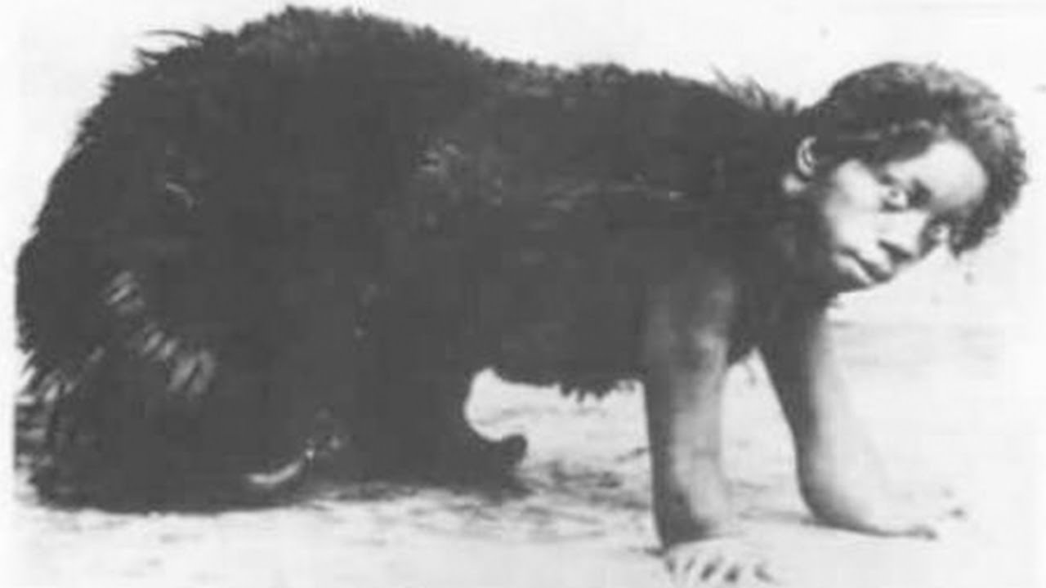
Instiktivno vs naučeno ponašanje (2)
Amala (1918. – 21. rujna 1921.) i Kamala (1918. – umrla 14. studenog 1929.).
Primjer rasprave oko jednog takvog kontroverznog pitanja je i ono gdje neki znanstvenici tvrde da je za razliku od pisanja (koje je relativno nedavni čovjekov izum), govorenje jezika instiktivno u tom smislu da djeca već posjeduju urođenu sposobnost govorenja (i sve kulture i plemena imaju jezik), npr. Pinker. Ipak, drugi znanstvenici misle kako to nije slučaj, te potkrepljuju svoje razmišljanje tragičnim slučajevima „divlje djece“ (feral children), npr. slučajem djevojčica Amale i Kamale iz Bengala u Indiji, koje je odgojila vučja obitelj i koje nikad nisu naučile govoriti. Za detaljnije opisanu Kamalu se danas smatra da je imala Rettov sy.

Slide 4
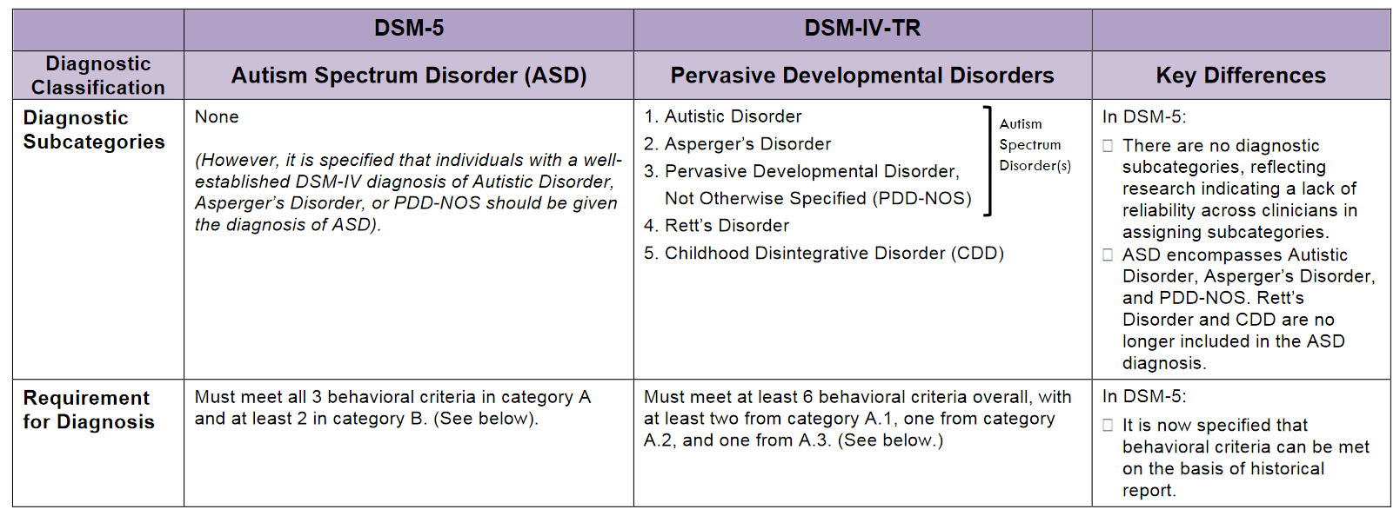
2013
2000

Slide 5
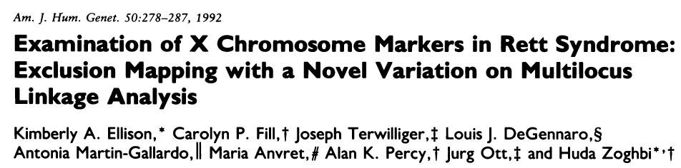
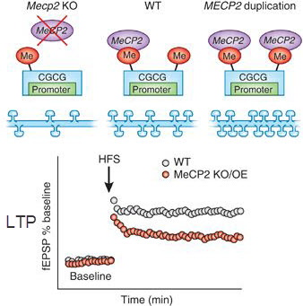

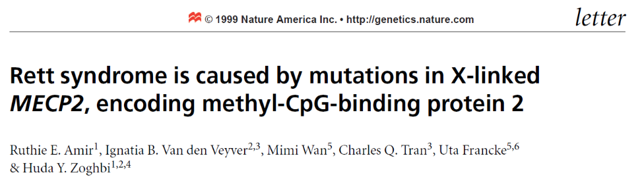
Rettov sy – mutacija MECP2 gena
astrociti + glu
oligo – mijelin.
Jin et al., Front. Mol. Neurosci, 2017
Na et al., Neuropsychopharmacology 2013
Bolest prvi opisao Andreas Rett, bečki pedijatar, 1966. godine
Bengt Hagberg, švedski pedijatar, po Rettu nazvao bolest 1983. godine
simptomi slični autizmu (intenzivno vrištanje, neumoljiv plač, izbjegavanje kontakta očima, izostanak recipročne soc. i emoc. komunikacije, poremećeni neverbalni oblici ponašanja koji reguliraju soc. interakcije, izostanak ili poremećaj govora, ispadi osjeta, regresija sna), usporen rast, atipičan sastav glikolipida mozga, povećana količina glutamata, a smanjena NGF-a u likvoru, smanjen volumen mozga, nestabilan hod, nemogućnost koordinacije pokreta, poremećaj ciklusa budnosti i spavanja, epilepsija, često se vide repetitivni pokreti ruku, EEG i EKG abnormalnosti, itd.
uobičajeno nastaje kao nova mutacija u 1:8.500 ženske djece, <1% se nasljeđuje, dječaci obično umru kratko po rođenju

Slide 6
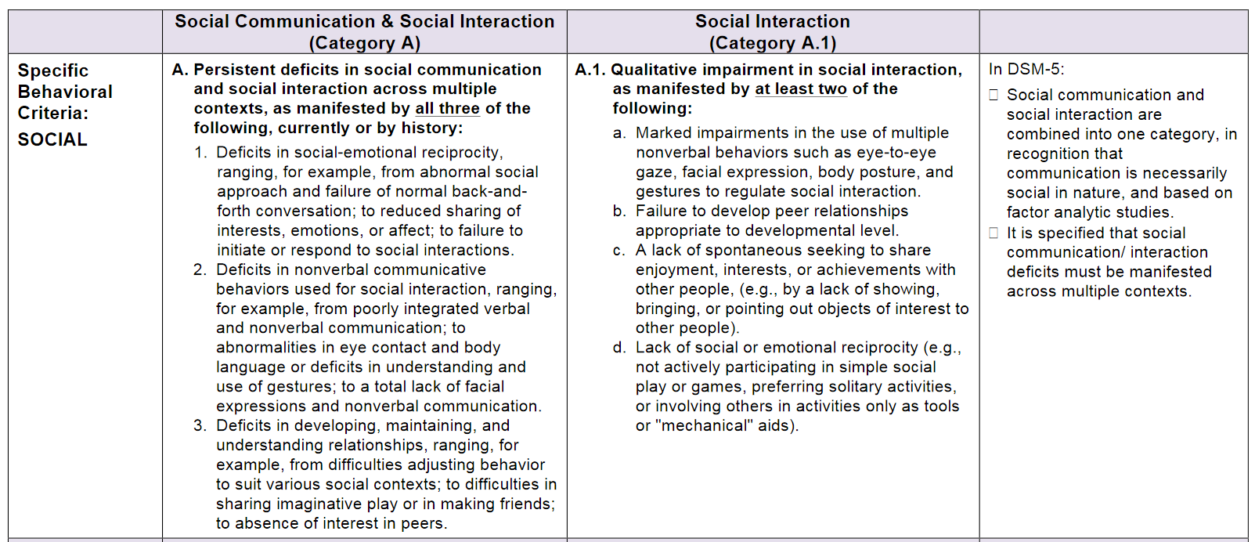
2013
2000

Slide 7
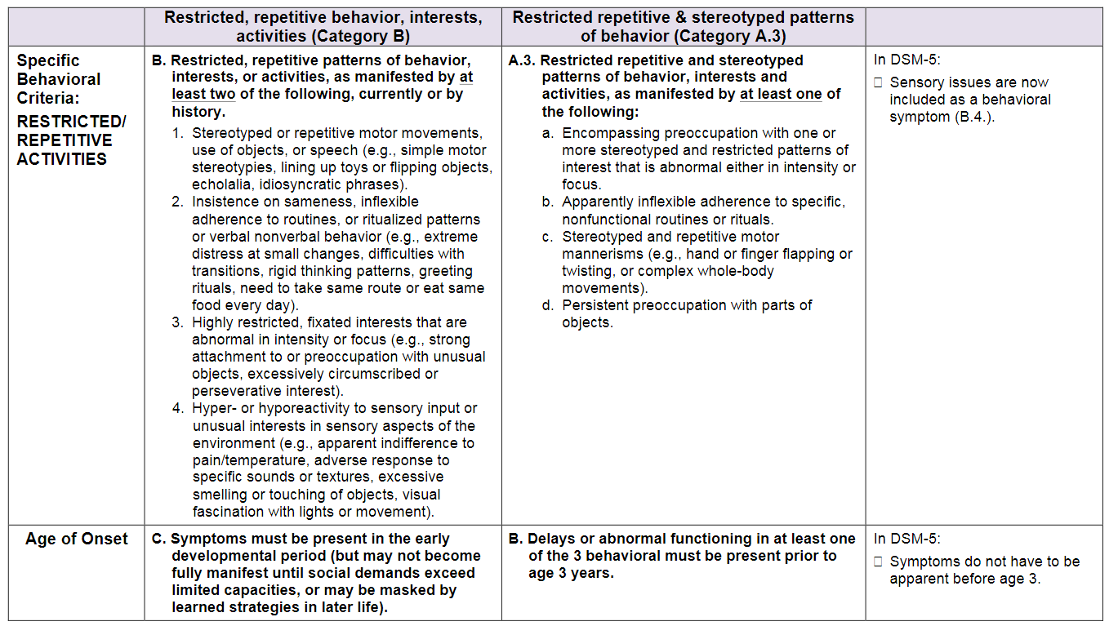
2013
2000

Slide 8
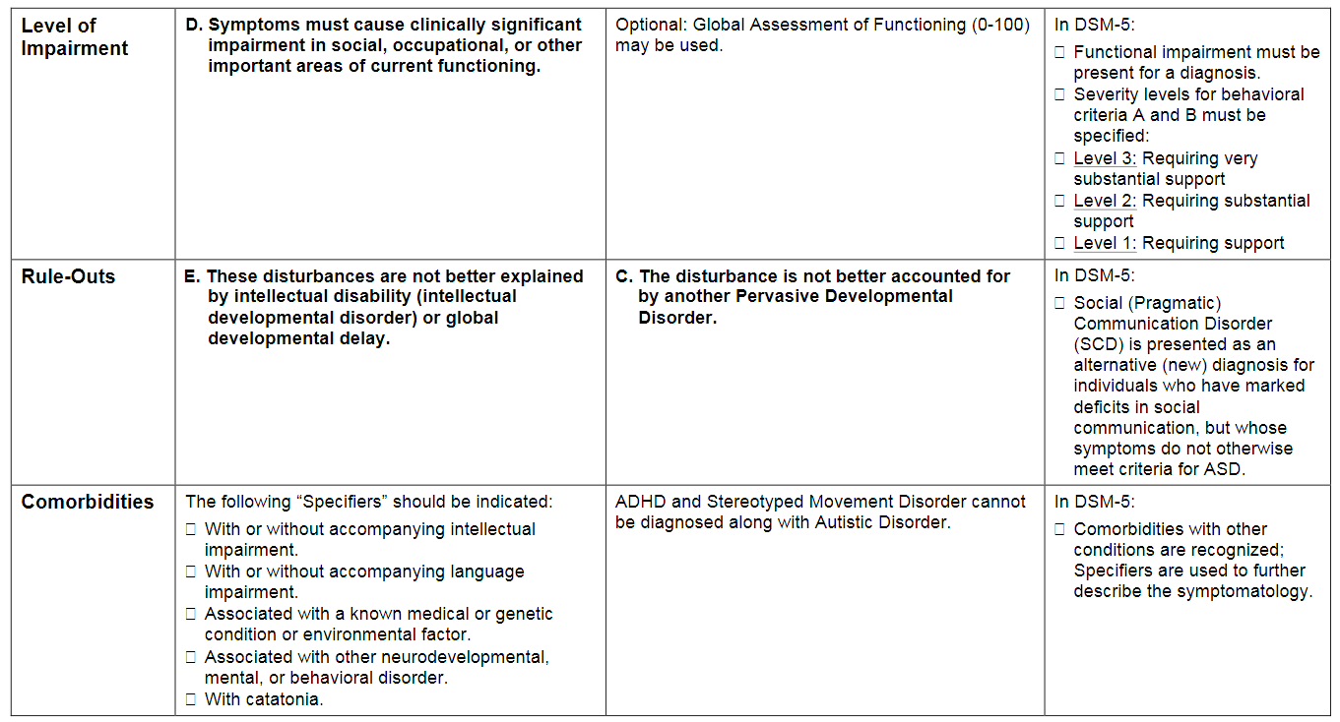
2013
2000

Slide 9
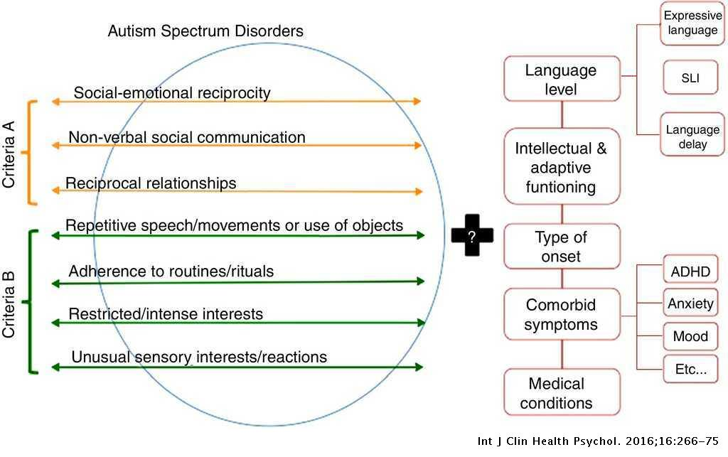
3/3
2/4
SLI = specific language impairment

Slide 10
Instiktivno vs naučeno ponašanje (3)
Pod instinktivnim se općenito smatra bilo koje ponašanje za čije izvršenje nije potrebna pozornost ili svijest. Obrnuto, spoznaja proizlazi iz transcedencije instinktivnog, ali kolika je dubina sinaptičkog intermedijarnog procesiranja potrebna da bi se to postiglo nije jasna.

Slide 11
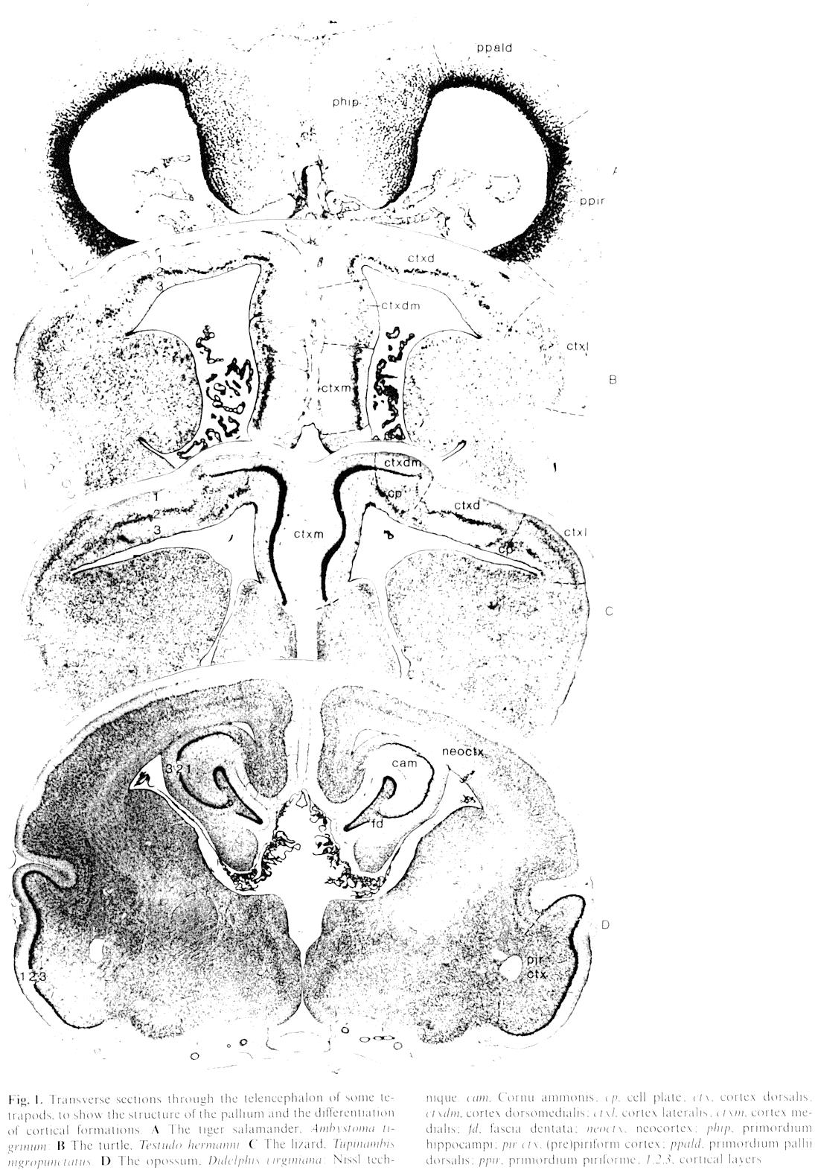
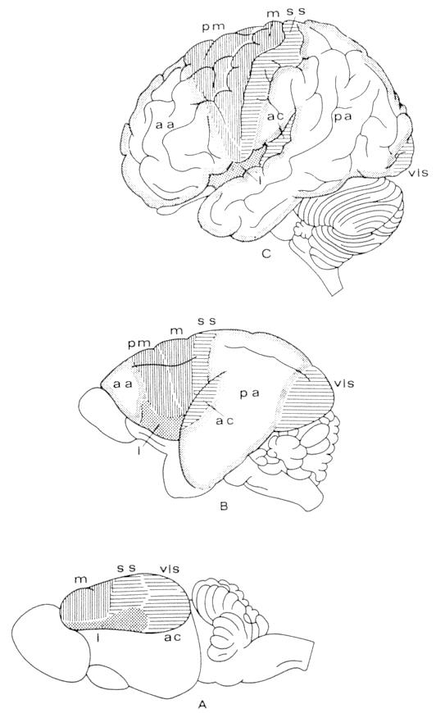
salamander
turtle
telencefalizacija
man
lizard
monkey
oposum
hedgehog

Slide 12
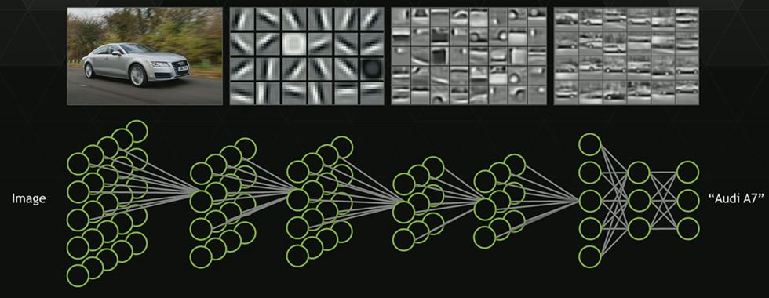
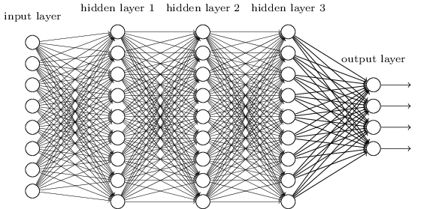
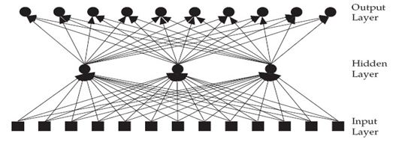
man
m
a
monkey
s
m
a
s
hedgehog

Slide 13
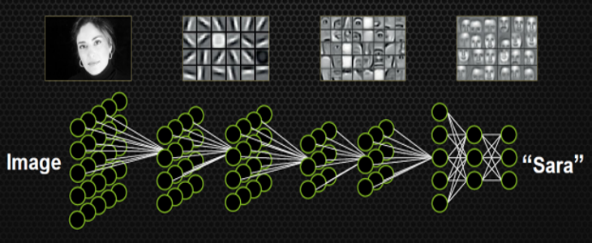
man
m
a
monkey
s
m
a
s
hedgehog

Slide 14
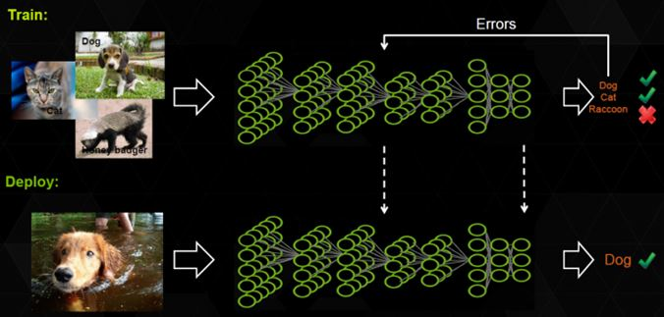
man
m
a
monkey
s
m
a
s
hedgehog

Slide 15
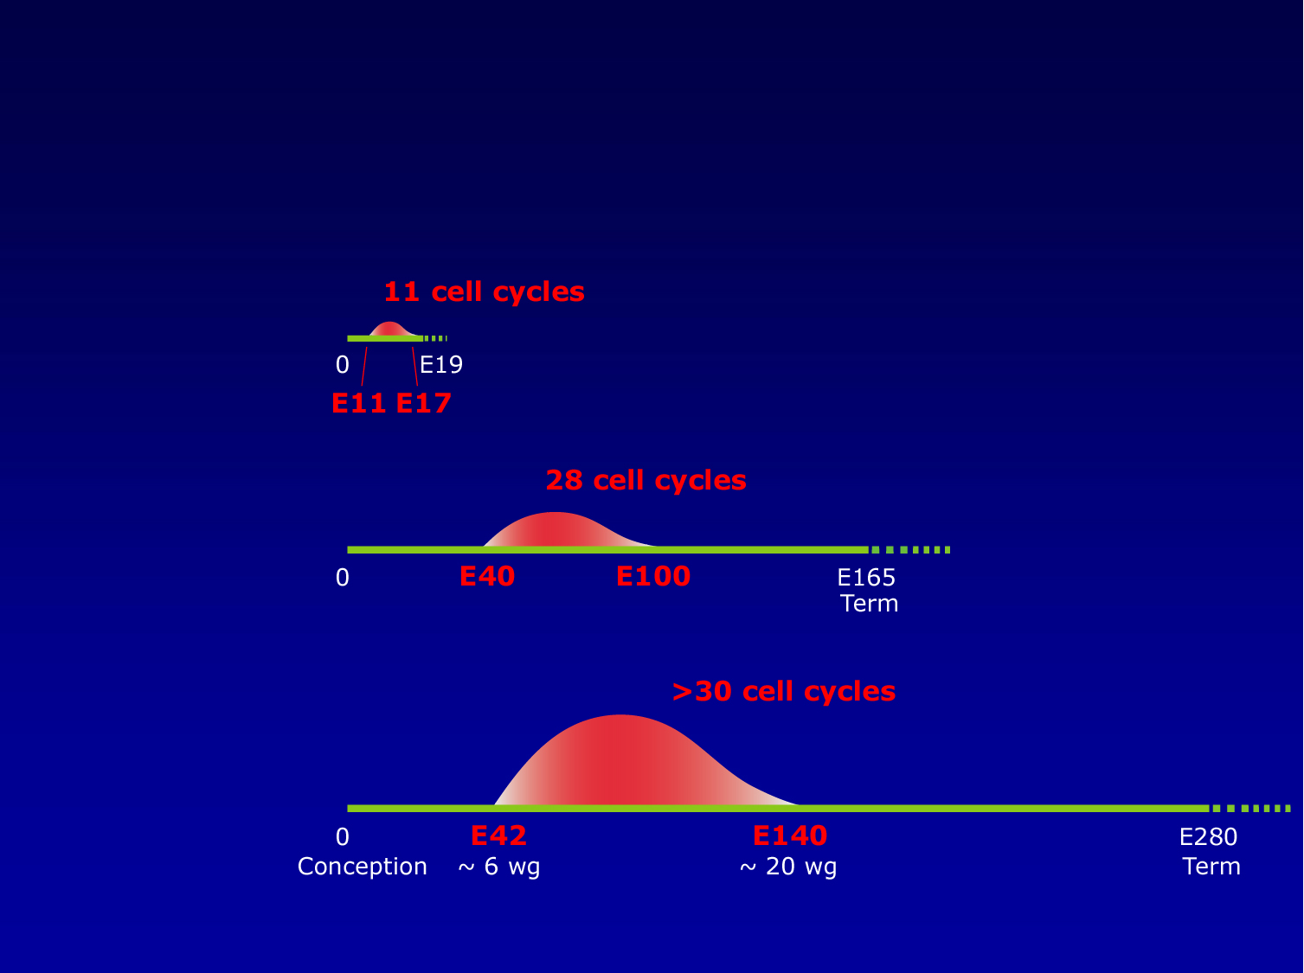
Razlike u duljini trajanja neurogeneze (CNV)
Mus musculus
Macaca mulatta
Homo s. sapiens

Slide 16
Neasocijativno vs asocijativno učenje
Procesi učenja se općenito mogu kategorizirati u asocijativne i neasocijativne. Asocijativno učenje nastaje kroz sparivanje dvaju prethodno nepovezanih podražaja, dok neasocijativno učenje nastaje u odgovoru na jedan te isti podražaj.
Nije točno jasno kako i koliko ta dva temeljna procesa doprinose učenju u okviru jednog zadatka koji treba naučiti, ali čini se kako je neasocijativno učenje uvijek prisutna komponenta asocijativnog učenja, a ne zaseban proces.

Slide 17
Vrste pamćenja
DEKLARATIVNO - asocijacije istovremenih podražaja - semantičko (referentno) - epizodičko (autobiografsko)
REFLEKSIVNO - ne ovisi o svijesti i pažnji - vještine i navike - jednostavno kondicioniranje - neasocijativni oblici učenja (habituacija, senzitizacija)

Slide 18
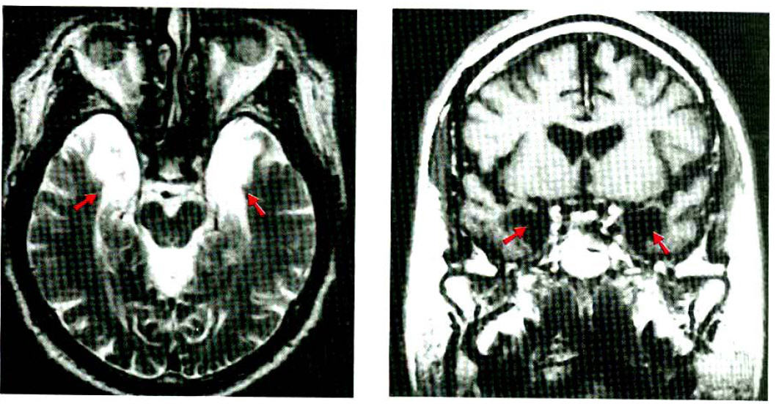
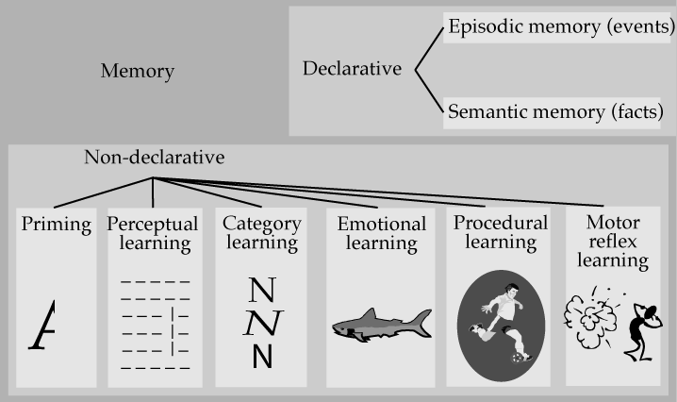
Vrste zapamćenih sadržaja (pamćenja)
H.M.

Slide 19
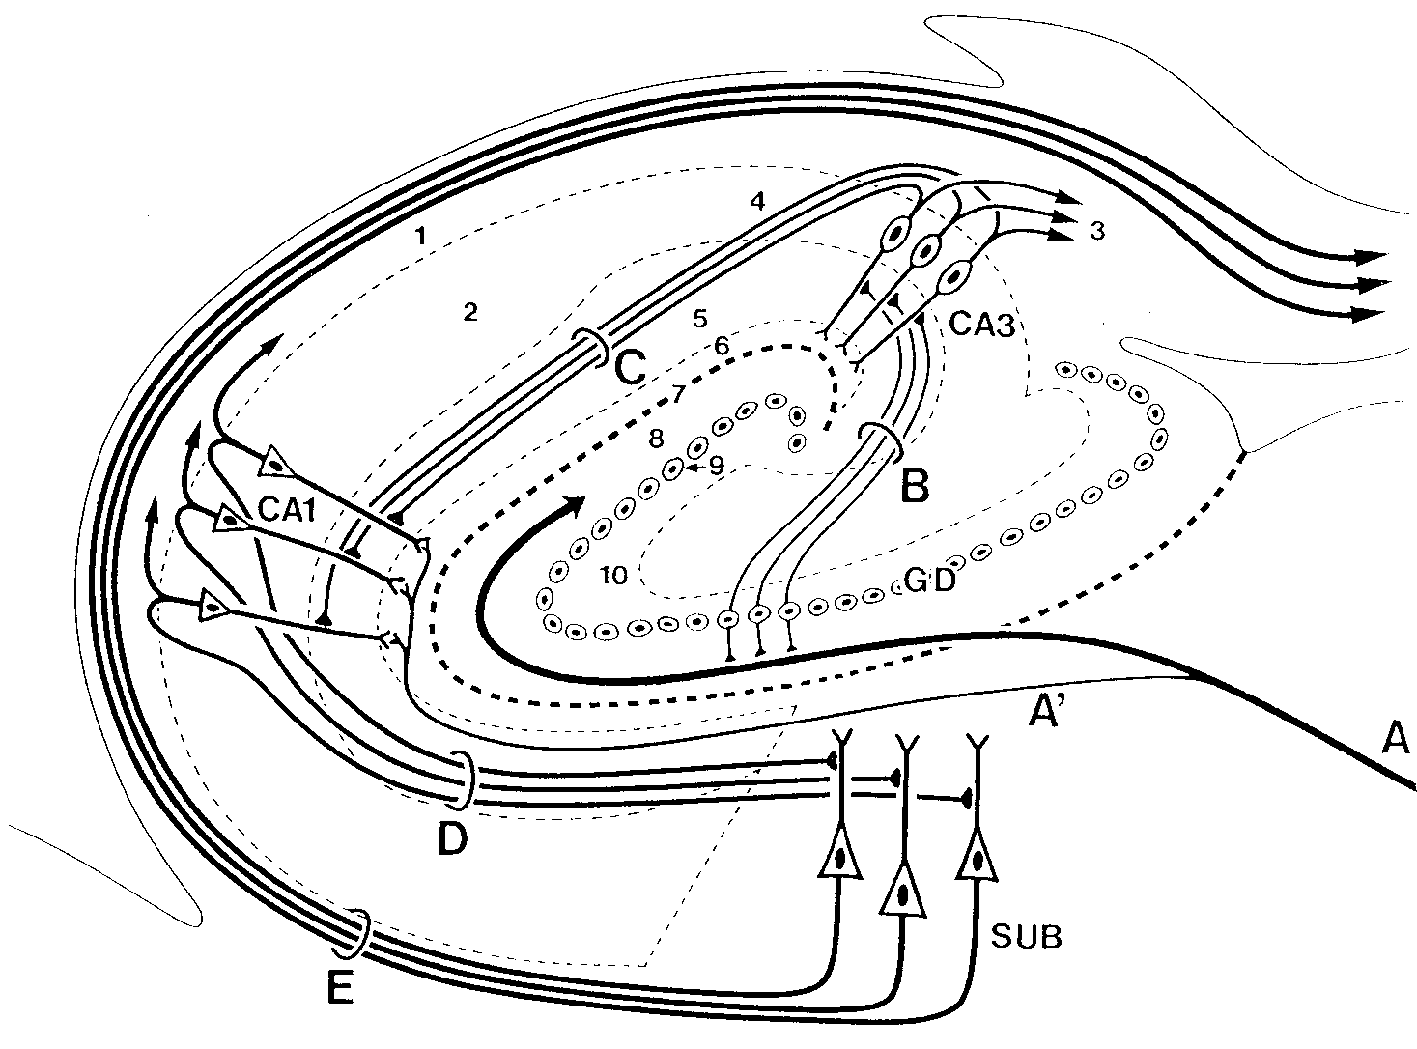
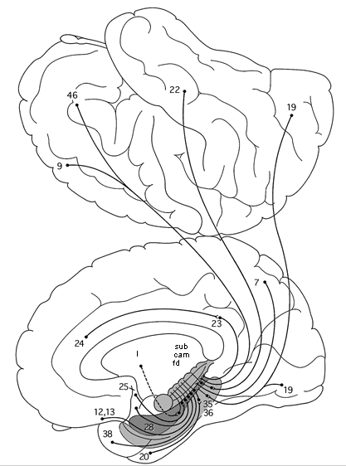
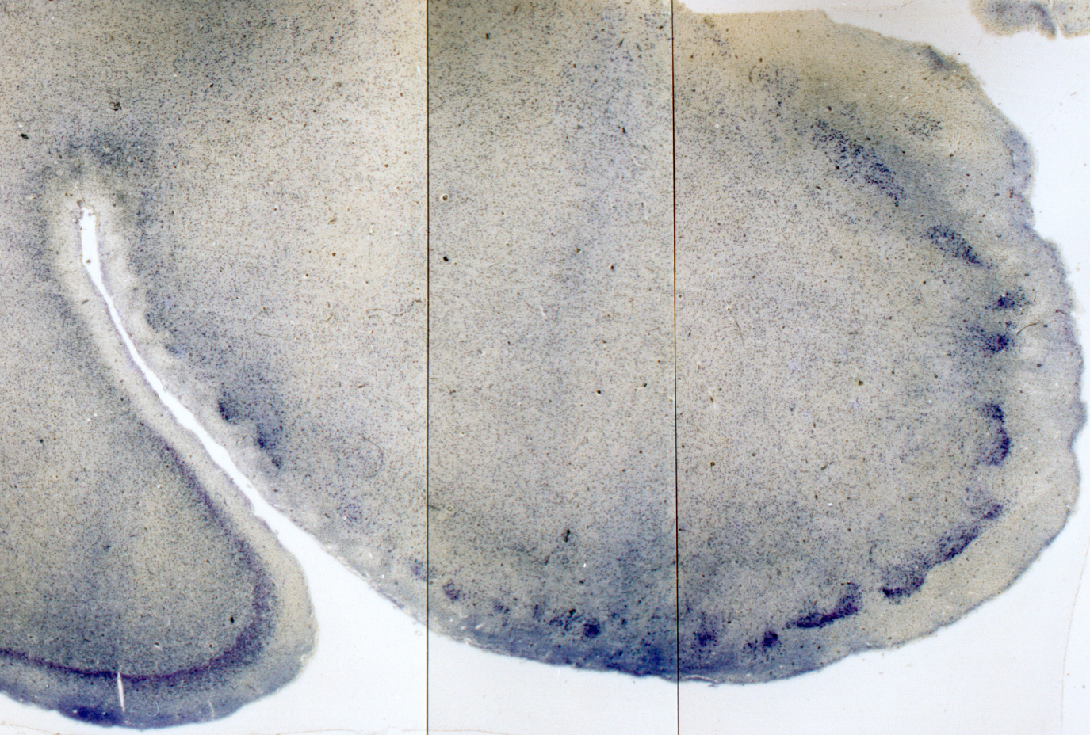
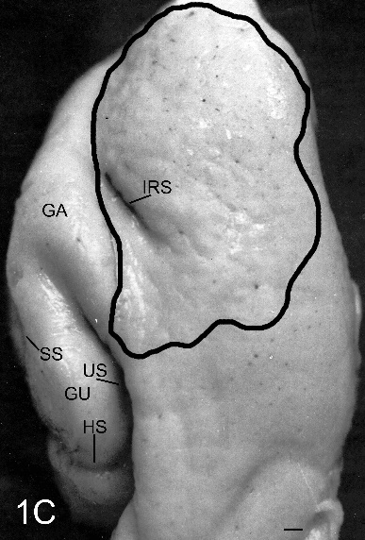
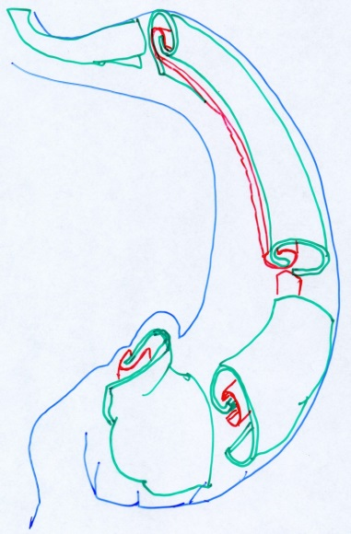
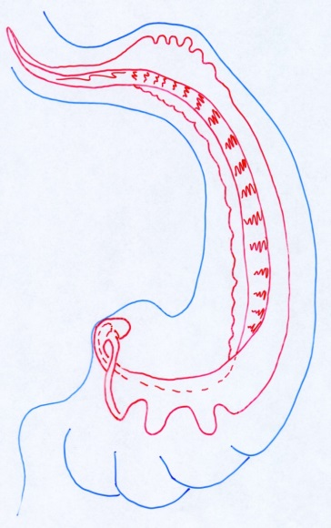
TLE
2
3
1

Slide 20
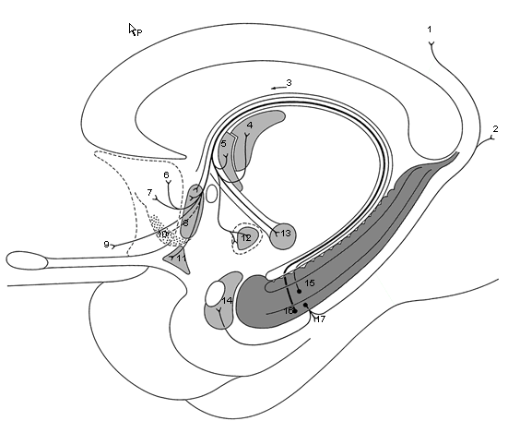
Efferent connections of HF
1. g. cinguli
2. cx. retrosplenialis
4. n. ant. thalami
5. n. interst. striae term.
6. hipp. precommissuralis
7. cx. frontalis medialis
8. nn. septi
9. g. rectus
10. n. accumbens septi
11. n. olfact. ant.
12. n. ventromedialis thalami
13. corpus mamillare
14. corpus amygdaloideum

Slide 21
Function of HF
1888. Brown i Schäffer
1900. Bechterew
1930-1950. Penfield i Rasmussen
Bilateral removal of HF: long-lasting inability to form long-term memories (global amnesia)
1953. patient H.M. (Scoville, Milner, Corkin)
1975. patient N.N. (Damasio, Damasio)
1978. patient R.B. (Squire, Zola-Morgan, Amaral)
Unilateral HF damage - partial compensation (left: lowered ability to make long-term verbal memories; right: deja vu syndrome)

Slide 22
Koliko je vremena potrebno za trajno zapamćivanje?
Nakon stjecanja iskustva za konsolidaciju zapamćenog potrebno je 6-8 tjedana (Squire, Zola-Morgan i Amaral, 1989)
Σ HF: 1. Povezuje informacije iz različitih područja Cx za vrijeme učenja, 2. Nakon razdoblja od 6-8 tjedana konsolidira navedene informacije u neokorteks tako da postaju dostupne i neovisno od HF

Slide 23
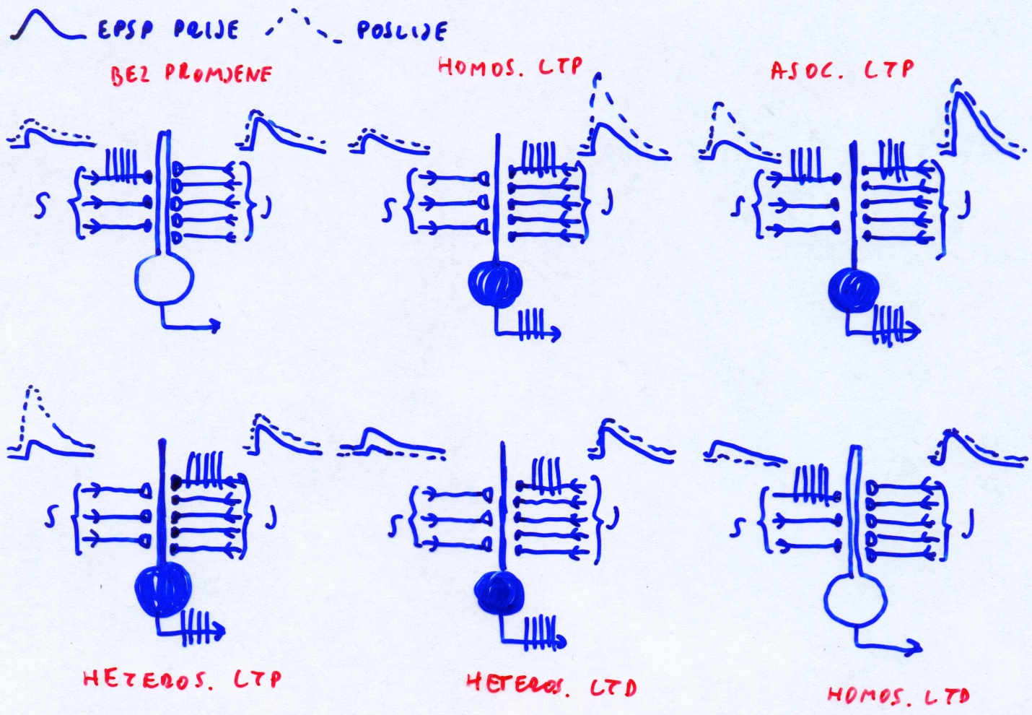
Promjene sinaptičke učinkovitosti sinapsi HF
1949. Hebb: hipoteza dvostrukog traga
1973. Bliss i Lømo: LTP (“vanilija”)
+ “čokolada LTP” (Llinas)
U „normalnim” okolnostima je LTP rezultat povećane aktivnosti između neurona („neurons that fire together – wire together”)

Slide 24
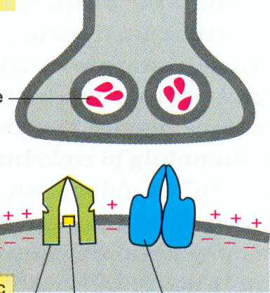
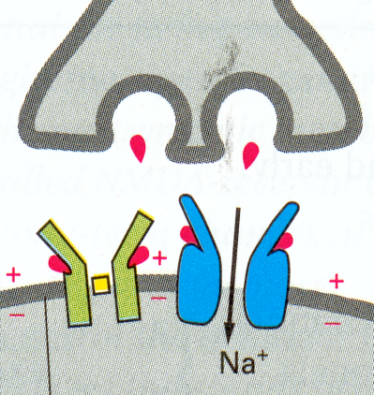
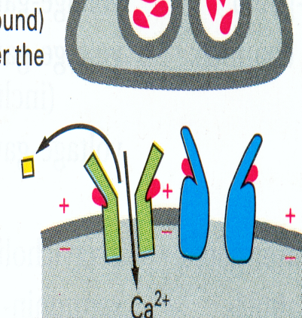
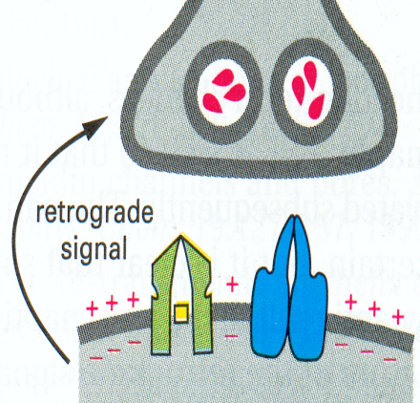
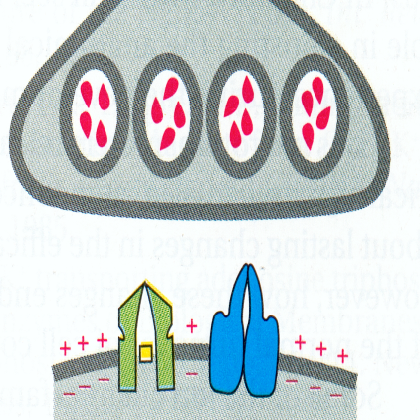
Uloga NMDA receptora u LTP
NMDA receptor se ponaša kao detektor spregnutog djelovanja (asocijativnost), jer za indukciju LTP zahtijeva:
vezanje za receptorno mjesto (specifičnost) i
prethodnu ili istovremenu depolarizaciju postsinaptičke membrane putem AMPA receptora (da bi se odstranili ioni Mg2+ elektrostatičkom repulzijom) (kooperativnost)
retrogradni difuzibilni signal (NO) omogućuje potencijaciju susjednih sinapsi

Slide 25
Porast unutarstanične c Ca2+ dovodi do:
RANIH promjena (trajanje do nekoliko sati), napose izražavanje još većeg broja AMPA receptora na postsinaptičkom neuronu
KASNIH promjena (dugoročnog učinka) putem aktivacije transkripcijskih čimbenika, napose CREB-a (cAMP response element binding protein: 1. put opisan 1987. da se veže za promotor gena za somatostatin, a kasnije i za gene C-FOS, BDNF, CRH, VGF inducibilni čimbenik rasta, PER1 i PER2 (reguliraju cirkadijani ritam u sisavaca), TH i druge

Slide 26
Metaplastičnost

Slide 27
Homeosinaptička plastičnost
odnosi se na sposobnost neurona regulirati vlastitu ekscitabilnost u odnosu na mrežnu aktivnost (Gina G. Turrigiano)
iako se hebovski oblici plastičnosti, poput LTP-a i LTD-a javljaju relativno brzo, homeostatska plastičnost prvenstveno se oslanja na sintezu proteina de novo, a može potrajati satima ili danima
važni posrednici homeosinaptičke plastičnosti su TNF-α i različite mikroRNA. Smatra se da homeostatska plastičnost uravnotežuje hebovsku plastičnost modulacijom aktivnosti sinapse ili svojstava ionskih kanala

Slide 28
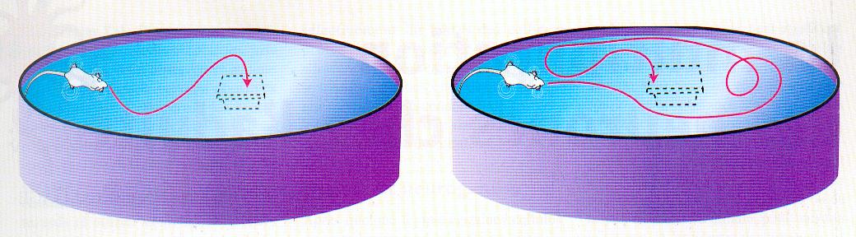
Dokaz uloge LTP u učenju
Injiciranje antagonista NMDA receptora (2-amino-5-fosfonovalerične kiseline):
  spriječava nastanak LTP u bloku (lameli) hipokampalnog tkiva,
  spriječava učenje na razini ponašanja (Morrisov test pronalaženja platforme uronjene u vodi)
- oba učinka razmjerna su dozi

Slide 29
MAIN PREMISES (1)
Mini-Mental State Examination test (MMSE) is not a mental status examination: it was made to differentiate organic from functional psychiatric patients (and not to detect dementia) (Folstein et al., J Psychiatr Res, 1975)
Therefore, it comes as no surprise that MMSE has notoriously low sensitivity in detecting dementia and also has poor specificity, NPV, and PPV, especially in early-stage of AD (Pasquier, J Neurol, 1999; Arevalo-Rodriguez et al., Cochrane Database Syst Rev, 2015)

Slide 30
MAIN PREMISES (2)
MMSE is focused on cognitive deficits produced by dysfunction of hippocampal and high-order neocortical areas, whereas non-cognitive behavioural and psychological symptoms of dementia (BPSD) are often not considered at all.
A retrospective review of 100 autopsy-confirmed AD cases found that, on average, depression, mood change, social withdrawal, confusion, agitation, disturbed wake-sleep cycle and other BPSD were documented more than 2 years before the diagnosis of AD was made
The first non-cognitive symptom appeared, on average, 33 months before diagnosis (Jost and Grossberg, J Am Geriatr Soc, 1996)

Slide 31
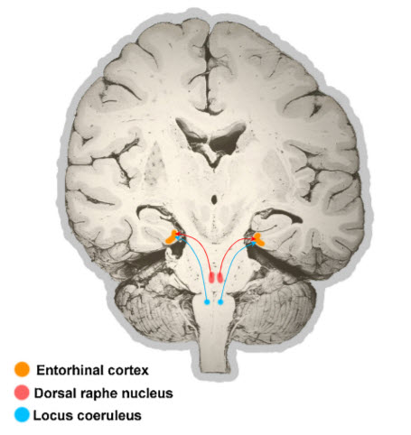
MAIN PREMISES (2 – cont.)
Noradrenaline is released from LC when subject is engaged in cognitive and motor tasks in relation to novelty, interest, excitement, or effort (Mather and Harley, Trends Cogn Sci 2016).
+ about 50 papers from Gary Ashton-Jones (since 1980):
https://www.ncbi.nlm.nih.gov/pubmed/31501542 !!
Locus coeruleus input to hippocampal CA3 drives single-trial learning of a novel context (Wagatsuma et al., PNAS 2017).
The reason for this is the fact that the earliest neuropathological changes in AD are usually seen in the brainstem (Šimić et al., Neuropathol Appl Neurobiol, 2009)
For example, a postmortem analysis of 118 brains showed that than >20% of BB stage 0 and all of BB stage I cases were found to have substantial NF changes in DRN (the earliest site of NF pathology in 6% of all AD cases) and LC (the earlies site of NF pathology in 8% of all AD cases) (Grinberg et al., Neuropathol Appl Neurobiol, 2009; Šimić et al., Neuropathol Appl Neurobiol, 2009)
Šimić et al., Prog Neurobiol, 2018

Slide 32
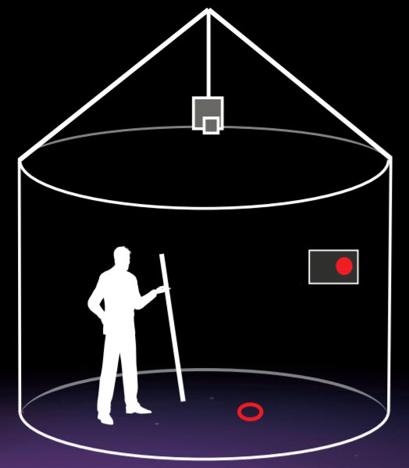
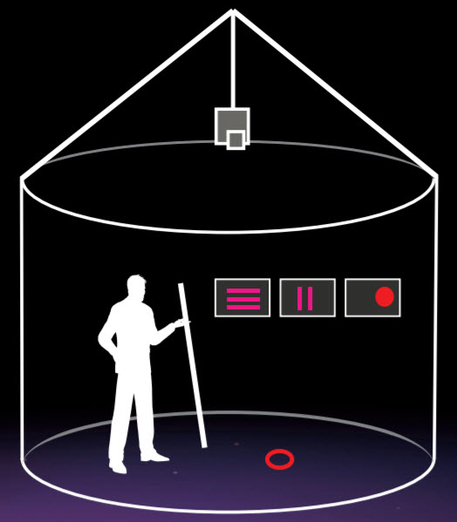
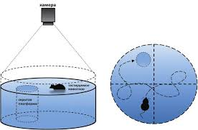
MAIN PREMISES (3)
The hidden goal task could serve as a sort of human analog of the Morris Water Maze (Morris et al., Nature, 1982; Kalova et al., Behav Brain Res, 2005)

Slide 35


ALZENTIA®: a non-invasive hidden-goal test
for spatial orientation impairment detection
in subjects with possible neurocognitive disorder
Goran Šimić MD, PhD
Department of Neuroscience
Croatian Institute for Brain Research
University of Zagreb Medical School
REPUBLIC OF CROATIA

Slide 36
ROC analysis between MCI and HC subjects adjusted for age and gender
 | MCI vs HC
 |  |  |  |  |  | Prevalence 5% |  | Prev. 10% |  | Prev. 16% |  | Prev. 20% |  | Prev. 36.7%
 |  | Sensitivity | Specificity | Cut-off | AUC, p | PPV | NPV | PPV | NPV | PPV | NPV | PPV | NPV | PPV | NPV
Ego 1st attempt | Error | 93.9% | 80.7% | 0.2519 | 0.917, p<0.001* | 20.3% | 99.6% | 35% | 99.1% | 48% | 98.5% | 54.8% | 98.1% | 73.8% | 95.6%
 | Time | 96.9% | 78.4% | 0.2466 | 0.900, p<0.001* | 19.1% | 99.8% | 33.3% | 99.6% | 46.1% | 99.3% | 52.9% | 99% | 72.2% | 87.9%
Ego average of last 4 attempts | Error | 87.9% | 83% | 0.3153 | 0.901, p<0.001* | 21.4% | 99.2% | 36.5% | 98.4% | 49.6% | 97.3% | 56.4% | 96.5% | 75% | 92.2%
 | Time | 100% | 71.6% | 0.1511 | 0.899, p<0.001* | 15.6% | 100% | 28.1% | 100% | 40.1% | 100% | 46.8% | 100% | 67.1% | 100%
Ego average of all 8 attempts | Error | 93.9% | 76.1% | 0.1956 | 0.915, p<0.001* | 17.1% | 99.6% | 30.4% | 99.1% | 42.8% | 98.5% | 49.6% | 98% | 69.5% | 95.6%
 | Time | 100% | 73.9% | 0.2053 | 0.888, p<0.001* | 16.8% | 100% | 29.9% | 100% | 42.2% | 100% | 48.9% | 100% | 69% | 100%
Allo 1st attempt | Error | 100% | 72.7% | 0.1951 | 0.887, p<0.001* | 16.2% | 100% | 28.9% | 100% | 41.1% | 100% | 47.8% | 100% | 68% | 100%
 | Time | 100% | 75% | 0.2109 | 0.895, p<0.001* | 17.4% | 100% | 30.8% | 100% | 43.2% | 100% | 50% | 100% | 69.9% | 100%
Allo average of last 4 attempts | Error | 100% | 70.5% | 0.1707 | 0.879, p<0.001* | 15.1% | 100% | 27.4% | 100% | 39.2% | 100% | 45.9% | 100% | 63.3% | 100%
 | Time | 100% | 70.5% | 0.2059 | 0.892, p<0.001* | 15.1% | 100% | 27.4% | 100% | 39.2% | 100% | 45.9% | 100% | 66.3% | 100%
Allo average of all 8 attempts | Error | 100% | 71.6% | 0.1642 | 0.896, p<0.001* | 15.6% | 100% | 28.1% | 100% | 40.1% | 100% | 46.8% | 100% | 67.1% | 100%
 | Time | 100% | 73.9% | 0.1831 | 0.890, p<0.001* | 16.8% | 100% | 29.9% | 100% | 42.2% | 100% | 48.9% | 100% | 69% | 100%
Combined Allo-Ego 1st attempt | Error | 90.9% | 80.7% | 0.2294 | 0.920, p<0.001* | 15.5% | 99.4% | 34.4% | 98.8% | 47.3% | 97.9% | 54.1% | 97.3% | 73.2% | 93.9%
 | Time | 96.9% | 77.3% | 0.2367 | 0.886, p<0.001* | 18.3% | 99.8% | 32.2% | 99.6% | 44.8% | 99.2% | 51.6% | 99% | 71.2% | 97.7%
Combined Allo-Ego average of last 4 attempts | Error | 97% | 73.9% | 0.1787 | 0.906, p<0.001* | 16.4% | 99.8% | 29.2% | 99.6% | 41.4% | 99.2% | 48.2% | 99% | 68.3% | 97.7%
 | Time | 100% | 73.9% | 0.1886 | 0.889, p<0.001* | 16.8% | 100% | 29.9% | 100% | 42.2% | 100% | 48.9% | 100% | 69% | 100%
Combined Allo-Ego average of all 8 attempts | Error | 93.9% | 80.7% | 0.2453 | 0.917, p<0.001* | 20.4% | 99.6% | 35.1% | 99.2% | 48.1% | 98.6% | 54.9% | 98.1% | 73.8% | 95.8%
 | Time | 96.9% | 77.3% | 0.2624 | 0.888, p<0.001* | 18.3% | 99.8% | 32.2% | 99.6% | 44.8% | 99.2% | 51.6% | 99% | 71.2% | 97.7%
Ego average of first 4 attempts | Error | 93.9% | 77.3% | 0.1874 | 0.920, p<0.001* | 17.9% | 99.6% | 31.5% | 99.1% | 44.1% | 98.5% | 50.8% | 98.1% | 70.6% | 95.6%
Allo aver. of first 4 attempts | Error | 100% | 70.5% | 0.1658 | 0.893, p<0.001* | 15.1% | 100% | 27.4% | 100% | 39.2% | 100% | 45.9% | 100% | 66.3% | 100%
Comb. Allo-Ego average of first 4 attempts | Error | 90.9% | 83% | 0.2774 | 0.917, p<0.001* | 22% | 99.4% | 37.3% | 98.8% | 50.5% | 98% | 57.2% | 97.3% | 75.6% | 94%

Slide 37
Zaključci (1)
None of the examined data reached sensitivities and specificities characteristic for ideal biomarker (both sensitivity and specificity above 85%)
However, after adjustment for age and gender, which highly improved discriminative properties of all the subtests performed, several of them reached high sensitivities and specificities (near ideal values)
Error measured in the egocentric subtest (average of all 8 attempts) showed overall the best discriminative properties (AUC – 0.915) and diagnostic performance (93.9% sensitivity and 76.1% specificity)

Slide 38
Zaključci (2)
Since value for prevalence of MCI vary between different populations studied (Roberts and Knopman, Clin Geriatr Med, 2013; Sachdev et al., PLoS One, 2015), PPVs and NPVs were determined when prevalence of MCI was set at 5%, 10%, 16%, 20% and 36.7%: none of the subtests reached ideal values of both PPVs and NPVs (above 95%)
Generally, results of NPVs were much better than results of PPVs (in majority of subtests, NPV values were above 90%)

Slide 39
Zaključci (3)
Error measured in egocentric subtest (average of all 8 attempts) reached high NPVs (above 90%), but insufficient PPVs (below 65%), which means that this test could be a good “screening test” (due to high NPVs), but doesn’t have potential to be used as “confirmatory test” (due to low PPVs)
For example, error measured in egocentric subtest (average of all 8 attempts, cut-off = 24 cm) at prevalence set at 20% has 40.9% PPV and 93.9% NPV: this means that there is 59.1% probability of no MCI with a positive test, and 6.1% probability of MCI with a negative test

Slide 40
Zaključci (4)
There is always a fraction of MCI patients that will remain stable and will not progress to dementia
Still, there is a possibility that the hidden object test may be also a good confirmatory test, although not in the group of all MCI patients but in the group of those MCI patients that show some additional indices of dementia (e.g. worsened performance on other neuropsychological tests or altered levels of CSF and plasma different biomarkers)

Slide 41
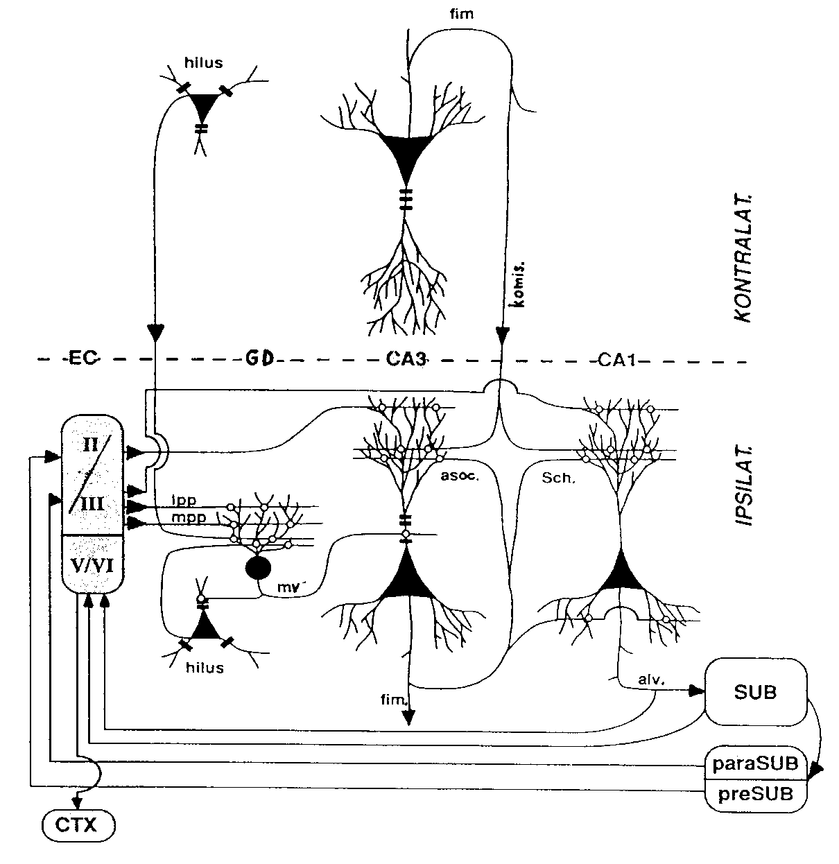
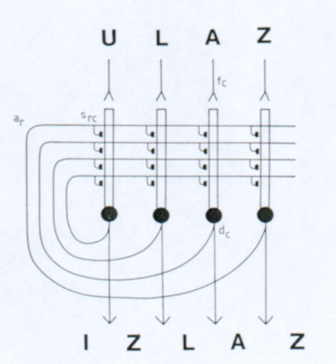
Fiziološki ritmovi HF i hipoteza učenja u 2 koraka
1. Korak: “istraži i iskusi” - theta ritam
2. Korak: “odmori se i konsolidiraj” - oštri valovi - ‘kompresija vremena’
Svojstva CA3/CA1 mreže:
- učenje iz jednog pokušaja
- generalizacija
- otpornost na šum

Slide 42
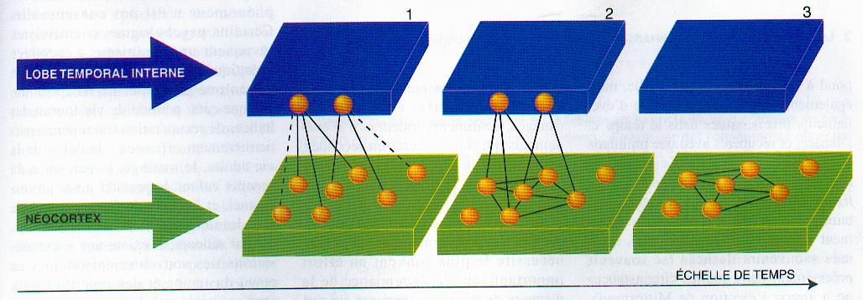
Predmnijevani mehanizam konsolidacije

Slide 43
Vrste zapamćenih sadržaja (pamćenja)
H.M.

Slide 44
Svi nedeklarativni oblici (ne uključuju svijest i pozornost) učenja i pamćenja mogu se podijeliti na:
Asocijativne (učenje nastaje kroz sparivanje dvaju ili više prethodno nesparenih podražaja)
Neasocijativne (učenje nastaje u odgovoru na isti podražaj koji se daje jedanput ili više puta)

Slide 45
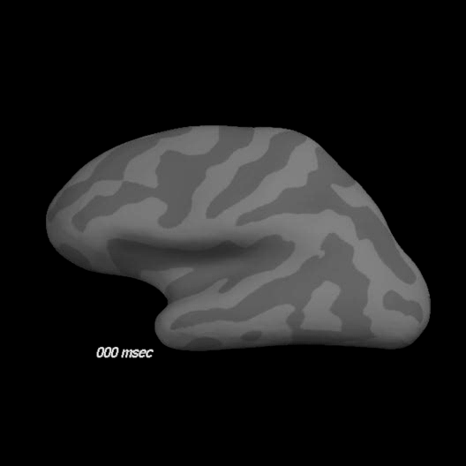
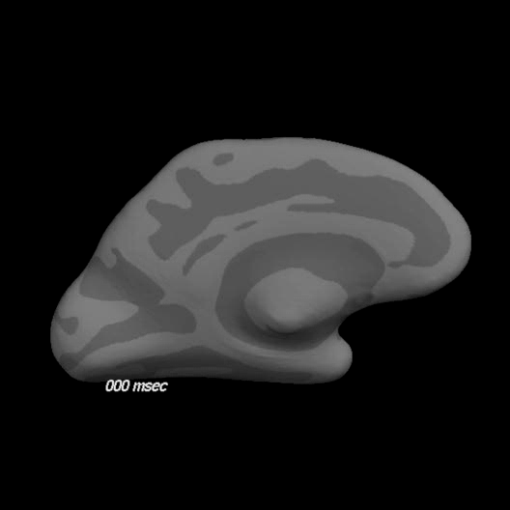
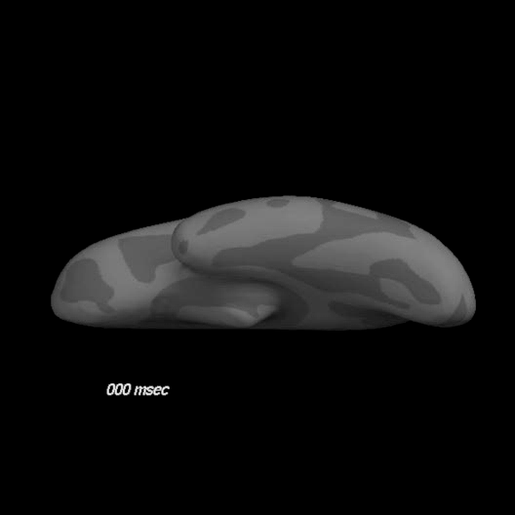
Spatiotemporal dynamics of word processing in the human cortex (fMRI + MEG)
Marinkovic K, Neuroscientist, 2004

Slide 46
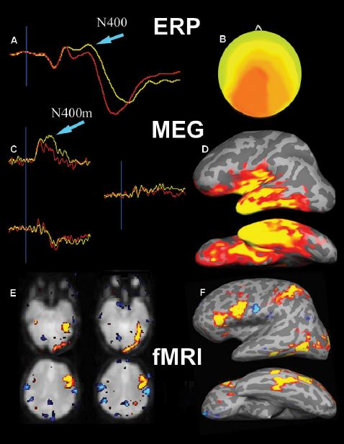
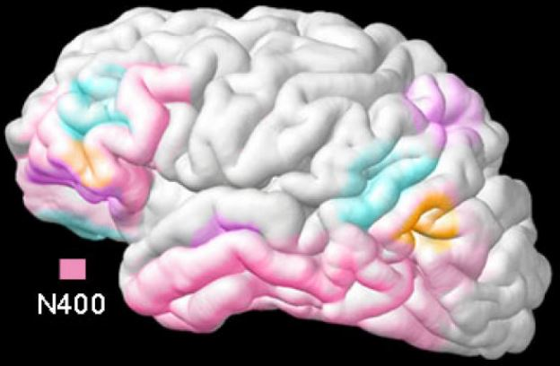
Spatiotemporal dynamics of word processing in the human cortex (MEG + fMRI + ERP)
Marinkovic K, Neuroscientist, 2004

Slide 47
O'Keefe, J., and Dostrovsky, J. (1971) The hippocampus as a spatial map. Preliminary evidence from unit activity in the freely‐moving rat. Brain Research 34, 171‐175.
Place cells maintain a „cognitive map of known locations” in rodents, and episodic memory in humans.
Hafting, T., Fyhn, M., Molden, S., Moser, M.B., and Moser, E.I. (2005) Microstructure of spatial map in the entorhinal cortex. Nature 436, 801‐806.

Slide 49
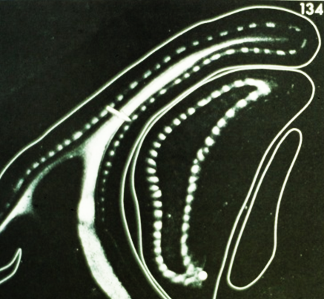
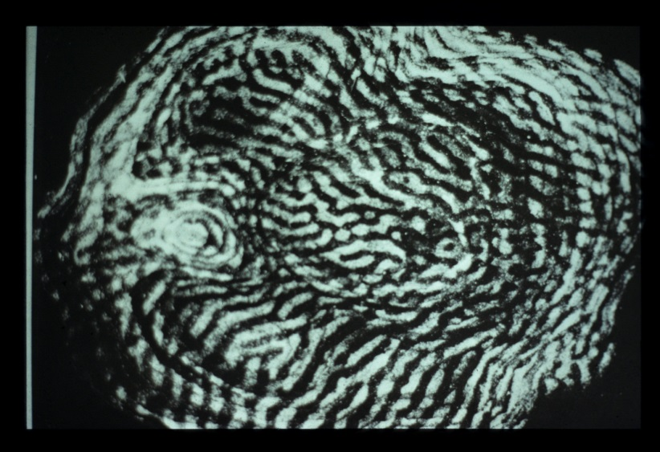
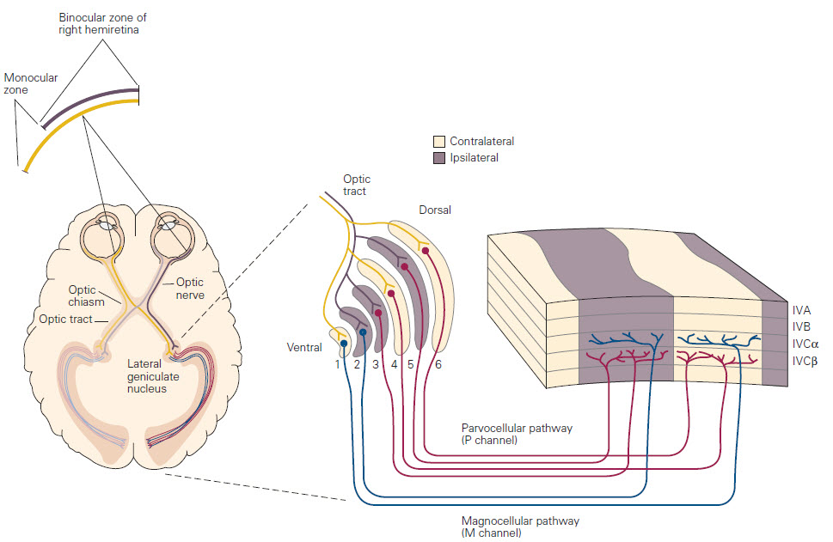
Okulodominantne kolumne
NN - 1981 Hubel & Wiesel / Sperry
Hubel D.H. and Wiesel T.N. (1969) Anatomical demonstration of columns in the monkey striate cortex. Nature, 221: 747–750.

Slide 50
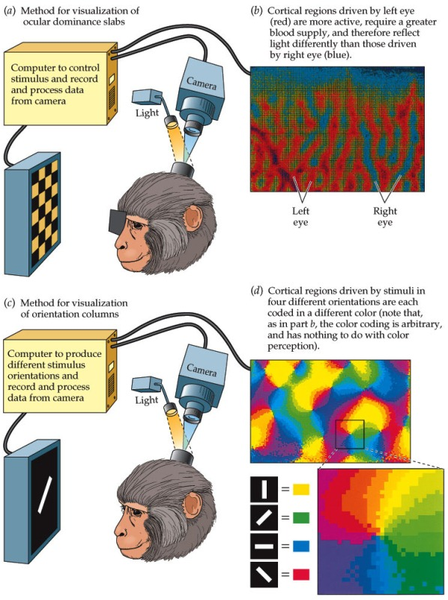
Orijentacijske kolumne
Hubel & Wiesel 1959, 1962
Hubel, D. H.; Wiesel, T. N. (1959) Receptive fields of single neurons in the cat’s striate cortex. J. Physiol. 148: 574-591
Hubel, D. H.; Wiesel, T. N. (1962) Receptive fields, binocular interaction and functional architecture in the cat’s visual cortex. J. Physiol. 160:106-154
Bonhoeffer, T., and Grinvald, A. (1991) Iso-orientation domains in cat visual cortex are arranged in pinwheel-like patterns. Nature, 353, 429–431.

Slide 51
CA1
Firing rate maps
mEC
Place cell firing patterns can be modelled as the thresholded sum of BVC inputs. BVC are found in in subiculum, parasubiculum and mEC: they fire at a specific distance and direction from environmental boundaries
+ head-direction cells
+ cells that encode object locations …
Bush D, Barry C, Burghess N (2014) What do grid cells contribute to place cell firing? Trends Neurosci. 37: 136-145

Slide 52
Čimbenici koji utječu na okidanje stanica koje pamte mjesta
Deformacija poznate okoline
Postavljanje nove granice u poznatoj okolini (ista stanica sada reprezentira (kodira) za dva mjesta
Rotacija distalnog vidnog orijentira (crna linija) u inače simetričnoj okolini
Although approximately 90% of principal cells in the dorsal hippocampus can exhibit place fields, only 15–50% do so in any given environment
Rate remapping
Global remapping
Minor manipulations of environmental features may modulate the firing rate of active place cells, particularly in CA3 (‘rate remapping’), whereas larger manipulations of the environment can change the entire ensemble of active place cells and their firing locations (‘global remapping’)
Bush D, Barry C, Burghess N (2014) What do grid cells contribute to place cell firing? Trends Neurosci. 37: 136-145

Slide 53
Kako stanice mreže (grid cells) utječu na okidanje stanica koje pamte mjesta?
Place cell spatial firing patterns are determined by environmental sensory inputs, including those representing the distance and direction to environmental boundaries (BVC)
Grid cells provide a complementary self-motion related input that contributes to maintaining place cell firing: In this view, grid and place cell firing patterns are not successive stages of a processing hierarchy, but complementary and interacting representations that work in combination to support the reliable coding of large-scale space.
Inferotemporal visual stream: epizodičko deklarativno pamćenje razvilo se iz neurona koji pamte prostor i objekte (300 ms - konceptni neuroni neosjetljivi su na male razlike u izgledu podražaja, za razliku od V1, V2, etc. neurona koji su osjetljiviji i na male razlike).

Slide 54
Konceptni neuroni
Quian Quaroga R. (2012) Concept cells: the building blocks of declarative memory functions. Nat. Rev. Neurosci. 13: 587-597

Slide 55
Attractor dynamics of concept neurons from a few visual cues
by the activation of a network representing a given concept
Quian Quaroga R. (2012) Concept cells: the building blocks of declarative memory functions. Nat. Rev. Neurosci. 13: 587-597

Slide 56
Striking similarities between place cells in the rodent hippocampus and concept neurons in MTL of humans:
1. Both are very selective and fire to their preferred stimulus (place field / concept)
2. Place cells give an explicit representation of the environment that allows an accurate prediction of the animal’s location, similar to the explicit representation of concepts by human MTL neurons that allow the prediction of the stimulus seen
3. Both place and concept cells show attractor dynamics: their firing changes abruptly when environmental shapes are changed incrementally, which resembles all‑or‑none responses of human MTL neurons that dramatically change their firing upon picture recognition and could set up on an attractor (by the activation of a network representing a given concept) from a few visual cues
4. Place cells maintain their tuning after the light is turned off — that is, their firing can be triggered in the absence of visual information — just like the firing of concept cells can be elicited by imagery, internal thoughts or recall
5. Place cells can be formed within minutes, and concept cells can also encode new concepts and associations relatively quickly (for example, in one study, MTL cells responded to researchers the patient did not know a couple of days before the experiment took place)
6. In the rat hippocampus neighbouring neurons do not necessarily have neighbouring place fields; it is common to find that neighbouring concept neurons — the activities of which could be separated after spike sorting — respond to completely unrelated things (for example, Halle Berry and Mother Teresa)

Slide 57
Mental imagery mechanisms are similar to those used during visual perception
Recording from single neurons in the human medial temporal lobe were made while the subjects were asked to imagine previously viewed images. Single neurons in the hippocampus, amygdala, entorhinal cortex and parahippocampal gyrus that selectively altered their firing rates depending on the stimulus the subjects were imagining. Of the neurons that fired selectively during both vision and imagery, the majority (88%) had identical selectivity, suggesting a common substrate for the processing of incoming visual information and visual recall.
Krieman G, Koch C, Fried I (2000) Imagery neurons in the human brain, Nature, 408: 357-360.

Slide 58
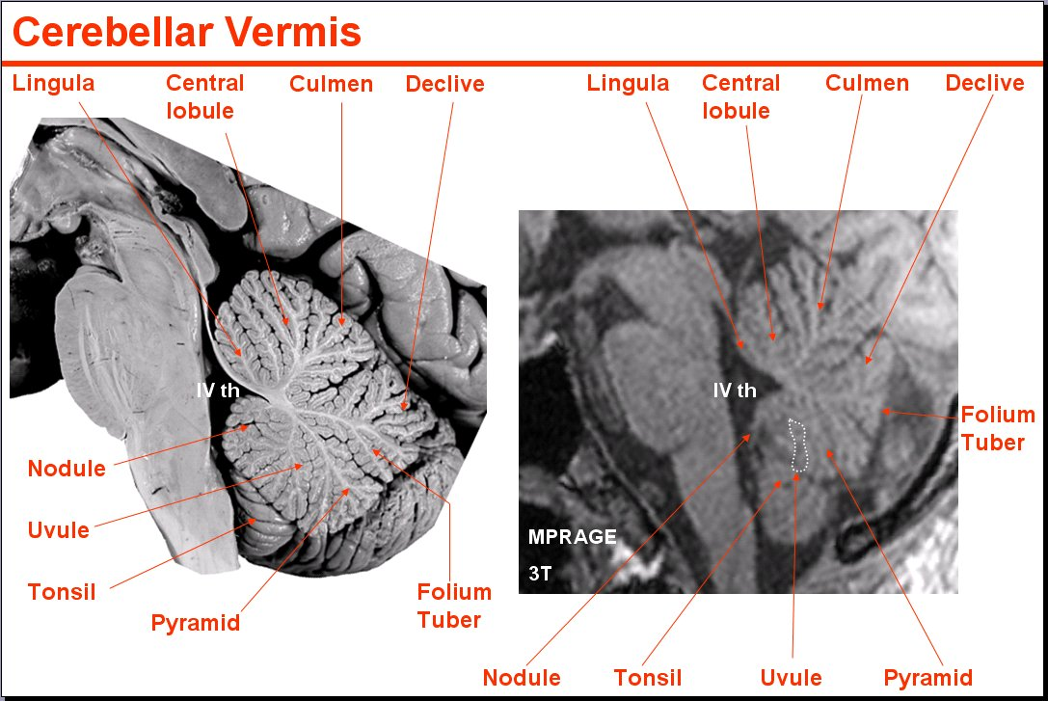
Peg system / Memory palace
"Govoreći sam sa sobom -1. Lingula (asocijacija na jezik – lingua), počnem hodati iz centra grada -2. Lobulus centralis, prema Sljemenu - 3. Culmen, a zatim se spustim nizbrdo - 4. Declive, putem uzmem u ruku list - 5. Folium, u njega zamotam krumpir - 6. Tuber, te ga stavim na piramidu - 7. Pyramis, pa sve zajedno zamotam u maramicu i na njezinoj resici - 8. Uvula, zavežem čvor - 9. Nodulus".

Slide 59

Stanični i molekularni mehanizmi pamćenja mogu se proučavati i na jednostavnim organizmima poput beskralježnjaka (Eric Kandel, NN 2000 s Arvidom Carlssonom i Paulom Greengardom za DARPP-32 (dopamine- and cAMP-regulated neuronal phosphoprotein), sad protein phosphatase 1 regulatory subunit 1B (PPP1R1B)).
Aplysia californica:
ima oko 20.000 izrazito velikih neurona koji se mogu lako izolirati i na njima provoditi eksperimenti u kulturi stanica

Slide 60

Habituacija (homosinaptička depresija)
I najneobičniji događaji postaju uobičajeni nakon opetovanog ponavljanja. Taj se fenomen naziva habituacija, a vidi se čak i u organizama bez mozga.
Prilikom habituacije neki organizam ili osoba uče zanemarivati ponavljani podražaj ili događaj. Iako se takvo neasocijativno učenje smatra najjednostavnijim oblikom učenja budući da ne zahtjeva svijest i pozornost, puno je važnije u svakodnevnom životu nego što to obično mislimo.

Slide 61
https://www.youtube.com/watch?v=vx_BT6DU624
jednokratno podraž. sifona – uvlačenje škrga,
ako podražimo sifon vodom nakon bolnog podraživanja repa – nastupa senzitizacija
opetovano podraž. sifona – habituacija zbog homosinaptičke depresije
neasoc.
klasično uvjetovanje
asoc.

Slide 62
https://www.youtube.com/watch?v=vx_BT6DU624
jednokratno podraž. sifona – uvlačenje škrga,
ako podražimo sifon vodom nakon bolnog podraživanja repa – nastupa senzitizacija
neasoc.
obratiti pozornost na razliku između
senzitizacije i kondicioniranja
(kod kondicioniranja je uvlačenje škrga još jače nego kod senzitizacije)
0,5 sec. dovodi do najjačeg kondicioniranja
asoc.

Slide 63
Acoustic startle response (odgovor na nagli glasan zvuk) i
Orienting response (obraćanje pozornosti na nove /neprijeteće/ podražaje)
Budući da uključuje samo jedan podražaj koji je lako kontrolirati i samo jedan lako mjerljiv odgovor, vjerojatno najjednostavniji primjer na kojemu se eksperimentalno proučava habituacija jest obrambeni refleks štakora na nagli glasan zvuk. Na takav podražaj štakor će skočiti baš kao i ti kad bi ti se netko prišuljao s leđa i glasno viknuo na uho. Ipak, ako se isti zvuk stalno ponavlja, npr. po jednom svake minute, odgovor štakora na taj zvuk sve će više slabjeti i na kraju prestati: nastupila je habituacija na glasan zvuk. Ovakav odgovor na nagli glasan zvuk prvi je opisao 1863. godine Ivan Sečenov.
Urođena reakcija organizma na novi podražaj iz okoline naziva se orijentirajući odgovor (obraćanje pozornosti). Vrijeme trajanja gledanja u taj objekt (vrijeme fiksacije) smanjuje se s ponavljenjem predočavanja podražaja slično kao i kod odgovora na glasan zvuk.

Slide 64

PPI
Prepulse inhibition (PPI) is a neurological phenomenon in which a weaker prestimulus (prepulse) inhibits the reaction of an organism to a subsequent strong startling stimulus (pulse). The stimuli are usually acoustic, but tactile stimuli (e.g. via air puffs onto the skin) and light stimuli are also used. Deficits of prepulse inhibition manifest in the inability to filter out the unnecessary information; they have been linked to abnormalities of sensorimotor gating. Such deficits are noted in patients suffering from illnesses like schizophrenia and Alzheimer’s disease, and in people under the influence of drugs, surgical manipulations, or mutations.

Slide 65

Startle

Slide 66
Startle response (refleks zaprepaštenja)
In animals, including humans, the startle response is a largely unconscious defensive response to sudden or threatening stimuli, such as sudden noise or sharp movement, and is associated with negative affect. It is a brainstem reflectory reaction (reflex) that serves to protect vulnerable parts, such as the back of the neck (whole-body startle) and the eyes (eyeblink) and facilitates escape from sudden stimuli. It is found across the lifespan of many species. An individual's emotional state may lead to a variety of responses. The startle response is implicated in the formation of specific phobias.
First, there is a synapse from the auditory nerve fibers in the ear to the cochlear root neurons neurons (CRN). These are the first acoustic neurons of the CNS. Studies have shown a direct correlation to the amount of decrease of the startle to the number of CRNs that were killed. Second, there is a synapse from the CRN axons to the cells in the nucleus reticularis pontis caudalis (PnC) of the brain. These are neurons that are located in the pons of the brainstem. A study done to disrupt this portion of the pathway by the injection of PnC inhibitory chemicals has shown a dramatic decrease in the amount of startle by about 80 to 90 percent. Third, a synapse occurs from the PnC axons to the motor neurons in the facial motor nucleus or the spinal cord that will directly or indirectly control the movement of muscles. The activation of the facial motor nucleus causes a jerk of the head while an activation in the spinal cord causes the whole body to startle.
During neuromotor examinations of newborns, it is noted that, for a number of techniques, the patterns of the startle reaction and the Moro reflex may significantly overlap, the notable distinction being the absence of arm abduction (spreading) during startle responses.

Slide 67

Moroov refleks
razvija između 28. i 32. tjedna trudnoće i nestaje u dobi od 3-6 mjeseci;
to je odgovor na iznenadni gubitak podrške i uključuje tri različite komponente:
[1] širenje (abdukciju) i uvlačenje ruku (addukciju) plakanje (obično)
[2] Za razliku od startle refleksa (zaprepaštenja), Moroov refleks se ne smanjuje s ponovljenom stimulacijom!
[3] Primarni značaj Moroovog refleksa je u procjeni integracije (sazrijevanja) SŽS-a
https://www.youtube.com/watch?v=PTz-iVI2mf4
https://www.youtube.com/watch?v=R5J-tmO1-5s

Slide 68


Senzitizacija (presinaptička facilitacija)
Odgovor postaje jači od početnog zbog prethodne stimulacije (aktivacije facilitirajućeg neurona), npr.
nakon što prestanemo obraćati pozornost na vrata koja se stalno otvaraju u kafiću, no ako nam se iza leđa aktivira alarm sljedeće otvaranje vrata izazvat će jači odgovor i osjećaj straha.

Slide 69
Senzitizacija (presinaptička facilitacija)

Slide 70

Klasično kondicioniranje

Slide 71

Senzitizacija (kratkoročna)
postoje 3 tipa
modulatornih interneurona,
ali su najbolje proučeni oni
koji izlučuju 5-HT
Hidrolizira PIP₂ (fosfatidilinozitol 4,5 bisfosfat – fosfolipid stanične membrane) tako da nastaju IP₃ i DAG
Gq
aktivira
Gs
Fosforilacija kalijevih kanala dovodi do produljenog djelovanja AP-a
ATP ->
Fosforilira SNAP receptor (SNARE) proteine koji dovode do egzocitoze

Slide 72

Senzitizacija (dugoročna) u morskog puža

Slide 73

Aktivacija cAMP - > PKA - > CREB-1 (cAMP response element-binding protein) signalnog puta potvrđena je kod pretvorbe kratkoročnog u dugoročno pamćenje (dual-trace theory) u svih životinjskih vrsta, od morskog puža do primata

Slide 74
cAMP - > PKA - > CREB-1
1. put opisan 1987. da se veže za promotor gena za somatostatin, a kasnije i za gene C-FOS, BDNF, CRH, VGF inducibilni čimbenik rasta, PER1 i PER2 (reguliraju cirkadijani ritam u sisavaca), TH i druge
Hvala na pozornosti!

