Slide 1

Macro- and microarchitecture of cognitive processing
Goran Šimić
NeuRI 2015
Rijeka, 24. travnja 2015.

Slide 2
Macro- and microarchitecture of cognitive processing
In my talk I will try to integrate and interpret recent insights obtained with different structural and functional neuroimaging modalities such as fMRI, EEG/MEG, DTI, and SPECT/PET through state-of-the-art description of the several major neuronal networks of the cerebral cortex (the default mode network, networks for recognition of people and objects, spatial attention, linguistic abilities, episodic memory and emotions, executive functions and behavior). Then, I will describe discoveries in relation to evolution and functional specialization of “concept” neurons and their role in formation of long-term declarative episodic memories, as revealed by microelectrode recordings in epileptic patients. Finally, cognitive enhancement and therapeutic possibilities for selected neuropsychiatric disorders using transcranial magnetic stimulation (TMS - spTMS, rTMS) and transcranial electrical stimulation (TES - tDCS, tRNS, tACS) will be discussed.

Slide 3
Makroarhitektura spoznajnih procesa
(razina velikih populacija neurona – mreža)
Struktura - DTI
Funkcija -
fMRI (trMRI, rsMRI, fcMRI - DMN)
SPECT/PET
MEG, MEG + fMRI
Th perspektive: TMS (spTMS & rTMS) vs TES (tDCS, tRNS, tACS)
Mikroarhitektura spoznajnih procesa
Elektrofiziološko snimanje aktivnosti pojedinačnih neurona mikroelektrodama

Slide 4
NIH (+ NIMH)
2009 - 2014
1st Consortium (30 mil. US$) = WashU (David Van Essen) + UMinnesota
fMRI
(task-related & resting-state)
2nd Consortium (8.5 mil. US$) = UCLA (Arthur Toga, Jack Van Horn, Paul Thompson) + MGH
(Randy Buckner, Jean Augustinack)
structural imaging (DTI – tractography)
EU FP7 / H2020
2013 - 2023
86 institutions:
École polytechnique de Lausanne (Henry Markram)
Univ. Vaudois (Richard Frackowiak)
Institut Pasteur (Jean-Pierre Changeux)
Karolinska Institutet (Sten Grillner)
Univ. Madrid (Javier DeFelipe)
Jülich Univ. (Katrin Amunts) etc.
1.19 billion € (555 million € to personnel)
„Gaining profound insight into what makes us human, developing new treatments for brain diseases and building revolutionary new computing technologies.”

Slide 5
Makroarhitektura spoznajnih procesa
(razina velikih populacija neurona – mreža)
Struktura - DTI
Funkcija -
fMRI (trMRI, rsMRI, fcMRI - DMN)
SPECT/PET
MEG, MEG + fMRI
Th perspektive: TMS (spTMS & rTMS) vs TES (tDCS, tRNS, tACS)
Mikroarhitektura spoznajnih procesa
Elektrofiziološko snimanje aktivnosti pojedinačnih neurona mikroelektrodama

Slide 6
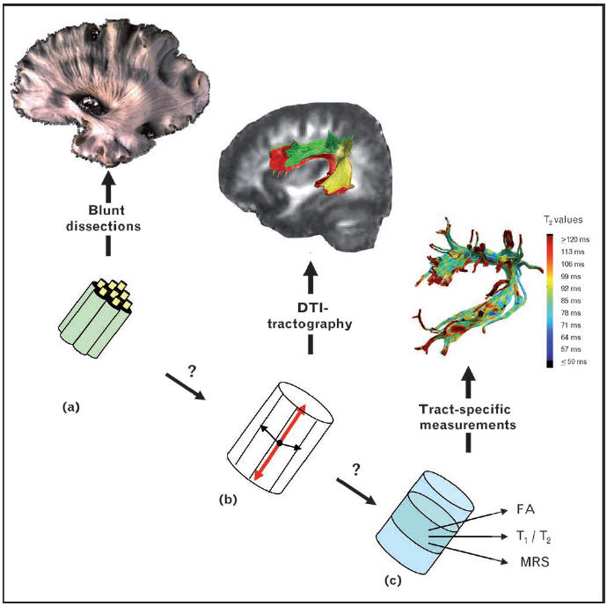
Diffusion tensor imaging (DTI)
DTI measures the diffusion of water molecules in the brain (Le Bihan 2003; Moseley et al., 1990)
In an unrestricted environment, water molecules diffuse freely in any direction. In the brain however, diffusivity is restricted by the brain’s architecture such that water diffuses more readily along axons rather than across them; measuring the direction of diffusivity can be used, therefore, to infer the orientation of white matter tracts in the brain

Slide 7
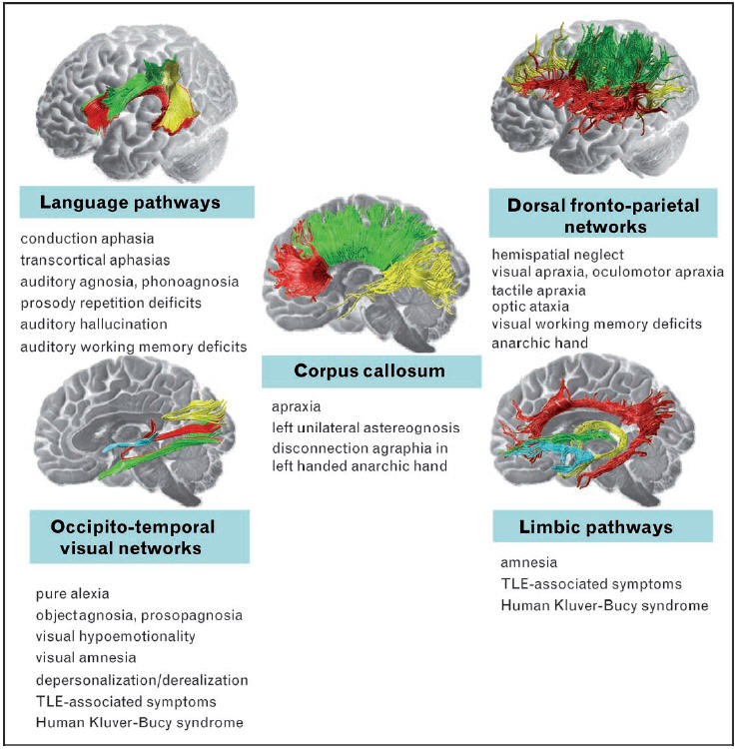
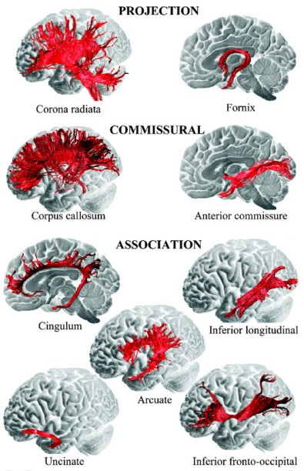
DTI
Catani M, ffytche DH et al.

Slide 8
DTI
Several measures are used to quantify WM integrity using DTI, the most common being fractional anisotropy (FA), mean diffusivity (MD), fiber count (FC) and probabilistic tractography (PT)
FA is a scalar measure of the degree of anisotropy (direction selectivity; higher FA values are also generally interpreted as reflecting healthier WM) and MD is a scalar measure of the total diffusivity (these two measures are calculated within a voxel)
FC and PT result from tracking the principle diffusion direction of every voxel between ROIs
FC results in a total number of fibers connecting a seed region with a target region and PT produces a measure of the likelihood that two regions are connected
Main limitations: signal loss and difficulty resolving small tracts as they cross large tracts (a given voxel can contain several small fiber tracts coursing in multiple directions: this can lead to an incorrect measure of the principal diffusion direction for a particular tract, resulting in both false positives and false negatives, making it difficult to discern crossing or ‘‘kissing’’ fibers)

Slide 9
DTI: a whole brain connectivity map (998 ROIs)

Slide 10
Connectomic mapping

Slide 11
Connectomic mapping
FRONTAL

Slide 12
Connectogram interpretation

Slide 13
Population averaging

Slide 14
Connectomic profiling and modeling
„Finger-print”

Slide 15
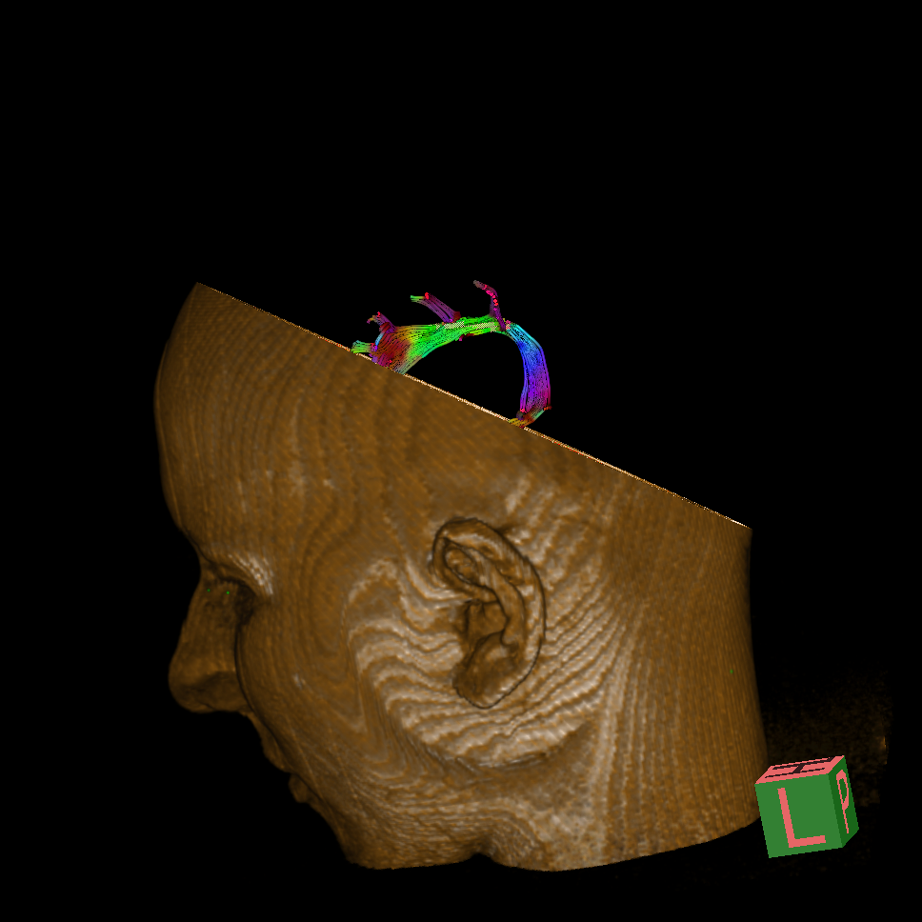
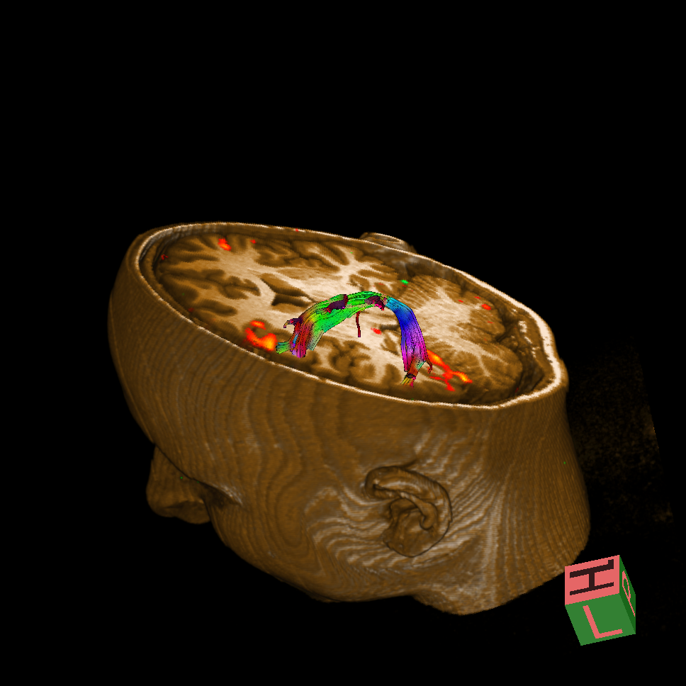
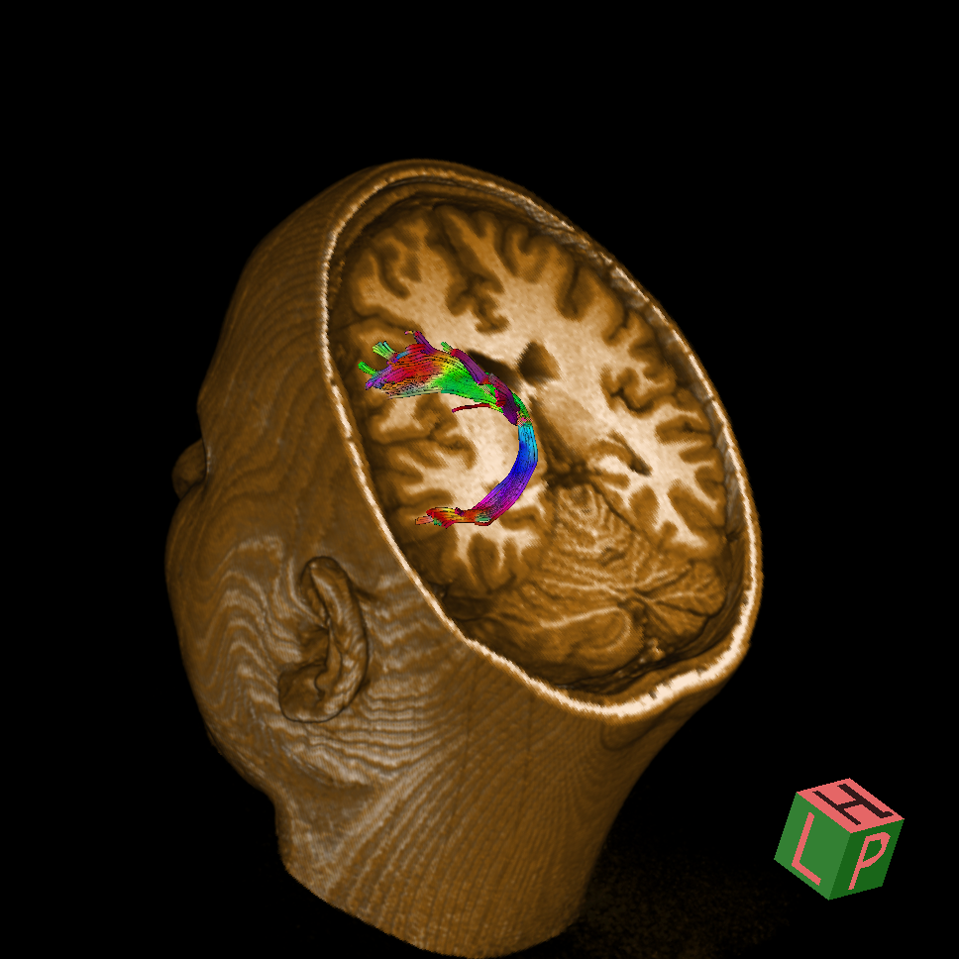
Fasciculus arcuatus

Slide 16
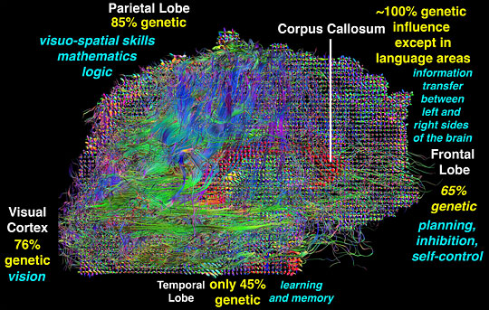
Genetic influence on white matter integrity (FA)
23 pairs of MZ twins and 23 pairs of DZ twins were analyzed; if the correlation between the voxel value of FA in one twin and the level of IQ in the other twin (“cross-trait” and “cross-twin”) is greater in MZ pairs than in DZ pairs, the excess in the MZ correlation over the DZ correlation is then assumed to be attributable to common genetic factors that mediate both WM integrity and intelligence, which was confirmed for WM in both frontal and parietal lobes and left occipital lobe
Chiang et al., J. Neurosci., 2009, 29, 2212-2224

Slide 17
Makroarhitektura spoznajnih procesa
(razina velikih populacija neurona – mreža)
Struktura - DTI
Funkcija -
fMRI (trMRI, rsMRI, fcMRI - DMN)
SPECT/PET
MEG, MEG + fMRI
Th perspektive: TMS (spTMS & rTMS) vs TES (tDCS, tRNS, tACS)
Mikroarhitektura spoznajnih procesa
Elektrofiziološko snimanje aktivnosti pojedinačnih neurona mikroelektrodama

Slide 18
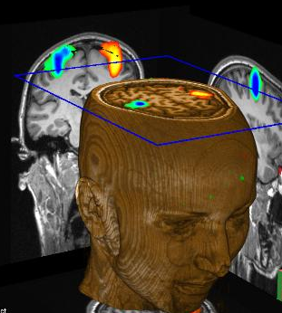
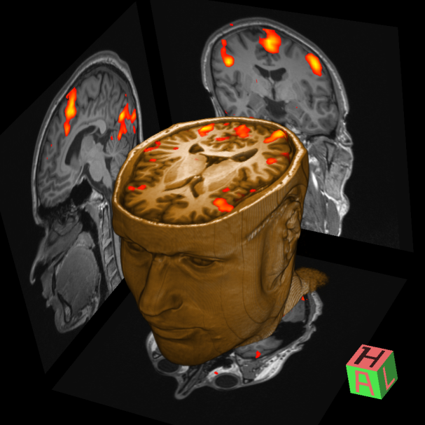

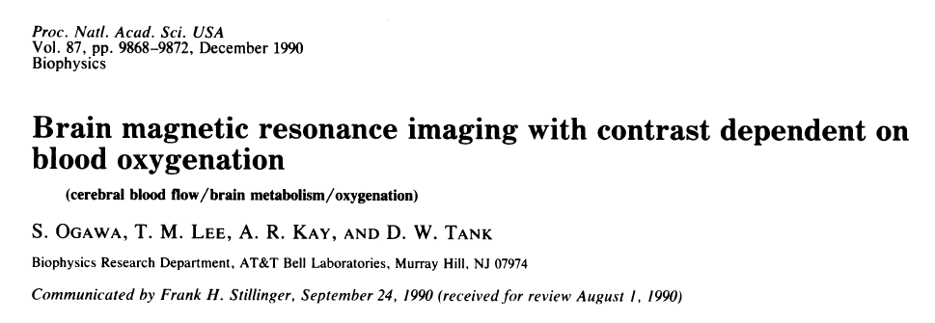
fMRI
Ne-invazivna metoda mjerenja aktivnosti mozga
Aktivnost živčanih stanica se promatra indirektno putem mjerenja vaskularnih i hemodinamskih signala
Najvažniji oblik fMRI snimanja je ono koje koristi BOLD signal
Seiji Ogawa 1990, AT&T Bell labs, Murray Hill, NJ, USA

Slide 19
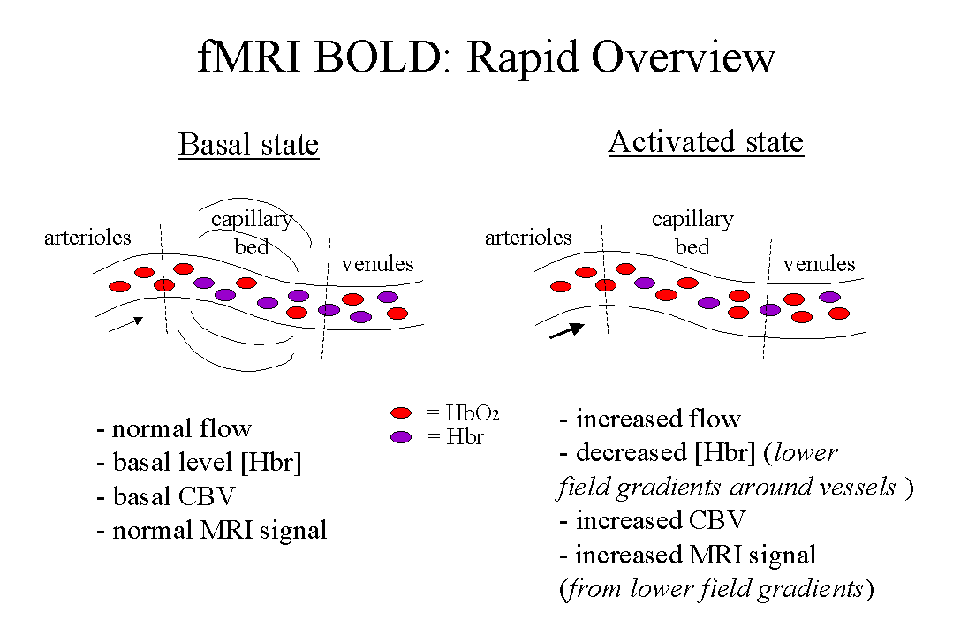
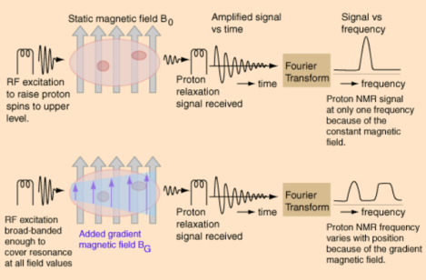
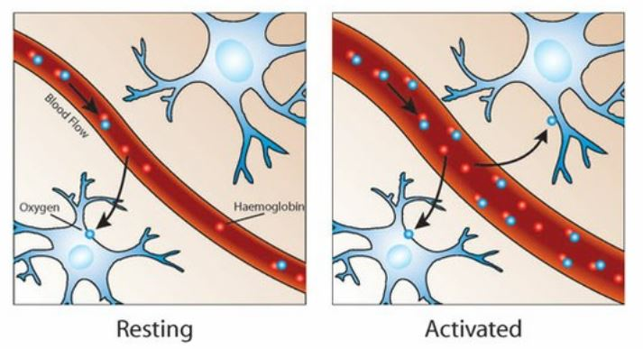
Blood Oxygen Level Dependent signal
M_{xy}
Signal
M_{o} sinθ
T₂* aktivacija
T₂* kontrola
S_{aktivacija}
S_{kontrola}
ΔS
TE_{optimum}
vrijeme

Slide 20
Task-related fMRI
An experimental task of interest is presented alternately with a control task and the BOLD signal during the experimental task is compared to the BOLD signal during the control task
The difference between baseline and task-related activation accounts for about 1–5% of the total BOLD signal
Thus, compared to ongoing ‘baseline’ brain activity, only a small percentage is needed to respond to an external stimulus
However, the functions of this vast amount of baseline activity remained unclear

Slide 21
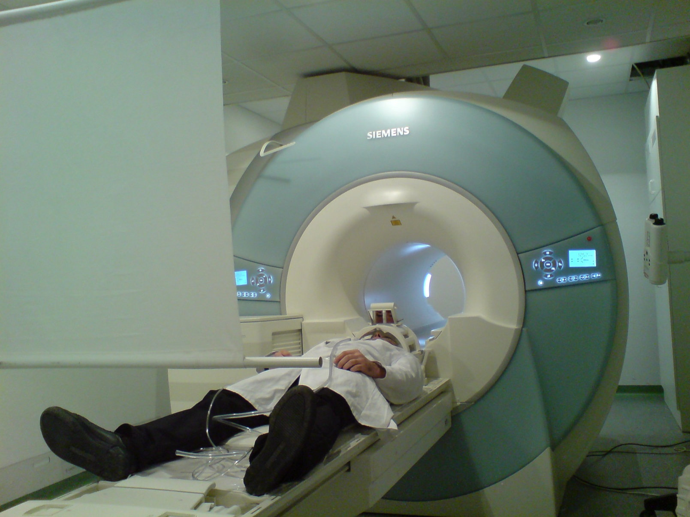
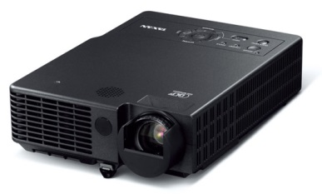
fMRI
projekcijsko
platno
LCD
projektor
ogledalo

Slide 22
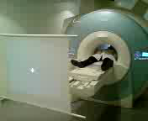



fMRI protokol
paradigma imenovanja predmeta
+
+
+
30 s
30 s
30 s
30 s
30 s
30 s

Slide 23
start

Slide 24
+
Notes:
Rounds off at the ms

Slide 25

Notes:
1

Slide 26
+
Notes:
Rounds off at the ms

Slide 27

Notes:
1

Slide 28
+
Notes:
Rounds off at the ms

Slide 29

Notes:
1

Slide 30
+
Notes:
Rounds off at the ms

Slide 31
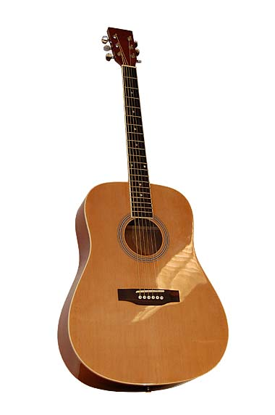
Notes:
1

Slide 32
+
Notes:
Rounds off at the ms

Slide 33

Notes:
1

Slide 34
+
Notes:
Rounds off at the ms

Slide 35

Notes:
1

Slide 36
+
Notes:
Rounds off at the ms

Slide 37
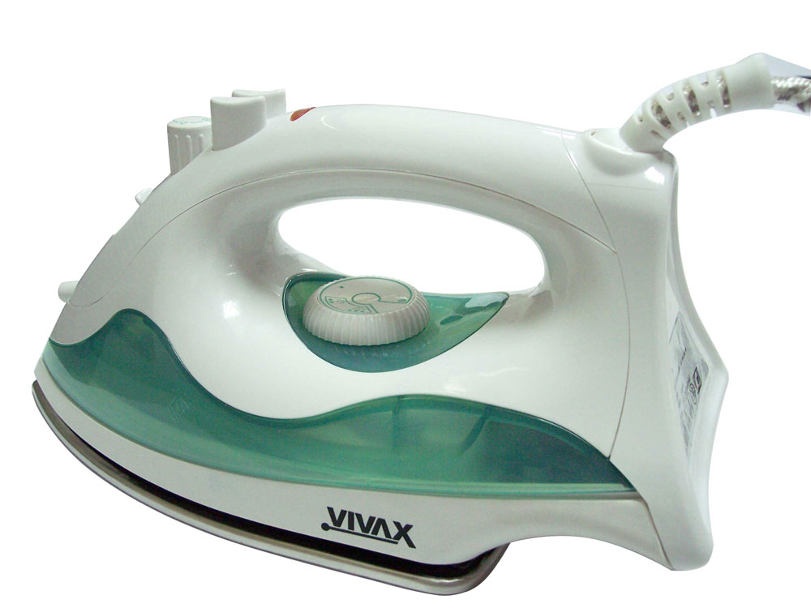
Notes:
1

Slide 38
+
Notes:
Rounds off at the ms

Slide 39
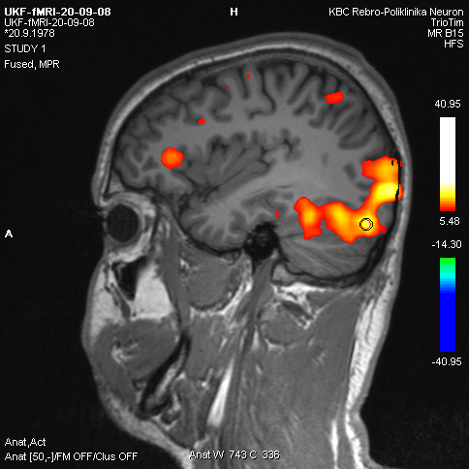
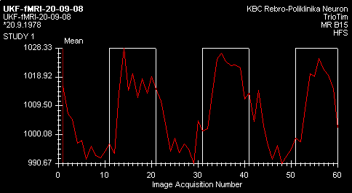
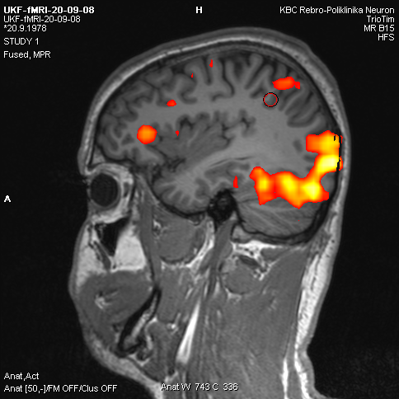
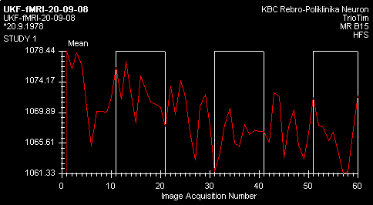
Korelacija podražaja i signala
slika
slika
slika
+
+
+
Ima
korelacije
podražaja
i signala
slika
slika
slika
+
+
Nema
korelacije
podražaja
i signala

Slide 40
Promjena intenziteta signala u fMRI
1020
2,5%
995
Relativno male primjene u intenzitetu signala (1 – 5%)

Slide 41
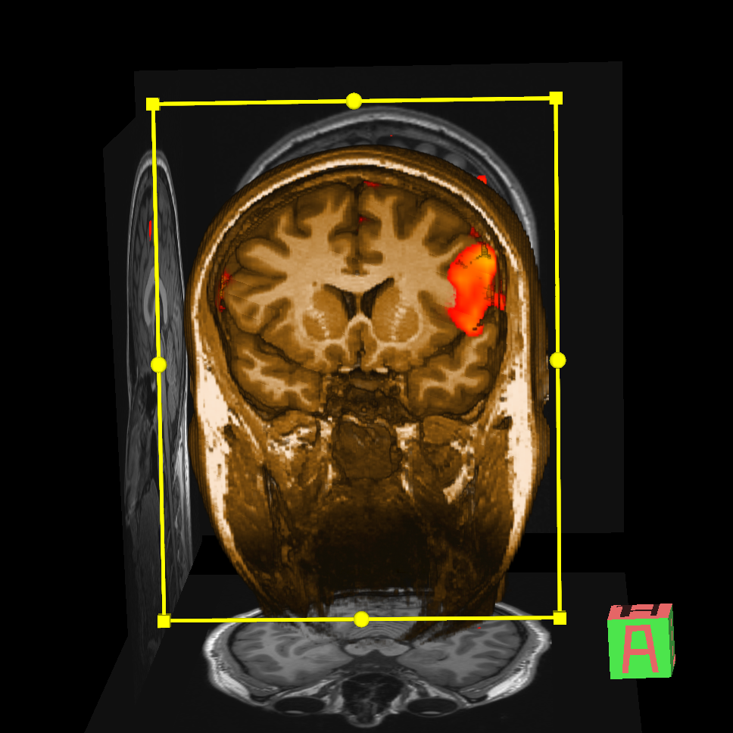
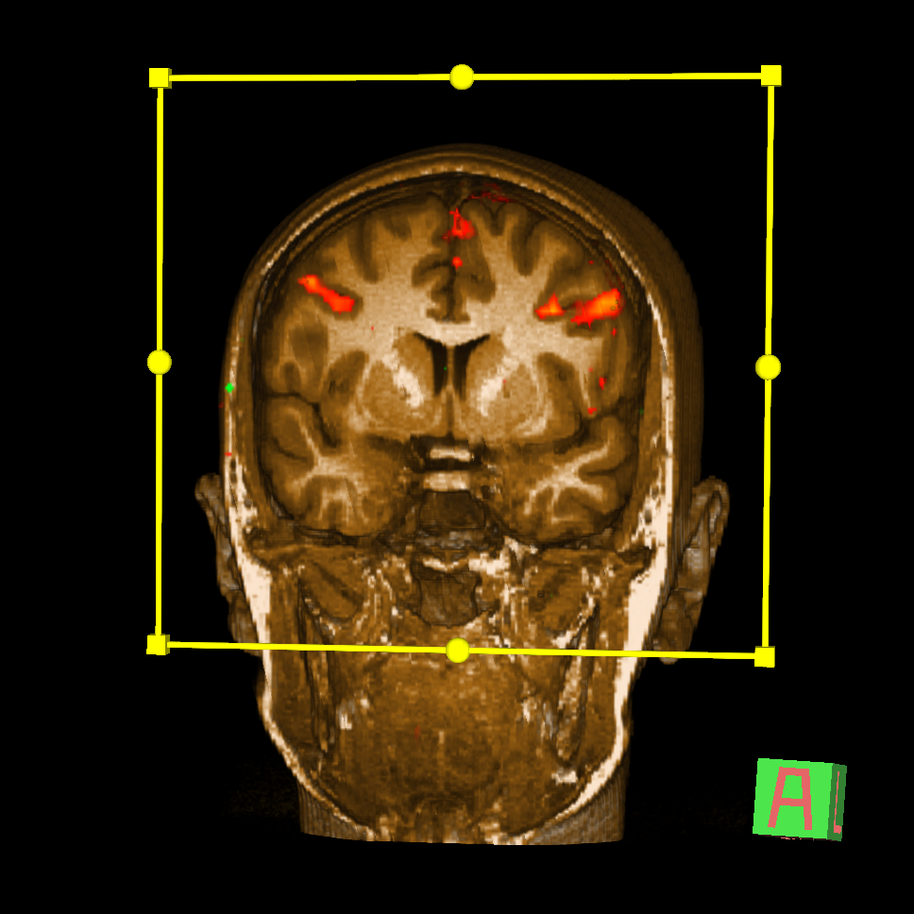
Elokventni korteks

Slide 42
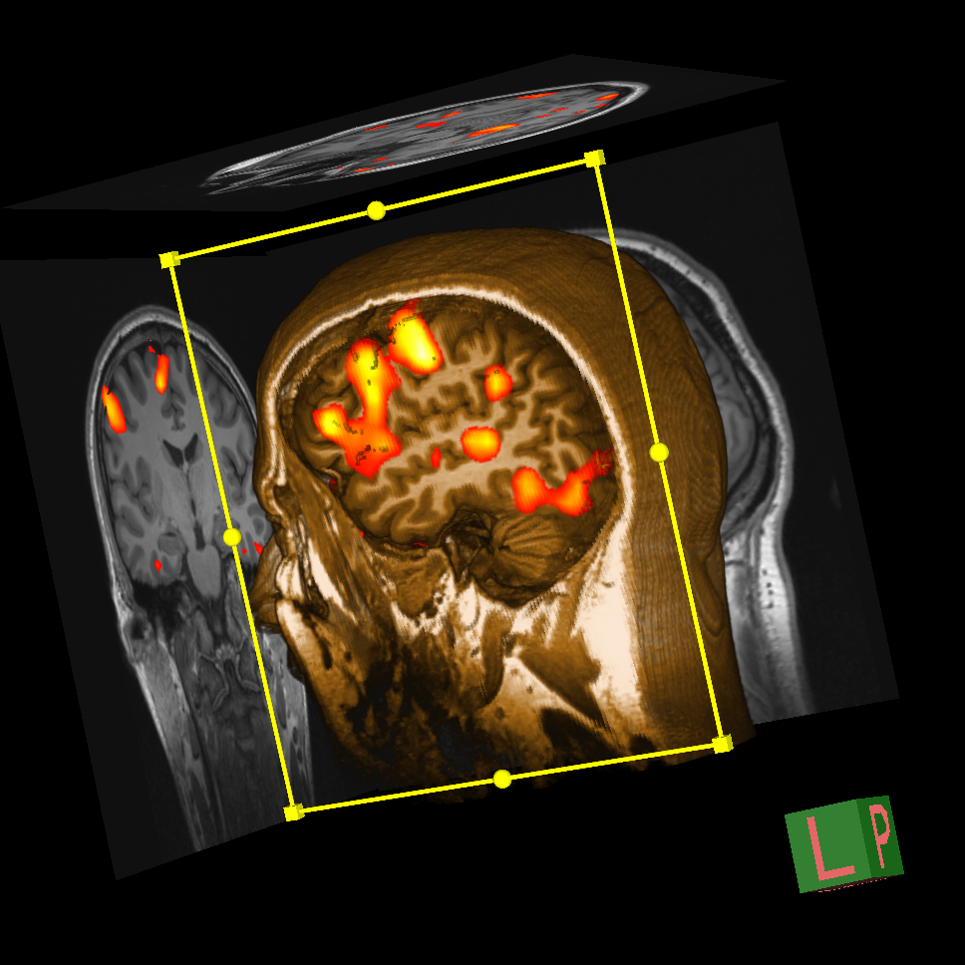
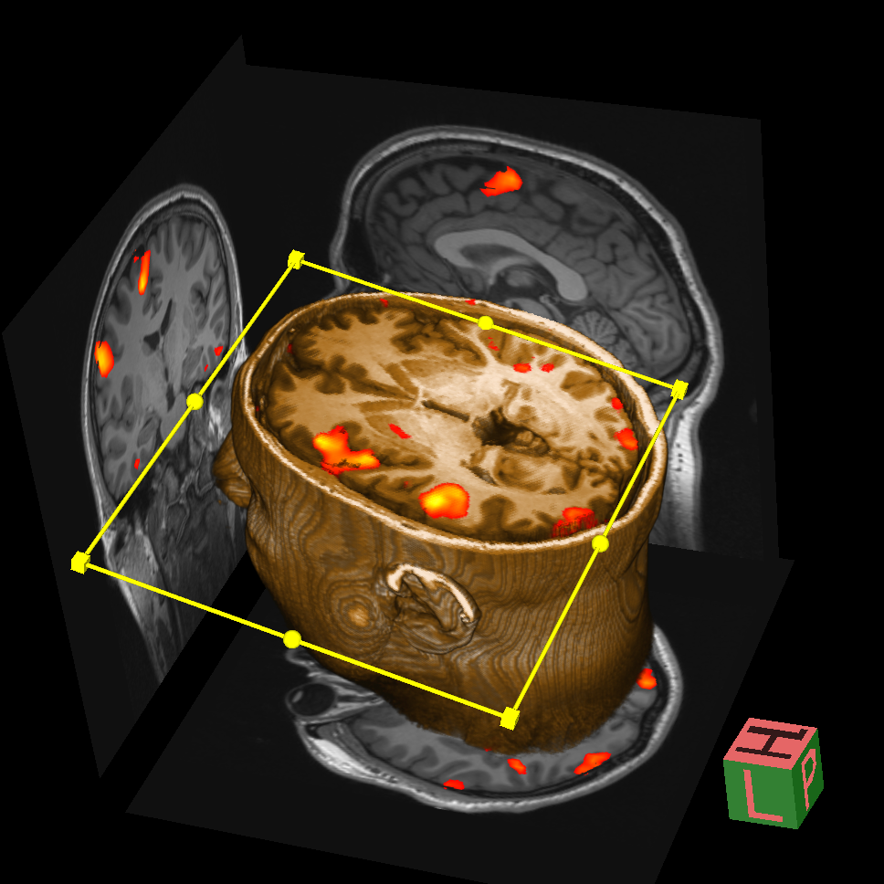
Područja povećane aktivnosti
ežanj
zatiljni režanj
čeoni režanj
sljepoočni režanj

Slide 43
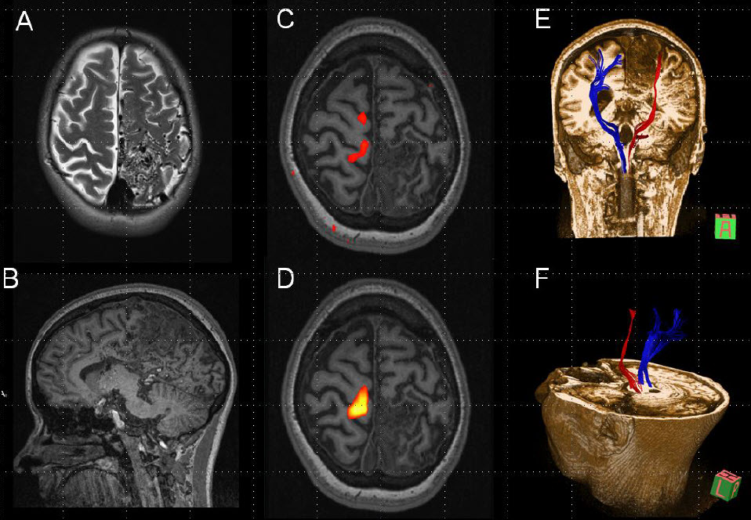
Functional reorganization of the primary motor cortex in a patient with a large arteriovenous malformation involving the precentral gyrus
Radoš et al., Transl. Neurosci. 2013

Slide 44
Resting-state fMRI
Focuses on spontaneous, rather than task-induced, fluctuations in BOLD signal
In the first resting-state fMRI study (Biswal, Magn. Reson. Med., 1995), the time course of a seed region-of-interest (ROI) in the left motor cortex was correlated with the time course of all other brain voxels
The resulting map demonstrated functional connectivity between the left and right motor cortex even in the absence of a task
fMRI has since been used to demonstrate that the brain is segregated into a wide array of 8-15 or more functional networks mediating a host of sensory, motor, cognitive, and affective functions (Smith et al., PNAS, 2009)

Slide 45
Resting-state fMRI
Limitations: the seed ROI must be selected by the investigator; a preprocessing step of regressing the global signal can induce false negative correlations between brain regions (Murphy et al., NeuroImage, 2009)
To avoid these issues independent component analysis (ICA) decomposes (separates) the 4-dim. (brain volume over time) BOLD signal into a set of spatially distinct maps and their associated time courses (Beckmann et al., Philos. Trans. R Soc. Lond. B, 2005).
A general limitation to resting-state fMRI is that it is very difficult to separate physiological noise, induced by the cardiac pulse and respiration, from the BOLD signal (Birn et al., Hum. Brain Mapp., 2008)
ICA separates linearly mixed sources:
Task related
Heart-beat related
Breathing related
Vasomotor oscillation
Motion related
„white noise”

Slide 46
ICA principle
A
2 independent sources
B
Linear mix: A-2B
Linear mix: 1.73*A+3.41*B
ICA algorithm

Slide 47
ICA applied to resting-state data identifies 8 main cortical networks
Primary
vision
Higher order
visual
processing
Hearing
Touch and
movement
DMN
(memory)
Salience
processing
Executive
control
Executive
control
Beckman et al., 2005, Philos. Trans. R Soc. Lond. B, 2005, 360, 1001–1013
Greicius M, Curr. Opin. Neurol., 2008, 21, 424-430

Slide 48
DMN activity at individual and group level
Individual best fit to standard DMN template among 26 components
Computed from 13 mean images
Greicius and Menon, J. Cogn. Neurosci., 2004, 16, 1484-1492

Slide 49
fMRI - default mode network (DMN)
The DMN includes:
mPFC,
PCC,
precuneus,
ACC,
parietal cortex and in a minority of studies also the hippocampus
Hafkemeijer et al., Biochim. Biophys. Acta, 2012, 1822, 431-441
It seems that DMN connectivity reflects the level of consciousness (Greicius et al., Hum. Brain Mapp., 2008; Vanhaudenhuyse et al., Brain, 2010), generates spontaneous thoughts, and preferentially activates when individuals engage in internal tasks such as daydreaming, envisioning the future, and retrieving memories, while it is negatively correlated with brain systems that focus on external visual signals
In a subject resting quietly for 8 min during an fMRI scan, BOLD signal will fluctuate up and down at a very low frequency (<0.1 Hz) - these low-frequency BOLD signal fluctuations are strongly correlated in time across regions that are known to be functionally connected
DMN undergoes developmental changes and coherent neuronal oscillations at a rate lower than 0.1 Hz become more consistent in children aged 9-12 years and in older subjects

Slide 50
DMN FC correlates with the level of consciousness
Vanhaudenhuyse et al., Brain, 2010, 133, 161-171

Slide 51
DMN activity is weaker in children (in mPFC)
Supekar et al., NeuroImage, 2010, 52, 290-301

Slide 52
DMN fc vs DTI
Most of baseline activity is mediated by neurons that are constantly active and participate in the default mode network (DMN, also known as „the resting state” or „task-negative” network) (Deco et al., TINS, 2013).
8 studies published so far that used both resting-state fMRI and DTI to study DMN
fMRI
DTI
Damoiseaux et al., Brain Struct. Funct. 2009, 213, 525-533

Slide 53
DMN in healthy elderly and AD subjects
(WashU data)
Healthy elderly subjects
Alzheimer’s disease subjects
Greicius et al., PNAS, 2004, 101, 4637-4642
AD subjects showed highly significant decreased resting-state activity in PCC (blue arrow), hippocampus and entorhinal cortex (green arrow).

Slide 54
Correlation of β-amyloid deposition (PIB PET) and DMN f-nal connectivity
Clinically normal participants with high amyloid
burden displayed significantly reduced f-nal correlations within DMN, including f-nal disconnection of the hippocampal formation relative to participants with low amyloid burden. These reductions were also observed when controlling for age and structural atrophy
Seed in PCC
(blue box)
Hedden et al., J. Neurosci., 2009, 29, 12686-12694;
findings confirmed in Sheline et al., Biol. Psychiatry, 2010, 67, 584-587

Slide 55
Biomarker correlation
CSF Aβ<500 pg/mL
vs. CSF Aβ >500 pg/mL
CSF p-tau181>80 pg/mL
vs. CSF p-tau181<80 pg/mL
The main opposing network to DMN is the Dorsal Attention Network (DAN): DAN turns off when DMN activates and vice-versa
In participants with low CSF Aβ42 and high p-tau181 (207 cognitively normal participants with preclinical AD), this switching between networks becomes sloppy: in these people, some nodes of the DAN did not turn off when DMN was active
increase decrease in f-nal conn.
increase decrease
PCC & MTL
MTL & mPFC
Wang et al., JAMA Neurol., 2013, Aug 29, Epub ahead of print

Slide 56
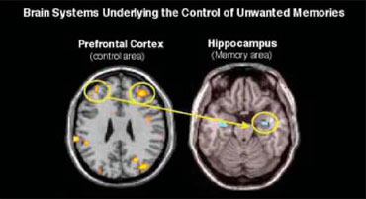
Supression of unpleasant memories
While study subjects tried to suppress memories, the prefrontal cortex became more active and the hippocampus became less active
Anderson et al., Science 2005

Slide 57
Makroarhitektura spoznajnih procesa
(razina velikih populacija neurona – mreža)
Struktura - DTI
Funkcija -
fMRI (trMRI, rsMRI, fcMRI - DMN)
SPECT/PET
MEG, MEG + fMRI
Th perspektive: TMS (spTMS & rTMS) vs TES (tDCS, tRNS, tACS)
Mikroarhitektura spoznajnih procesa
Elektrofiziološko snimanje aktivnosti pojedinačnih neurona mikroelektrodama

Slide 58
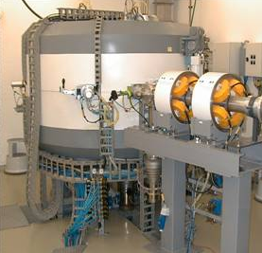
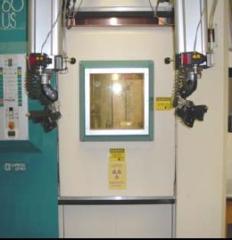
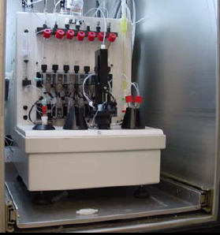
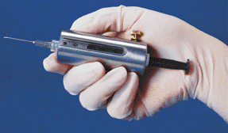
PET je najskuplja i najsloženija metoda oslikavanja
Produkcija radionuklida u ciklotronu
Transport u “vruću stanicu”
Sinteza radiofarmaka
Sterilizacija
Isporuka doze

Slide 59
Konvencionalni PET radionuklidi
¹⁵O
¹³N
¹¹С
¹⁸F
2,04 min
9,96 min
20,4 min
109,8 min
Jedino ¹⁸F-radiofarmaci mogu biti transportirani na veće udaljenosti od proizvodnog pogona (ciklotrona)
96.9% β⁺
E_{max} 0.635 MeV

Slide 60
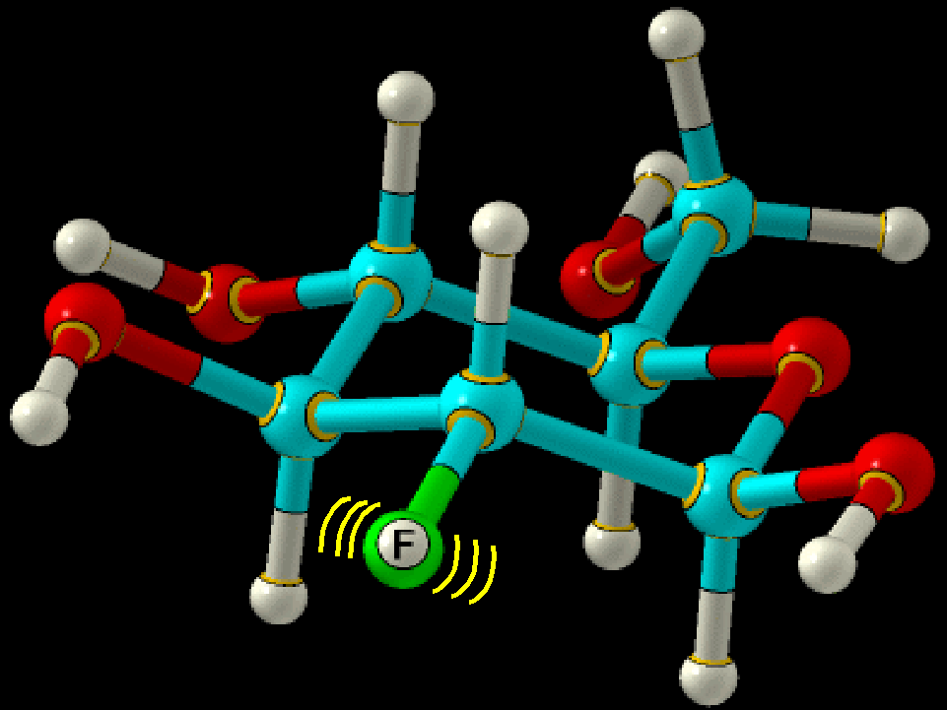
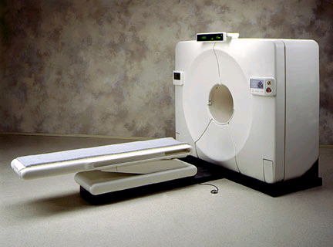
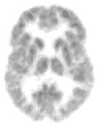
PET
c
⁻
511 keV
¹⁸F
e⁺
⁺
p
e⁻
511 keV
c
¹⁸F zbog beta raspada emitira pozitrone (e⁺ ) koji obično do anihilacije s e⁻ putuju manje od 1 mm) -> ¹⁸O + e⁺ + E (635 keV)

Slide 61
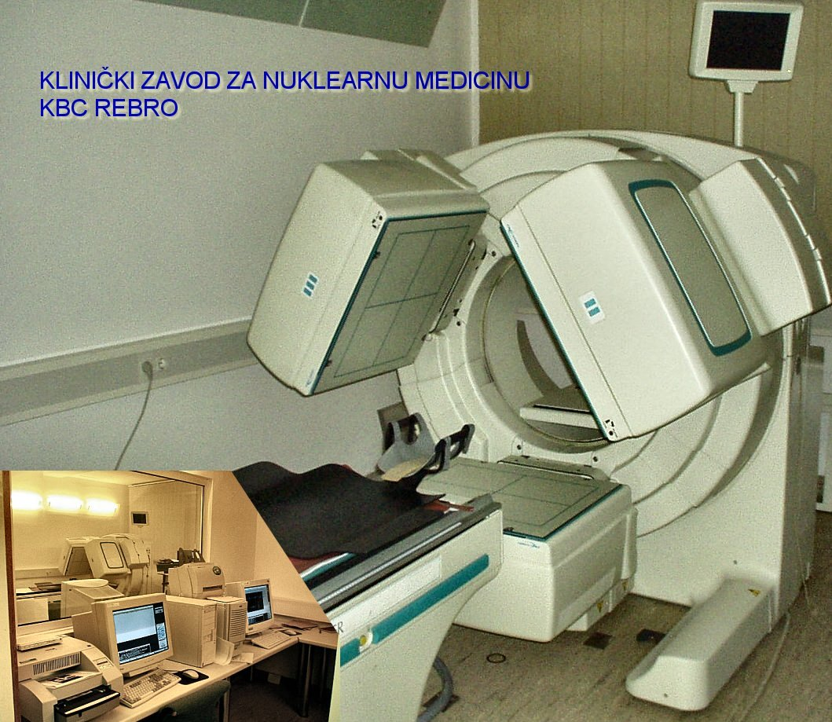
SPECT
Single Photon Emission Computerised Tomography
prikaz regionalnog cerebralnog protoka
^{99-m}Tc-HMPAO - radiofarmak “prvog prolaza”
korelira s regionalnom neuronalnom aktivnošću
relativno jeftin i dobavljiv
ALI
  nije moguća kvantitativna analiza

Slide 62
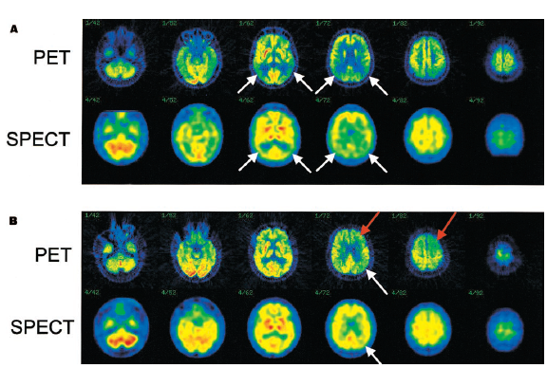
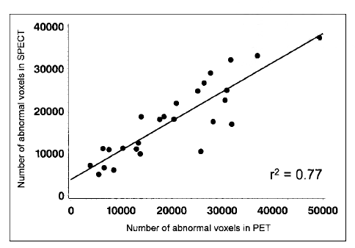
Usporedba PET-a
i SPECT-a

Slide 63
PET vs SPECT
Bolja rezolucija
Biološki korisni izotopi
  ¹¹C, ¹³N, ¹⁵O, ¹⁸F
Kvantitativan (b⁺)
Kratko poluvrijeme raspada T_{1/2}
Vrlo skup
Ciklotron
Slabija rezolucija
Kompleksne i velike molekule
Manje kvantitativan
Duže poluvrijeme raspada
Lako dobavljiv
Ne tako skup
Nepotrebna posebna oprema za produkciju izotopa

Slide 64
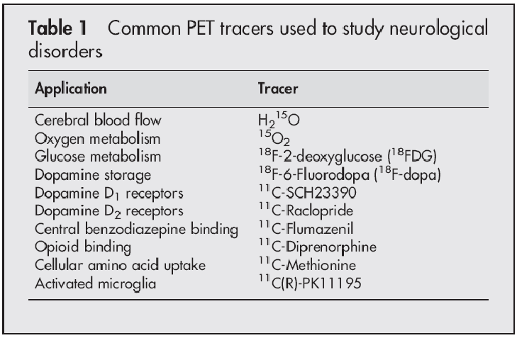
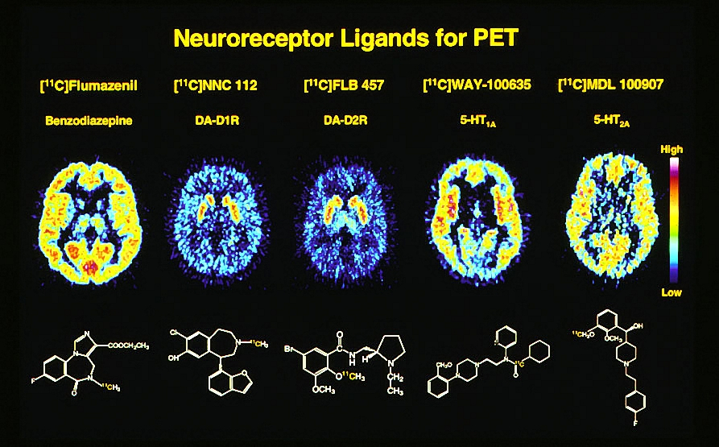
>85 molekula prikladna za SPECT scintigrafije
i
>170 molekula prikladnih za scintigrafije PET-om

Slide 65
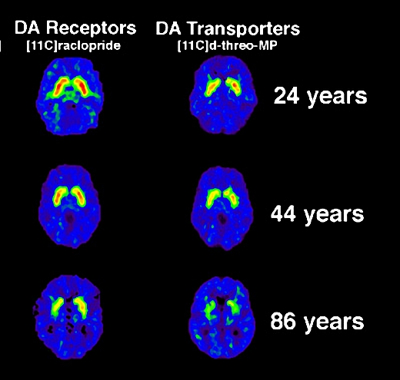
PET – dopaminergički receptori - smanjenje izraženosti tijekom starenja

Slide 66
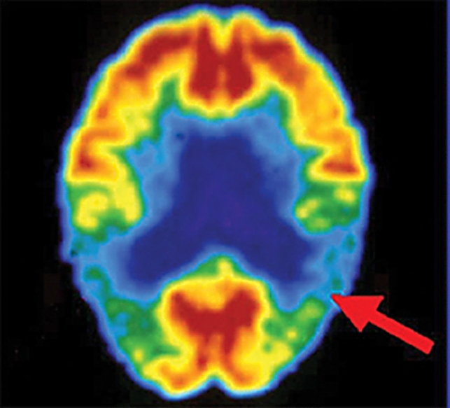
PET, 18F-FDG
Tipičan nalaz kod Alheimerove bolesti – parijetotemporalni hipometabolizam

Slide 67
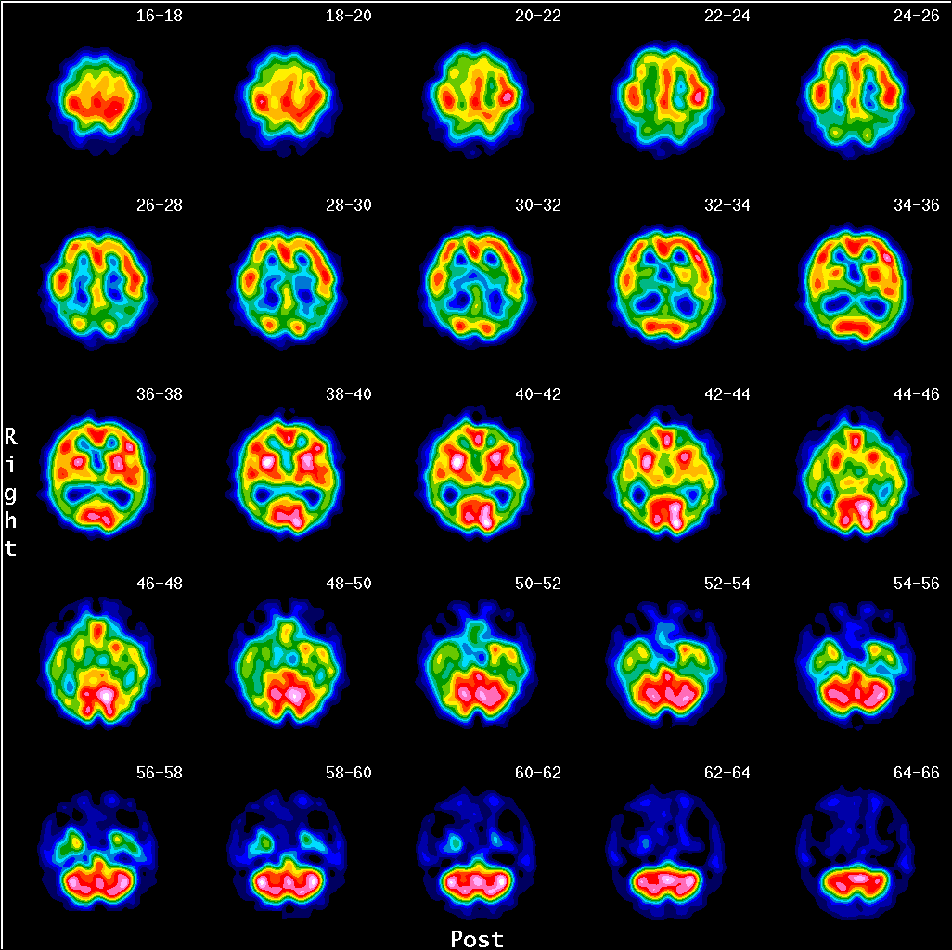

Slide 68
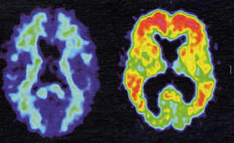
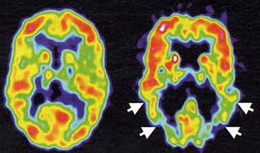
Uredan AD
PET - Pittsburgh Compound-B (PIB), omogućava kvanitativnu procjenu depozita amiloida
PET - FDG
PET - PIB
Klunk et al., Lancet Neurol. 2004

Slide 69
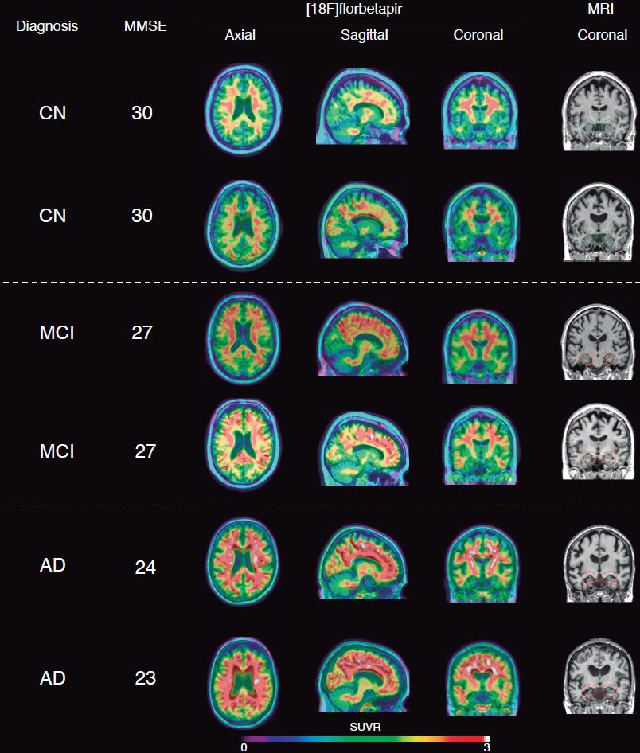
Leuzy et al., Transl. Neurosci., 2014

Slide 70
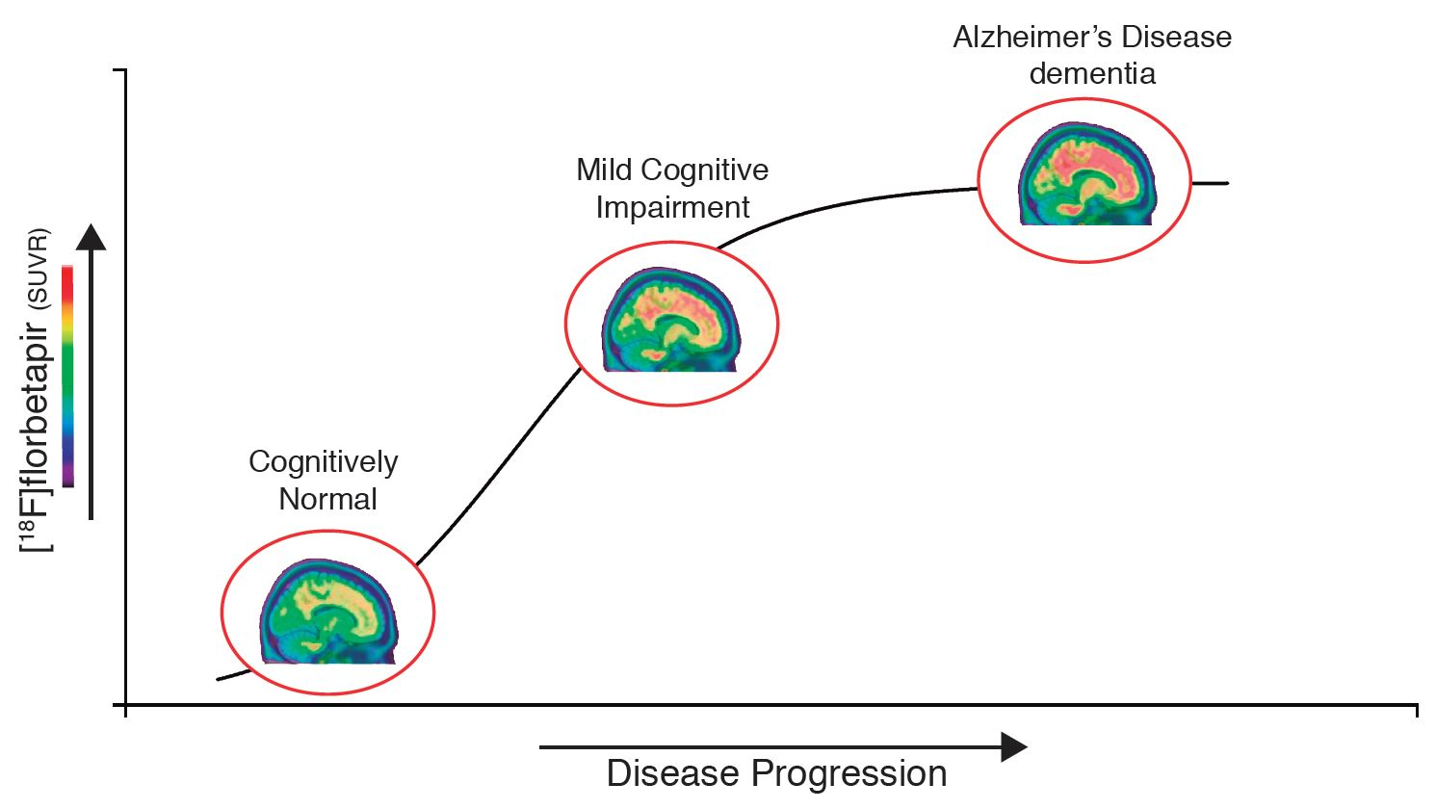
Leuzy et al., Transl. Neurosci., 2014

Slide 71
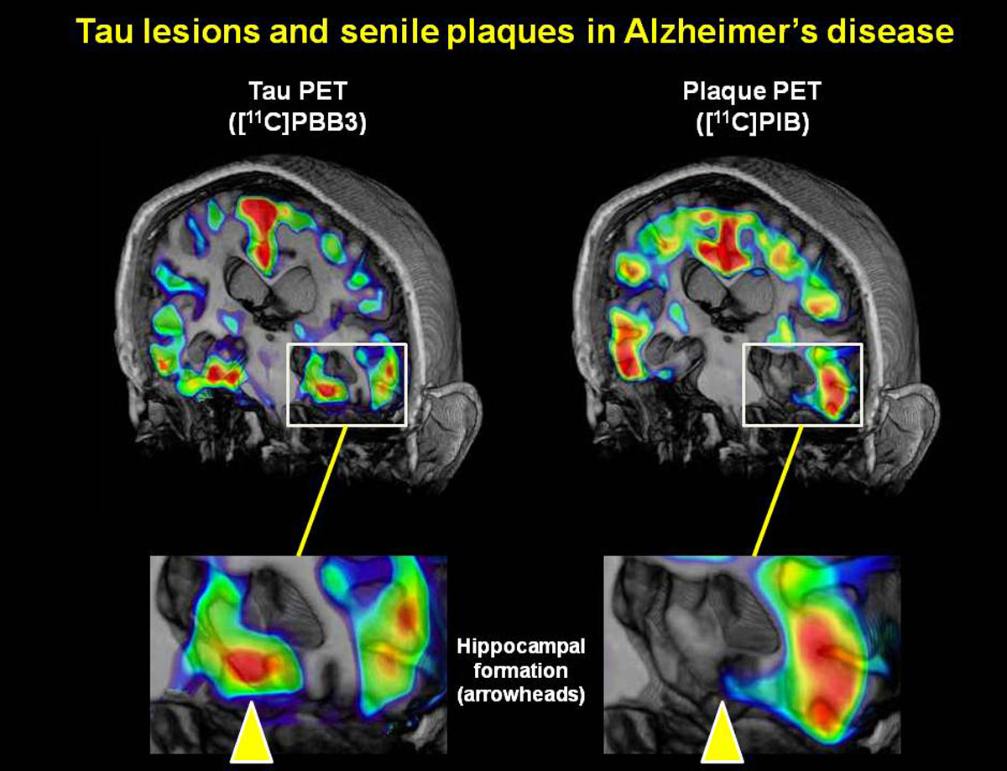

Slide 72
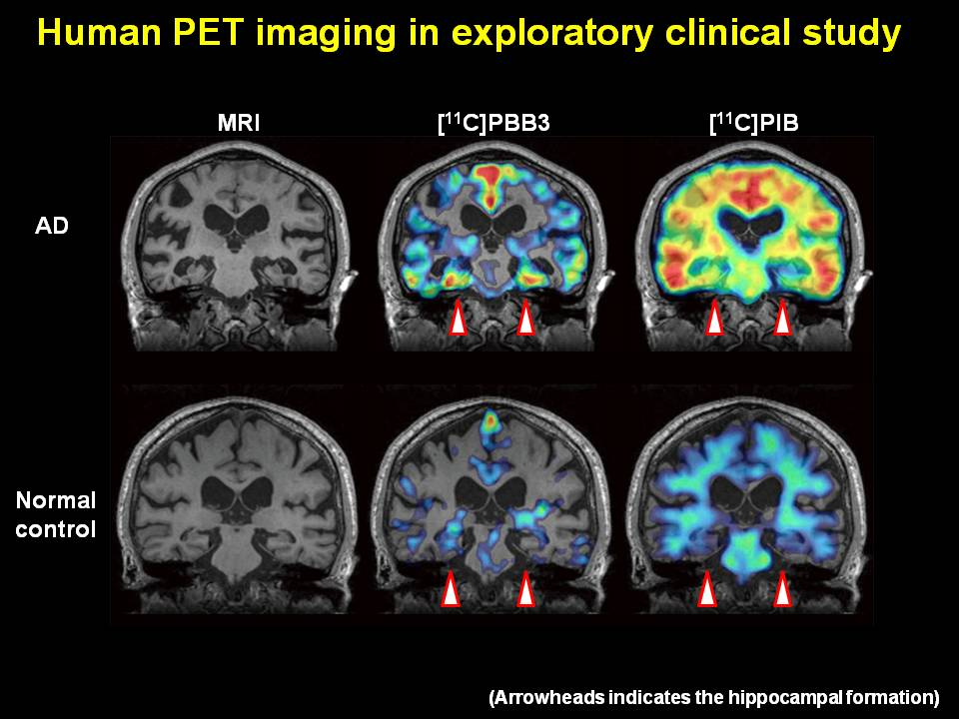

Slide 73
Cortical hubs and β-amyloid deposition overlap (cont.)
PCC
PCC
Buckner et al., J. Neurosci., 2009, 29, 1860-1873

Slide 75
Makroarhitektura spoznajnih procesa
(razina velikih populacija neurona – mreža)
Struktura - DTI
Funkcija -
fMRI (trMRI, rsMRI, fcMRI - DMN)
SPECT/PET
MEG, MEG + fMRI
Th perspektive: TMS (spTMS & rTMS) vs TES (tDCS, tRNS, tACS)
Mikroarhitektura spoznajnih procesa
Elektrofiziološko snimanje aktivnosti pojedinačnih neurona mikroelektrodama

Slide 76
MEG
Mjeri vrijednosti bilijuntog dijela magnetskog polja zemlje (zato je potrebna posebna soba s trostrukim vratima obloženim aluminijem i molibdenom, te da se spriječi interferencija radio valova)
Squid senzori su uronjeni u tekući dušik na -269 stupnjeva, gdje je impedancija tako mala da mogu detektirati magnetna polja svega nekoliko neurona na udaljenosti od nekoliko cm

Slide 77
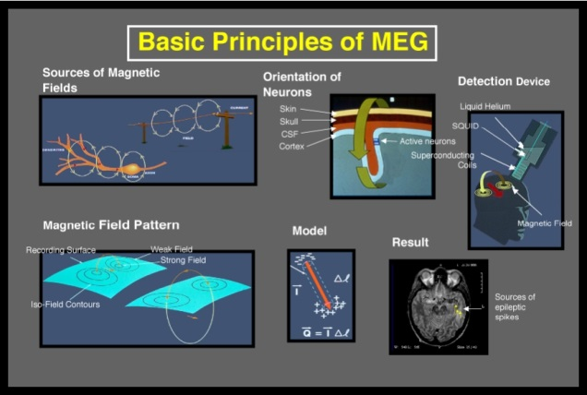

Slide 78




Slide 79



102 senzorska elementa x 3 kanala = 306 individualnih kanala

Slide 80
















Mreža prepoznavanja objekata i lica
2 epicentra: lateralna temporalna i temporopolarna moždana kora
ŽIVOTINJE
ALATI
LICA
EGO
LH čita „H”
DH čita „S”
V4
“GDJE” put
R
R
V3
V2
ALLO
V5
R
BA37 i 20 (prednji i srednji dio fuziformne vijuge – percepcija objekata i lica), granica BA19 i BA37 – percepcija Riječi
“ŠTO” put
30 mil. y.
Vidna integracija je stupnjevit proces: nepoznata lica aktiviraju samo unimodalne areje u i oko fuziformnog girusa, dok poznata aktiviraju i transmodalna područja, napose u prednjem dijelu srednjeg sljepooč. girusa (TBI, AD, CVI)
(hemi)akromatopsija (clV4), anomija za boje,
(hemi)akinetopsija (clV5)
vidna objektna agnozija (D), čista aleksija –
vidno prepoznavanje riječi (L)
deficit vidne integracije (D) – Hooperov test
asocijativna prozopagnozija (D)
diskonekcijski sindromi: vidna amnezija (L), vidna
hipoemocionalnost (D), Capgras sy (D): ”ova mačka izgleda baš kao i moja”
„ti si dvojnik moga prijatelja”
Fregoli sy

Slide 81










Mreža prostorne pozornosti
3 epicentra: u dorzoparijetalni BA5 i 7 (stvara privremene reprezentacije lokacija u prostoru), FEF (kontrolira konjugiranje pokrete očiju) i g. cinguli - ACC (raspodjeljuje pozornost s obzirom na motivaciju – prije usmjeravanja pozornosti ili posezanja rukom treba odlučiti je li objekt uopće vrijedan pozornosti)
EGO
ALLO
simultagnozija
nemogućnost percepcije vidnog polja kao cjeline(D)
→ sy jednostrane nepozornosti (D),
→ sy jednostranog zanemarivanja (D)
→ aperceptivna prozopagnozija (deficit
prostorne integracije vidnog podražaja) (D)
→ sy Balint (simultagnozija, nemogućnost fiksacije (okularna apraksija),
nemogućnost posezanja rukom prema objektima (opt. ataksija) (D)
→ astatognozija (gubitak osjećaja položaja dijelova tijela u prostoru (D)
→ = asomatognosia (D 7:1)
→ sy Gerstmann: agnozija prstiju, dezorijentacija
lijevo-desno, disgrafija (uz sačuvanu mogućnost
kopiranja napisanih riječi), diskalkulija, BA39 (L)
SM
A
G

Slide 82

Mreža prostorne pozornosti
3 epicentra: u dorzoparijetalni BA5 i 7 (stvara privremene reprezentacije lokacija u prostoru), FEF (kontrolira konjugiranje pokrete očiju) i g. cinguli - ACC (raspodjeljuje pozornost s obzirom na motivaciju – prije usmjeravanja pozornosti ili posezanja rukom treba odlučiti je li objekt uopće vrijedan pozornosti)
EGO
ALLO
simultagnozija
nemogućnost percepcije vidnog polja kao cjeline(D)
→ sy jednostrane nepozornosti (D),
→ sy jednostranog zanemarivanja (D)
→ aperceptivna prozopagnozija (deficit
prostorne integracije vidnog podražaja) (D)
→ sy Balint (simultagnozija, nemogućnost fiksacije (okularna apraksija),
nemogućnost posezanja rukom prema objektima (opt. ataksija) (D)
→ astatognozija (gubitak osjećaja položaja dijelova tijela u prostoru (D)
→ = asomatognosia (D 7:1)
→ sy Gerstmann: agnozija prstiju, dezorijentacija
lijevo-desno, disgrafija (uz sačuvanu mogućnost
kopiranja napisanih riječi), diskalkulija, BA39 (L)
SM
A
G

Slide 83



Mreža jezičnih sposobnosti
2 epicentra: Wernicke i Broca područje (L)
Wernicke (BA22 & parts of BA21, 39 & 40) koordinira interakcije između osjetnih reprezent. riječi i simboličkih asocijacija koje im daju značenje (razumijevanje)
STRAŽNJA/ FLUENT/ TEČNA AFAZIJA
Broca područje (BA44 i dijelovi BA45-47) specijalizirano je za artikulatorne (fonetičke) i gramatičke (sintaktičke) aspekte jezika (morfosintaksu) PREDNJA/NON-FLUENT/NE-TEČNA AFAZIJA
fa
Globalna afazija: CVI MCA (L)
- Sve kombinacije simptoma B/W afazije
- Slabo ponavljanje rečenica
B
W
Anomička afazija (9-11% AD)
- Oštećenje u području temp.-parijet. Spoja (SD) i
angularnog girusa (L)
- Otežano pronalaženje riječi (naročito imenica)
→ osjetna disprozodija (D)
→ čista aleksija (L)
→ čista gluhoća za riječi (L)
→ agrafestezija (somatosenzorna aleksija (L)
→ afemija
ideomotor, visual & tactile apraxia (BA6 dysconnection) (L)
akinetic mutism (bilateral)
semantička demencija (temporoparijetalni spoj)
Kondukcijska (provodna) afazija
- Ošt. parijetalnog operkuluma u kojem se nalazi f.a.
ili inzule i bijele tvari supramarg. girusa (L)
- Slabo ponavljanje rečenica, parafazije s
nemogućnošću pronalaženja pravih riječi
Transkortikalna motorna afazija
- „Watershed” CVI ispred ili iznad B ili WM ispod B
- Otežano započinjanje i usporen govor
- Sačuvano ponavljanje rečenica
„Watershed” područja – ishemija i nekroza na mjestima koja su najdalje od art. opskrbe (sistemska hipoperfuzija)
Transkortikalna osjetna afazija
- Isto „watershed” infarkt ali straga angularni g. ili iza
- Slabo razumijevanje, neologizmi
- Sačuvano ponavljanje rečenica (moguća eholalija)

Slide 84






Mreža epizodičkog
deklarativnog pamćenja
2
3
1

Slide 85


Mreža emocija, osjećaja i raspoloženja
a) fear conditioning
b) instructed fear
c) observational fear learning
Three different ways by which humans can learn about the aversive
properties of an event. In all of them the activation of amygdala is seen.
Le Doux JE (2000) Emotion circuits in the brain. Annu Rev Neurosci 24: 155-184; Gazzaniga et al., 2002.

Slide 86







Network for executive f-ons and control of behavior
mPFC
Epicentres in dorsolat. prefront. (working memory - representing, maintaining and manipulating information, executive f-ons, attention) (Wisconsin card-sorting, Stroop tests), medial frontal („theory of mind”) & orbitofront. cx (our “social” brain, “learned control over inner drives”)
Working memory provides recall of previous experience, even in absence of sensory stimuli (apstract thinking, subjective reality), mediating planning of actions with respect to time and space
dd FA: depression (pseudodementia)
dd FD: mania
FA
DLPFC
FD
OFC
Frontal Abulia (in general): lack of creativity, curiousity, initiative, planning, decision making based on risks, understanding of a context, mental flexibility (change of focus), etc. (more lateralized to the LEFT)(Tranel et al., 2005, Brain; signif. gender differences)
Frontal Dysinhibition (in general): dramatic impulsiveness with concurrent loss of emotional judgement, insight, lack of empathy, capability to delay fulfillment of immediate wishes, personality changes etc.) (BILATERAL)
‘high-functioning’ autism, sy Asperger (language o.k.)
autism (impaired social interaction, lack of empathy, inability to change roles, lack of imagery)

Slide 87



Spatiotemporal dynamics of word processing in the human cortex (fMRI + MEG)
Marinkovic K, Neuroscientist, 2004

Slide 88


Spatiotemporal dynamics of word processing in the human cortex (MEG + fMRI + ERP)
Marinkovic K, Neuroscientist, 2004

Slide 89
Makroarhitektura spoznajnih procesa
(razina velikih populacija neurona – mreža)
Struktura - DTI
Funkcija -
fMRI (trMRI, rsMRI, fcMRI - DMN)
SPECT/PET
MEG, MEG + fMRI
Th perspektive: TMS (spTMS & rTMS) vs TES (tDCS, tRNS, tACS)
Mikroarhitektura spoznajnih procesa
Elektrofiziološko snimanje aktivnosti pojedinačnih neurona mikroelektrodama

Slide 90

TMS vs TES
TMS – ‘ virtual’ impairment – magnetna zavojnica se stavi iznad područja od interesa
Single Pulse (spTMS) / Repetitive (rTMS) više frekvencije povećavaju aktivnost neurona, niže smanjuju
TES – bolja od TMS jer 1) ispitanik ne može razlikovati stvarnu od lažne stimulacije
Obično 1-2 mA (puno manje od TMS – zato je i 2) opasnost od EPI puno manja!), elektrode 25-35 cm², stimulacija traje oko 20 min, bezbolna je i sigurna;ne preporučuje ponovljati dok ne prođe 2-7 dana
tDCS: struja prolazi kroz kalvariju i lubanjske kosti, a u zavisnosti kako se postave elektrode može biti: ANODNA (struja ulazi u mozak i 3)
izaziva depolarizaciju/pojačava podražljivost i skoro uvijek pospješuje izvođenje zadataka,
promjene traju najmanje još 1 h nakon stimulacije
KATODNA (struja ‘izlazi’ iz mozga i vraća se u elektrodu
izaziva hiperpolarizaciju/smanjuje podražljivost – najčešće kvari izvođenje zadataka
još i Random Noise (tRNS) / Alternating Current (tACS)
Nuspojave: fosfeni

Slide 91

TMS Coil
Naeser et al. (2004), Fig 2, p 100
Maximum magnetic
field is at the center
of figure „8”

Slide 92


rTMS
Tegenthoff M, Ragert P, Pleger B, Schwenkreis P, Forster AF, et al. (2005) Improvement of tactile discrimination performance and enlargement of cortical somatosensory maps after 5 Hz rTMS. PLoS Biol 3(11): e362

Slide 93




tDCS

Slide 94

Typical design

Slide 95
Makroarhitektura spoznajnih procesa
(razina velikih populacija neurona – mreža)
Struktura - DTI
Funkcija -
fMRI (trMRI, rsMRI, fcMRI - DMN)
SPECT/PET
MEG, MEG + fMRI
Th perspektive: TMS (spTMS & rTMS) vs TES (tDCS, tRNS, tACS)
Mikroarhitektura spoznajnih procesa
Elektrofiziološko snimanje aktivnosti pojedinačnih neurona mikroelektrodama

Slide 96

Nobel Prize ceremony / Ceremonija dodjele Nobelove nagrade

Slide 97
O'Keefe, J., and Dostrovsky, J. (1971) The hippocampus as a spatial map. Preliminary evidence from unit activity in the freely‐moving rat. Brain Research 34, 171‐175.
Place cells maintain a „cognitive map of known locations” in rodents, and episodic memory in humans.
Hafting, T., Fyhn, M., Molden, S., Moser, M.B., and Moser, E.I. (2005) Microstructure of spatial map in the entorhinal cortex. Nature 436, 801‐806.

Slide 99



Okulodominantne kolumne
NN - 1981 Hubel & Wiesel / Sperry
Hubel D.H. and Wiesel T.N. (1969) Anatomical demonstration of columns in the monkey striate cortex. Nature, 221: 747–750.

Slide 100

Orijentacijske kolumne
Hubel & Wiesel 1959, 1962
Hubel, D. H.; Wiesel, T. N. (1959) Receptive fields of single neurons in the cat’s striate cortex. J. Physiol. 148: 574-591
Hubel, D. H.; Wiesel, T. N. (1962) Receptive fields, binocular interaction and functional architecture in the cat’s visual cortex. J. Physiol. 160:106-154
Bonhoeffer, T., and Grinvald, A. (1991) Iso-orientation domains in cat visual cortex are arranged in pinwheel-like patterns. Nature, 353, 429–431.

Slide 101

Promjene sinaptičke učinkovitosti sinapsi HF
1949. Hebb: hipoteza dvostrukog traga
1973. Bliss i Lomo: LTP (vanilija)
+ čokolada (Llinas, 1991)
+ NO. volumna transmisija (Dawson, 1991)

Slide 102





Uloga NMDA receptora u LTP
NMDA receptor se ponaša kao detektor spregnutog djelovanja (asocijativnost), jer za indukciju LTP zahtijeva:
vezanje za receptorno mjesto (specifičnost) i
prethodnu ili istovremenu depolarizaciju postsinaptičke membrane (da bi se odstranili ioni Mg2+) (kooperativnost)
retrogradni difuzibilni signal (NO) omogućuje potencijaciju susjednih sinapsi
Long-term potentiation in the hippocampus involves activation on N-methyl-D-aspartate receptors. Harris EW, Ganong AH, Cotman CW (1984) Brain Res. 323: 132-137.

Slide 103


Dokaz uloge LTP u učenju
Injiciranje antagonista NMDA receptora
(2-amino-5-fosfonovalerične kiseline):
  spriječava nastanak LTP u bloku (lameli) hipokampalnog tkiva,
  sprječava učenje na razini ponašanja (Morrisov test pronalaženja platforme uronjene u vodi)
- oba učinka razmjerna su dozi
Morris R. (1984) Developments of a water-maze procedure for studying spatial learning in the rat. Brain Res. 11: 47-60.

Slide 104

Hidden object goal test
Test skrivenog objekta

Slide 105


Koliko je vremena potrebno za trajno zapamćivanje?
Nakon stjecanja iskustva za konsolidaciju zapamćenog potrebno je 6-8 tjedana (Squire, Zola-Morgan i Amaral, 1988-1992)
Σ HF: 1. Povezuje informacije iz različitih područja Cx za vrijeme učenja, 2. Nakon razdoblja od 6-8 tjedana konsolidira navedene informacije u neokorteks tako da postaju dostupne i neovisno od HF
Saletin JM, Walker MP (2012) Nocturnal mnemonics: sleep and hippocampal memory processing. Front. Neurol. 10.3389/fneur.2012.00059

Slide 106


Fiziološki ritmovi HF i hipoteza učenja u 2 koraka
1. Korak: “istraži i iskusi” theta ritam
2. Korak: “odmori se i konsolidiraj” oštri valovi
hipokampalna ‘kompresija vremena’
Svojstva CA3/CA1 mreže:
- učenje iz jednog pokušaja
- generalizacija
- otpornost na šum
Buzsáki György lab (300 refs.)

Slide 107





Predilection site for NFD is not only transentorhinal cx but also some brainstem nuclei in „pre-tangle” stage of NFD from where spreading of NFC occur in AD
AT8 ICC
ST DRN
AT8 ICC
AT8 > AD2 > MN423
AT8 ICC

Slide 108
CA1
Firing rate maps
mEC
Place cell firing patterns can be modelled as the thresholded sum of BVC inputs. BVC are found in in subiculum, parasubiculum and mEC: they fire at a specific distance and direction from environmental boundaries
+ head-direction cells
+ cells that encode object locations …
Bush D, Barry C, Burghess N (2014) What do grid cells contribute to place cell firing? Trends Neurosci. 37: 136-145

Slide 109
Čimbenici koji utječu na okidanje stanica koje pamte mjesta
Deformacija poznate okoline
Postavljanje nove granice u poznatoj okolini (ista stanica sada reprezentira (kodira) za dva mjesta
Rotacija distalnog vidnog orijentira (crna linija) u inače simetričnoj okolini
Although approximately 90% of principal cells in the dorsal hippocampus can exhibit place fields, only 15–50% do so in any given environment
Rate remapping
Global remapping
Minor manipulations of environmental features may modulate the firing rate of active place cells, particularly in CA3 (‘rate remapping’), whereas larger manipulations of the environment can change the entire ensemble of active place cells and their firing locations (‘global remapping’)
Bush D, Barry C, Burghess N (2014) What do grid cells contribute to place cell firing? Trends Neurosci. 37: 136-145

Slide 110
Kako stanice mreže (grid cells) utječu na okidanje stanica koje pamte mjesta?
Place cell spatial firing patterns are determined by environmental sensory inputs, including those representing the distance and direction to environmental boundaries (BVC)
Grid cells provide a complementary self-motion related input that contributes to maintaining place cell firing: In this view, grid and place cell firing patterns are not successive stages of a processing hierarchy, but complementary and interacting representations that work in combination to support the reliable coding of large-scale space.
Inferotemporal visual stream: epizodičko deklarativno pamćenje razvilo se iz neurona koji pamte prostor i objekte (300 ms - konceptni neuroni neosjetljivi su na male razlike u izgledu podražaja, za razliku od V1, V2, etc. neurona koji su osjetljiviji i na male razlike).

Slide 111
Konceptni neuroni
Quian Quaroga R. (2012) Concept cells: the building blocks of declarative memory functions. Nat. Rev. Neurosci. 13: 587-597

Slide 112
Attractor dynamics of concept neurons from a few visual cues
by the activation of a network representing a given concept
Quian Quaroga R. (2012) Concept cells: the building blocks of declarative memory functions. Nat. Rev. Neurosci. 13: 587-597

Slide 113
Striking similarities between place cells in the rodent hippocampus and concept neurons in MTL of humans:
1. Both are very selective and fire to their preferred stimulus (place field / concept)
2. Place cells give an explicit representation of the environment that allows an accurate prediction of the animal’s location, similar to the explicit representation of concepts by human MTL neurons that allow the prediction of the stimulus seen
3. Both place and concept cells show attractor dynamics: their firing changes abruptly when environmental shapes are changed incrementally, which resembles all‑or‑none responses of human MTL neurons that dramatically change their firing upon picture recognition and could set up on an attractor (by the activation of a network representing a given concept) from a few visual cues
4. Place cells maintain their tuning after the light is turned off — that is, their firing can be triggered in the absence of visual information — just like the firing of concept cells can be elicited by imagery, internal thoughts or recall
5. Place cells can be formed within minutes, and concept cells can also encode new concepts and associations relatively quickly (for example, in one study, MTL cells responded to researchers the patient did not know a couple of days before the experiment took place)
6. In the rat hippocampus neighbouring neurons do not necessarily have neighbouring place fields; it is common to find that neighbouring concept neurons — the activities of which could be separated after spike sorting — respond to completely unrelated things (for example, Halle Berry and Mother Teresa)

Slide 114
Mental imagery mechanisms are similar to those used during visual perception
Recording from single neurons in the human medial temporal lobe were made while the subjects were asked to imagine previously viewed images. Single neurons in the hippocampus, amygdala, entorhinal cortex and parahippocampal gyrus that selectively altered their firing rates depending on the stimulus the subjects were imagining. Of the neurons that fired selectively during both vision and imagery, the majority (88%) had identical selectivity, suggesting a common substrate for the processing of incoming visual information and visual recall.
Krieman G, Koch C, Fried I (2000) Imagery neurons in the human brain, Nature, 408: 357-360.

Slide 115

Peg system / Memory palace
"Govoreći sam sa sobom -1. Lingula (asocijacija na jezik – lingua), počnem hodati iz centra grada -2. Lobulus centralis, prema Sljemenu - 3. Culmen, a zatim se spustim nizbrdo - 4. Declive, putem uzmem u ruku list - 5. Folium, u njega zamotam krumpir - 6. Tuber, te ga stavim na piramidu - 7. Pyramis, pa sve zajedno zamotam u maramicu i na njezinoj resici - 8. Uvula, zavežem čvor - 9. Nodulus".

Slide 116
Hvala na pozornosti!
Pitanja?

