Slide 2
Cholinergic system
Simplified schematics of the major cholinergic projections in the human brain

Slide 3
Cholinergic system
Based on the topographical distribution of ChAT-ir bodies in the rhesus macaque brain, a nomenclature proposed by Mesulam and colleagues was proposed in 1983. Although the human NBM is much larger and more complex, the same terminology has been adopted for human brain

Slide 4
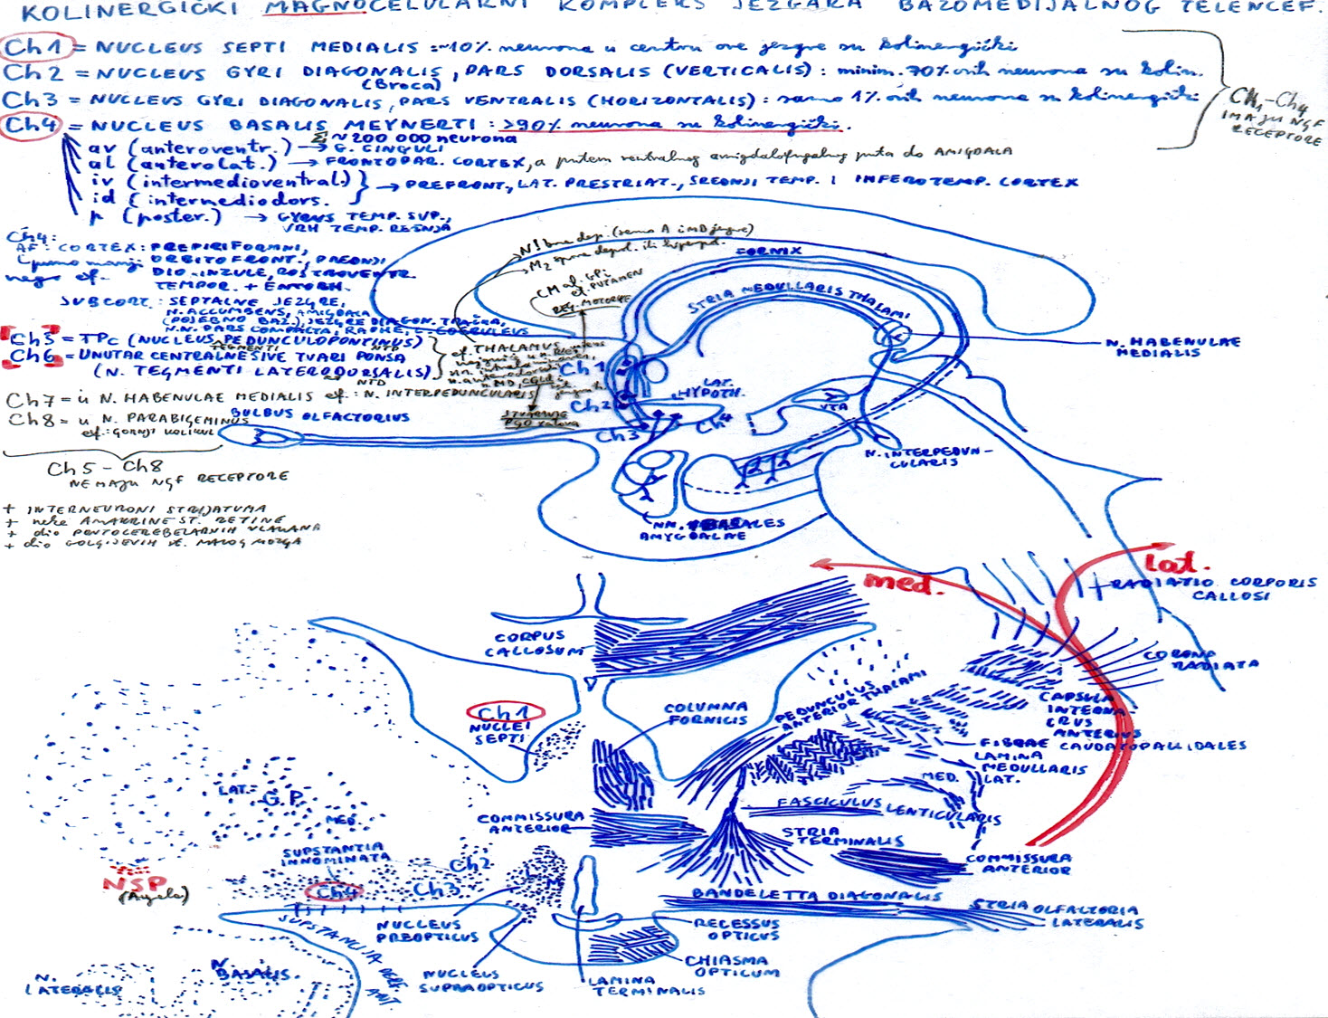

Slide 5
Basal telencephalon and basal nucleus
Theodor Meynert was first to analyze human basal forebrain in 1872, when he also described the nucleus of ansae lenticularis.
The eponym n. basalis of Meynert was given by Rudolf Albert von Kölliker in 1896. but it is a misnomer, as Meynert’s work does not exactly show this group of cells (as later shown by Mettler in 1968).
Kölliker also introduced the term "basal telencephalon" and defined cytological criteria to differentiate these neurons from others within this region: 1. to be large, 2. to be hyperchromatic (upon Nissl stain), 3. the staining to be more pronounced at the periphery of the perikaryon, 4. nuclei to be pale, and 5. nucleolus to be easily seen.
Reproduction of Meynert’s tranparent preparation of an unfixed section from his chapter in Stricker’s Handbook of histology (1872). The position of basal nucleus is denoted in the second layer "L" of the four layers of substantia innominata (labeled as SchL, L, St and Z).

Slide 6
The relatively small magnocellular group of cholinergic neurons located within the rostrolateral extension of the basal forebrain was named and described as the nucleus subputaminalis (NSP) in the human brain by Giuseppe Ayala in 1915 (Ayala G., Brain, 1915).

Slide 7
The relatively small magnocellular group of cholinergic neurons located within the rostrolateral extension of the basal forebrain was named and described as the nucleus subputaminalis (NSP) in the human brain by Giuseppe Ayala in 1915 (Ayala G., Brain, 1915).
Upon detailed analysis of the NSP in 33 normal subjects, we found the human NSP projects through the external capsule towards the inferior frontal gyrus and cingulum (it projects to amygdala too), which strongly suggests it is connected with the cortical speech area and involved in generation of P300 event-related potential (Šimić G. et al., Neuroscience, 1999).

Slide 8
The relatively small magnocellular group of cholinergic neurons located within the rostrolateral extension of the basal forebrain was named and described as the nucleus subputaminalis (NSP) in the human brain by Giuseppe Ayala in 1915 (Ayala G., Brain, 1915).
Upon detailed analysis of the NSP in 33 normal subjects, we found the human NSP projects through the external capsule towards the inferior frontal gyrus and cingulum (it projects to amygdala too), which strongly suggests it is connected with the cortical speech area and involved in generation of P300 event-related potential (Šimić G. et al., Neuroscience, 1999).
The larger size of the NSP on the left side (an observation that still needs a quantitative confirmation), the most protracted development among all magnocellular aggregations within the basal forebrain ("albino group", Kračun and Rösner, 1986) and the fact that anterointermediate and rostral parts of NSP are usually negligible or missing in monkeys (Rhaganti M.A., Šimić G., et al., 2011) indicates that these neurons are human specific.

Slide 9
The relatively small magnocellular group of cholinergic neurons located within the rostrolateral extension of the basal forebrain was named and described as the nucleus subputaminalis (NSP) in the human brain by Giuseppe Ayala in 1915 (Ayala G., Brain, 1915).
Upon detailed analysis of the NSP in 33 normal subjects, we found the human NSP projects through the external capsule towards the inferior frontal gyrus and cingulum (it projects to amygdala too), which strongly suggests it is connected with the cortical speech area and is involved in generation of P300 event-related potential (Šimić G. et al., Neuroscience, 1999).
The larger size of the NSP on the left side (an observation that still needs a quantitative confirmation), the most protracted development among all magnocellular aggregations within the basal forebrain ("albino group", Kračun and Rösner, 1986) and the fact that anterointermediate and rostral parts of NSP are usually negligible or missing in monkeys (Rhaganti M.A., Šimić G., et al., 2011) indicates that these neurons are human specific.
Recent postmortem analysis of NSP of cases presenting with primary progressive aphasia (PPA) revealed marked loss of cholinergic neurons in NSP regardless of underlying pathology, providing further evidence for the importance of NSP in language (Hamodat H. et al., Can. J. Neurol. Sci., 2019). Possible role of NSP in other neurological (variants of FTLD), neurodegenerative (AD) and psychiatric disorders (SCH) should be carefully investigated in future studies.

Slide 10
Ad. 1.
The relatively small magnocellular group of cholinergic neurons located within the rostrolateral extension of the basal forebrain was named and described as the nucleus subputaminalis (NSP) in the human brain by Giuseppe Ayala in 1915 (Ayala G., Brain, 1915).

Slide 11
Brain 1915(3-4): 433-448.

Slide 12
Brain 1915(3-4): 433-448.

Slide 13
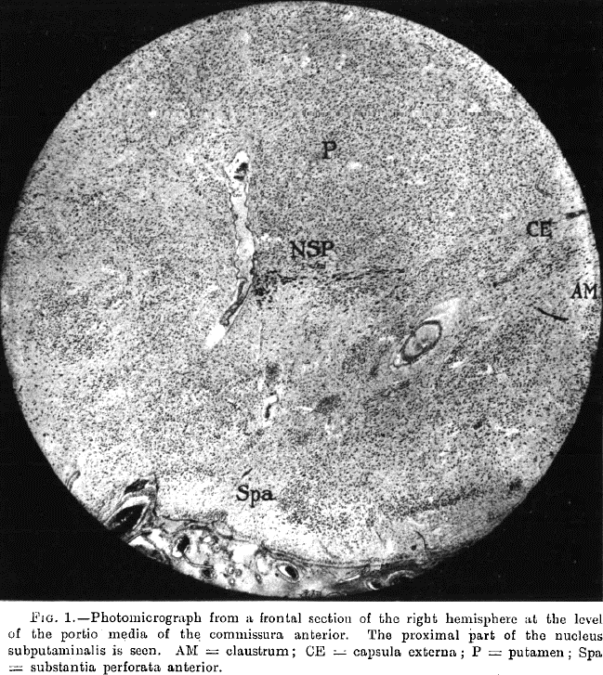
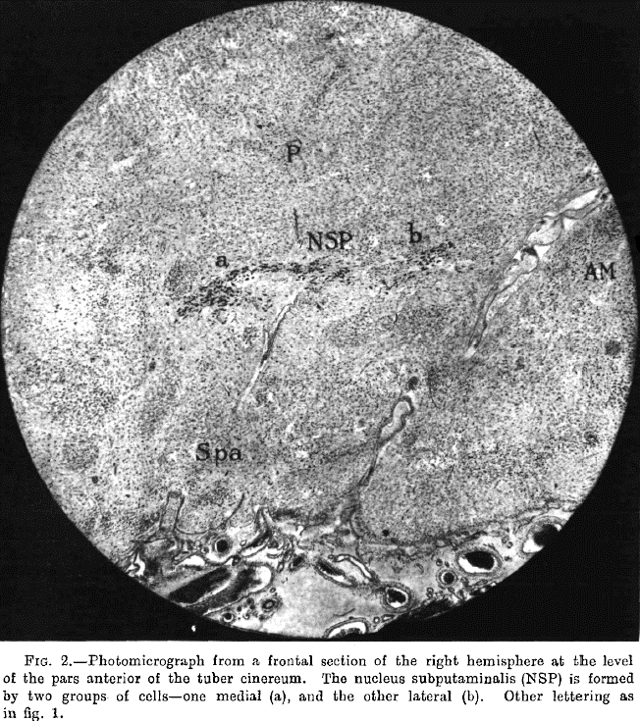

Slide 14
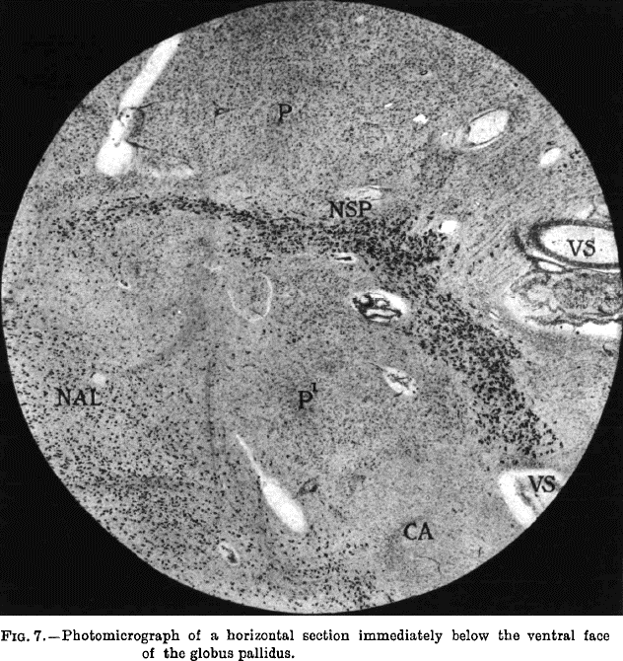

Slide 15
Ad. 2.
The relatively small magnocellular group of cholinergic neurons located within the rostrolateral extension of the basal forebrain was named and described as the nucleus subputaminalis (NSP) in the human brain by Giuseppe Ayala in 1915 (Ayala G., Brain, 1915).
Upon detailed analysis of the NSP in 33 normal subjects, we found the human NSP projects through the external capsule towards the inferior frontal gyrus and cingulum (NSP projects to amygdala too), which strongly suggests it is connected with the cortical speech area and involved in generation of P300 event-related potential (Šimić G. et al., Neuroscience, 1999).

Slide 16
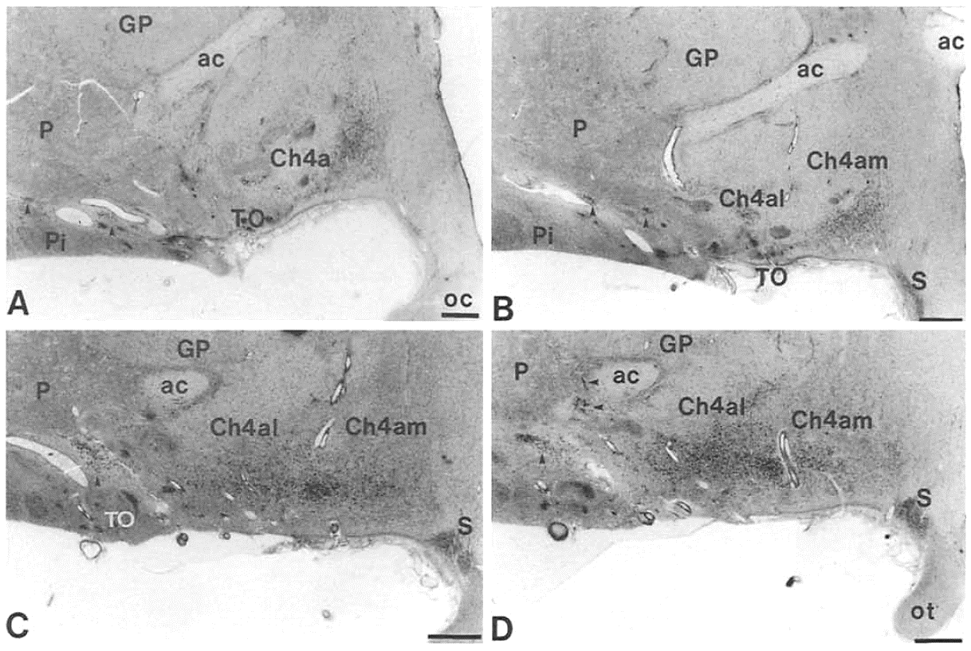
NSP at anterior (septal-chiasmatic) level (Nissl)

Slide 17
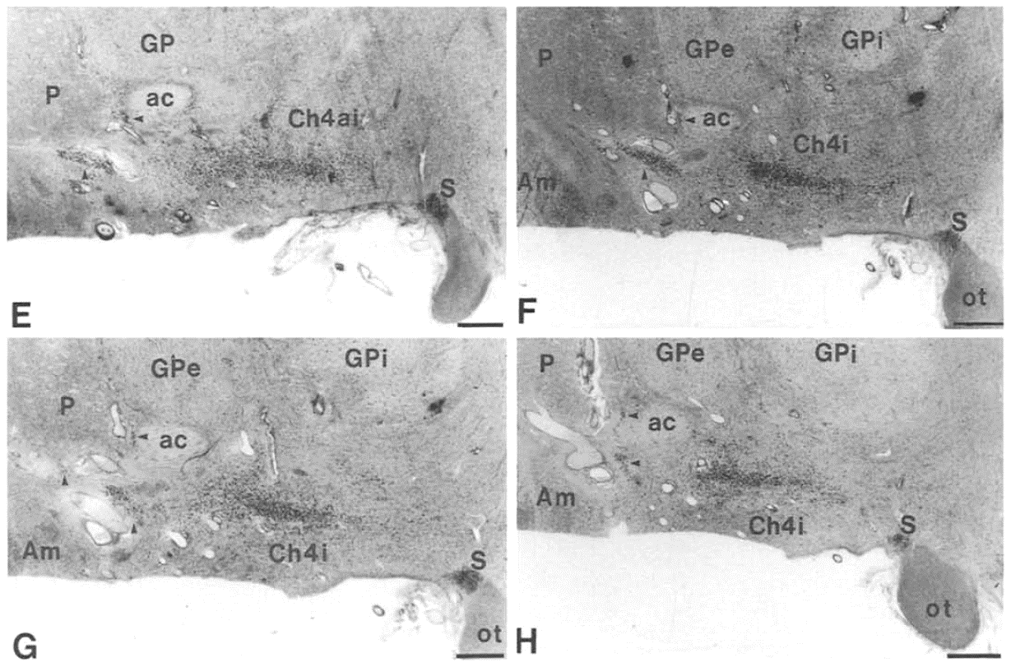
NSP at intermediate (tubero-infundibular) level

Slide 18
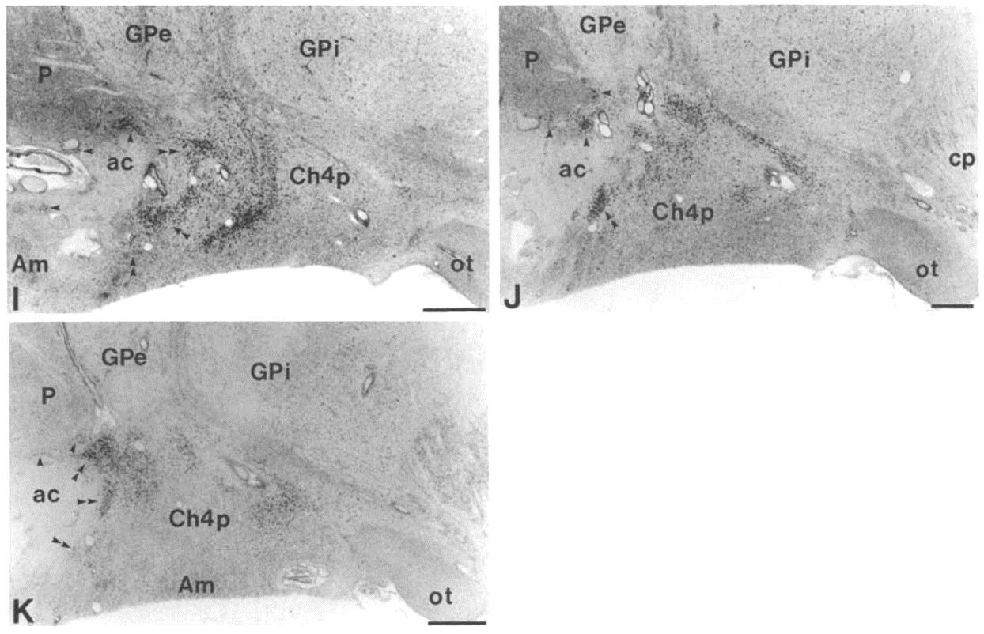
NSP at posterior (premammillary-mammillary) level (Nissl)

Slide 19
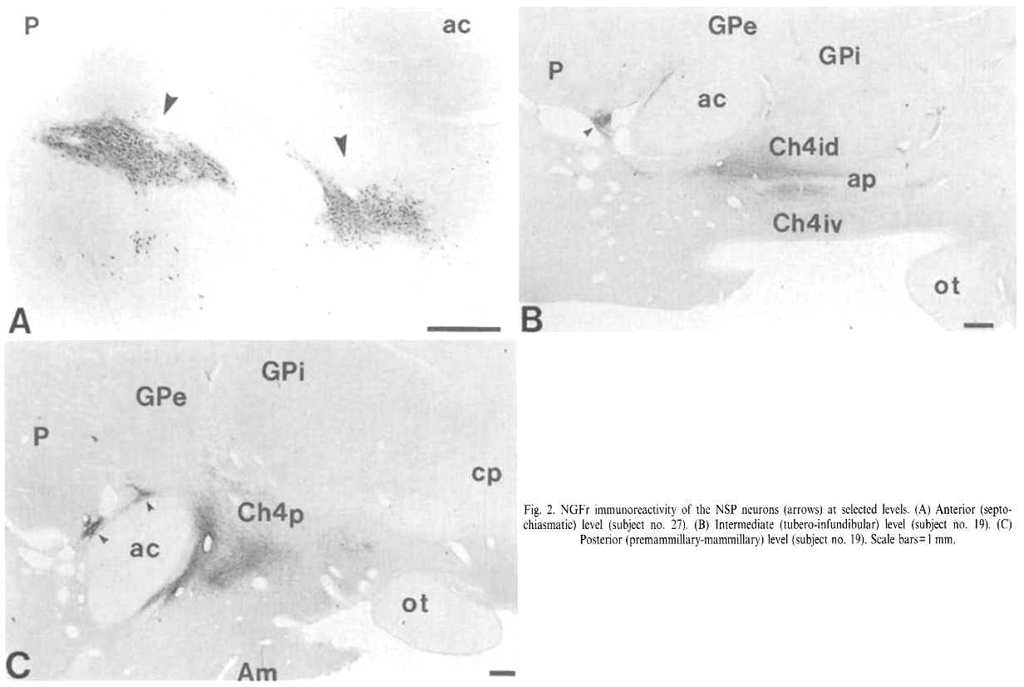
NSP at three aforesaid levels (NGFr-ir)
anterior level
intermediate level
posterior level

Slide 21
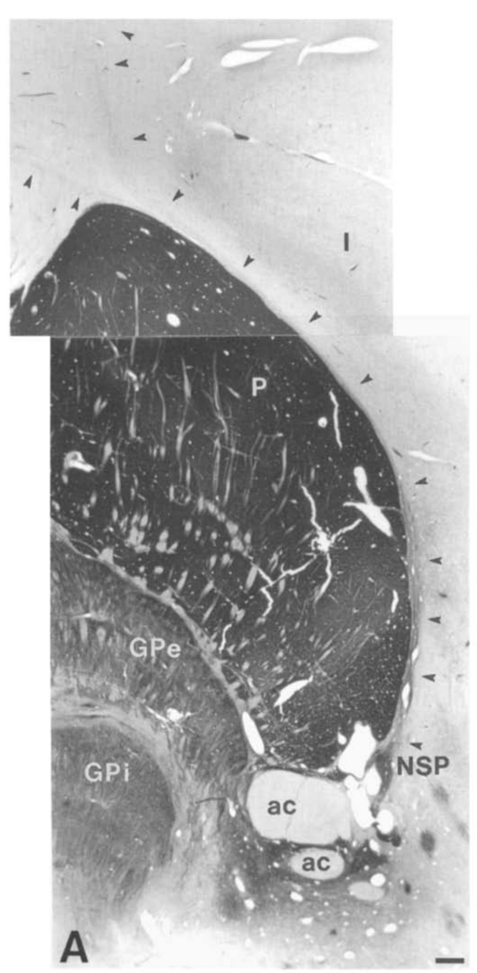
(A) Intensively labelled ChAT positive axons of the NSP at the anterointermediate level projecting towards the cerebral cortex (subject no. 23). Arrows indicate two fiber bundles ascending together through capsula externa along the lateral margin of the putamen and separating above its dorsolateral edge that innervate different regions of the cortex. A bundle with medial direction projects to the medial part of the hemisphere (cingulum), while the other one turning around the insular gyrus continues towards the inferior frontal gyrus (Šimić et al., 1999).

Slide 22
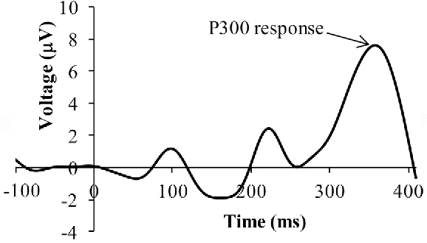
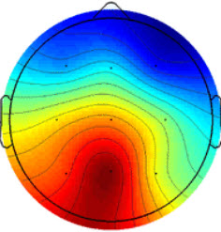
cognitive and affective processing of the stimulus
high-order perceptual processing, modulated by attention
stimulus detection
The P300 wave (P3) is a positive deflection in the human event-related potential (ERP)
It is most commonly elicited in an oddball paradigm when a subject detects an occasional "target" (novel) stimulus in a regular train of standard stimuli.
Neurons within the basal nucleus are known to respond to novel stimuli triggering the release of ACh within the cerebral cortex, which enhances responsiveness (at psychological level this corresponds to attention) to further excitatory inputs.
These effects are mediated mainly by the muscarinic M1 receptors.

Slide 23
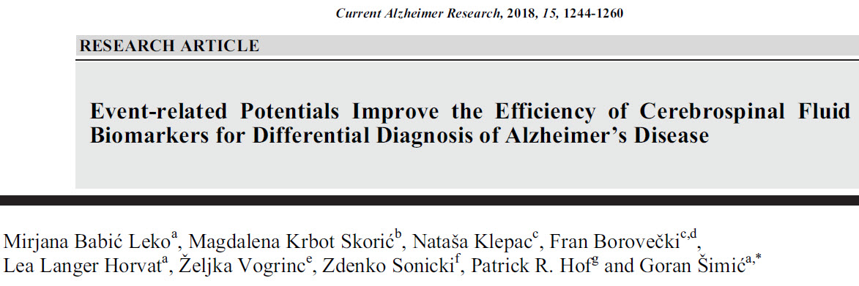
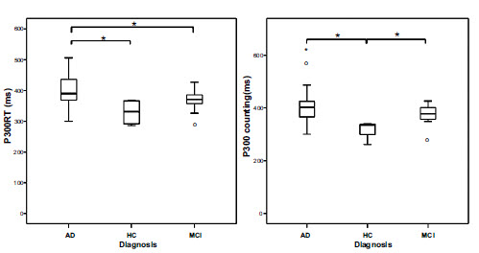
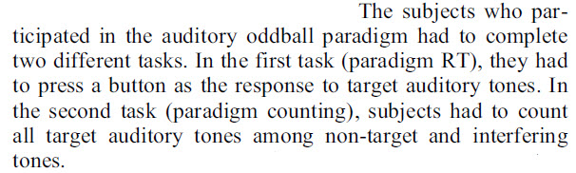
97 subjects

Slide 24
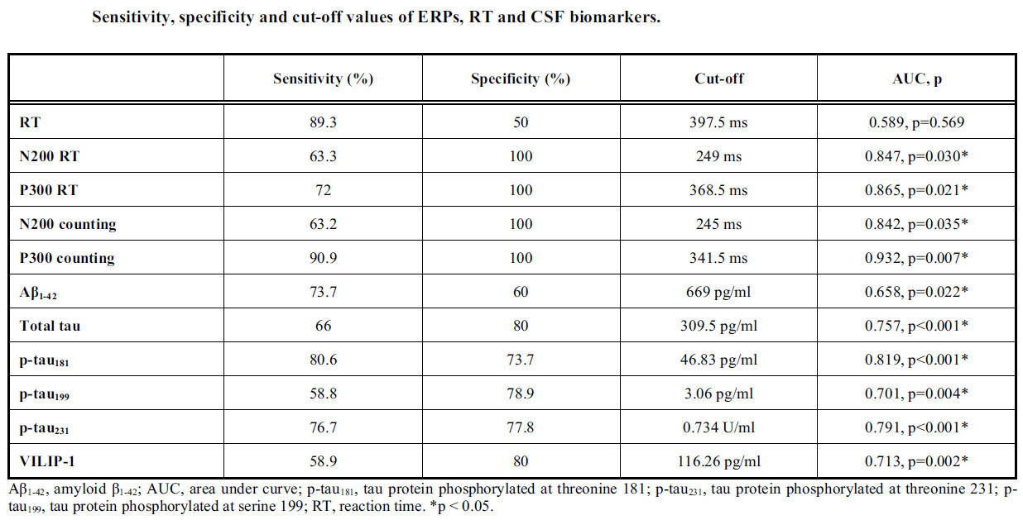

Slide 27
anterior level
intermediate level
posterior level

Slide 28
Ad. 3.
The relatively small magnocellular group of cholinergic neurons located within the rostrolateral extension of the basal forebrain was named and described as the nucleus subputaminalis (NSP) in the human brain by Giuseppe Ayala in 1915 (Ayala G., Brain, 1915).
Upon detailed analysis of the NSP in 33 normal subjects, we found the human NSP projects through the external capsule towards the inferior frontal gyrus and cingulum (it projects to amygdala too), which strongly suggests it is connected with the cortical speech area and is involved in generation of P300 event-related potential (Šimić G. et al., Neuroscience, 1999).
The larger size of the NSP on the left side (an observation that still needs a quantitative confirmation), the most protracted development among all magnocellular aggregations within the basal forebrain ("albino group", Kračun and Rösner, 1986) and the fact that anterointermediate and rostral parts of NSP are usually negligible or missing in monkeys (Rhaganti M.A., Šimić G., et al., 2011) indicates that these neurons are human specific.

Slide 29
anterior level
intermediate level
posterior level

Slide 30
Most carnivores have a moderately developed NB with a better expression of its medial division, while rodents have only medial, sub- and peripallidal equivalents of the NB.
The corresponding speech production region in the right (non-dominant) hemisphere has also roles in linguistic abilities: patients with right hemisphere disease may have dysprosody - sound flat in their intonation due to absence of rhythm, accent, melody, vocal quality, etc. and may fail to comprehend emotional nuances, irony, sarcasm, and humor in the speech of others.
anterior level
intermediate level
posterior level

Slide 31
23 individual brains from 12 anthropoid species
ChAT-ihc
HUMAN NSP
CHIMPANZEE NSP
anterior level
intermediate level
posterior level

Slide 32
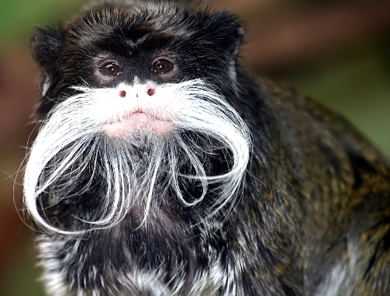
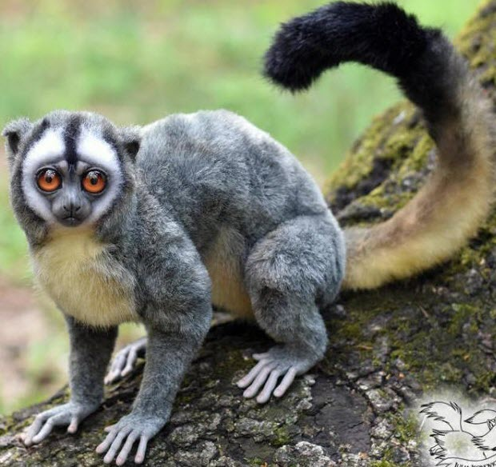
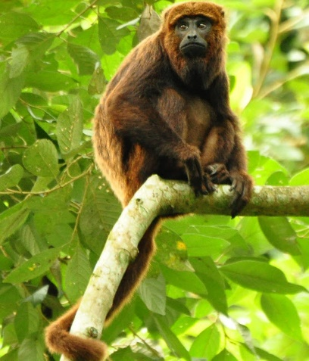
intermediate level
anterior level
posterior level

Slide 33
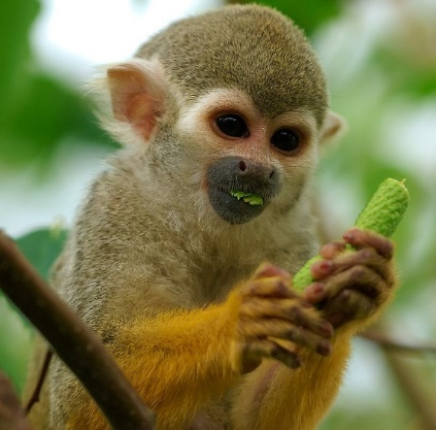
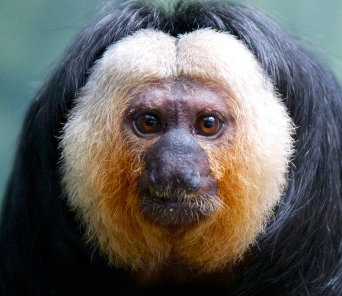
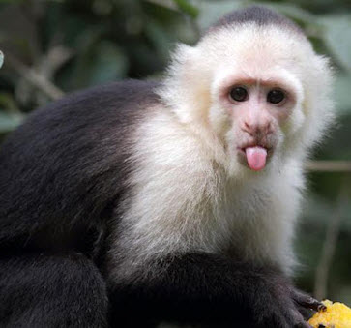
anterior
intermediate level
posterior

Slide 34
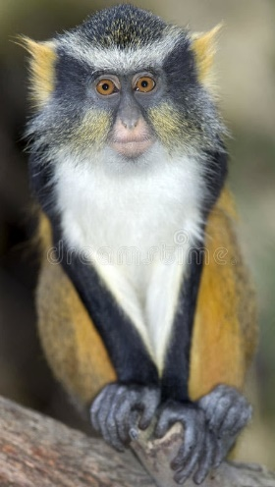
anterior
intermediate level
posterior

Slide 35
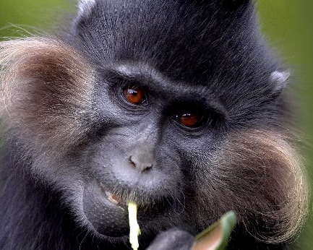
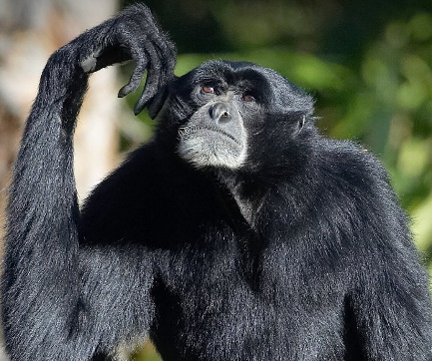
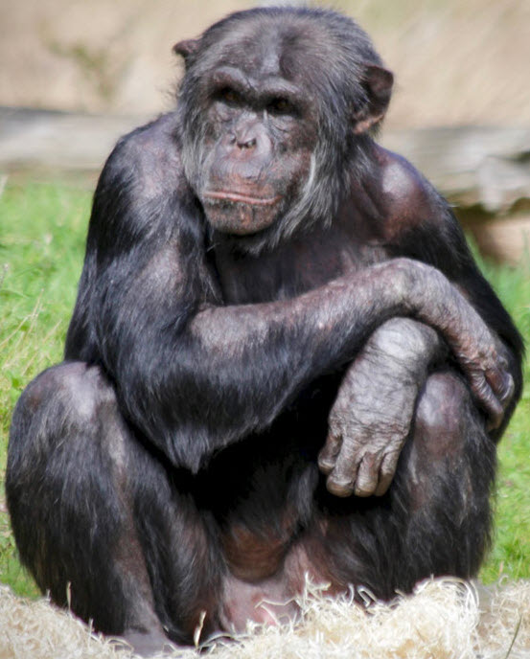
anterior
intermediate level
posterior

Slide 36
NSP
NSP
anterior
intermediate level
posterior

Slide 37
We concluded that many monkeys have a prominent NB complex, but lack a developed NSP.
Only some anthropoid monkeys have all subdivisions of the NB complex.
Only chimpanzees have a very small number of NSP neurons.

Slide 38
Human, 15 w.g. "albino cell group„ i.e. the future NSP (in between small arrowheads) indicates the most protracted development among all magnocellular aggregations within the basal forebrain

Slide 39
AChE ihc
temporopolar cx, CON
temporopolar cx, Alzheimer’s disease

Slide 40
Ad. 4.
The relatively small magnocellular group of cholinergic neurons located within the rostrolateral extension of the basal forebrain was named and described as the nucleus subputaminalis (NSP) in the human brain by Giuseppe Ayala in 1915 (Ayala G., Brain, 1915).
Upon detailed analysis of the NSP in 33 normal subjects, we found the human NSP projects through the external capsule towards the inferior frontal gyrus and cingulum (it projects to amygdala too), which strongly suggests it is connected with the cortical speech area and is involved in generation of P300 event-related potential (Šimić G. et al., Neuroscience, 1999).
The larger size of the NSP on the left side (an observation that still needs a quantitative confirmation), the most protracted development among all magnocellular aggregations within the basal forebrain ("albino group", Kračun and Rösner, 1986) and the fact that anterointermediate and rostral parts of NSP are usually negligible or missing in monkeys (Rhaganti M.A., Šimić G., et al., 2011) indicates that these neurons are human specific.
Recent postmortem analysis of NSP of cases presenting with primary progressive aphasia (PPA) revealed marked loss of cholinergic neurons in NSP regardless of underlying pathology, providing further evidence for the importance of NSP in language (Hamodat H. et al., Can. J. Neurol. Sci., 2019). Possible role of NSP in other neurological (variants of FTLD), neurodegenerative (AD) and psychiatric disorders (SCH) should be carefully investigated in future studies.

Slide 42
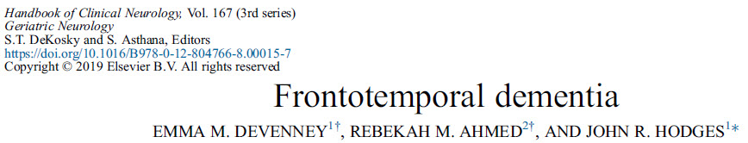
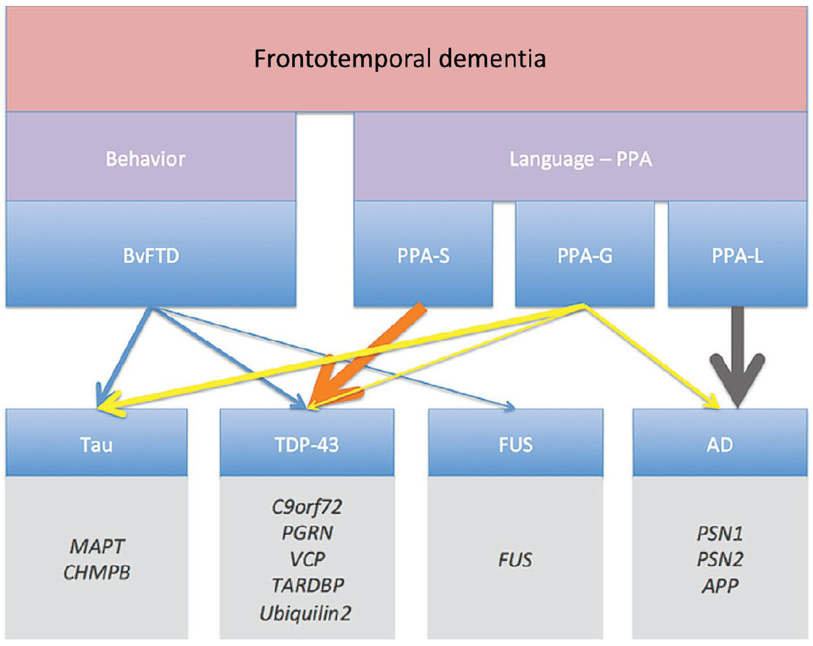
Clinical and pathological subtypes of FTD.
Weighted lines represent the approximate frequency of pathology for each variant.

Slide 43
Clinical and MRI features of language variants of FTD
Atrophy of angular g., middle temp. g. inf. parietal lobule, post. part. of sup. temp. g.
"knife-edge" atrophy of the anterior temporal lobe
Atrophy of BA44/BA45 (P3b)
Feature | SD (svPPA) | PNFA (nfPPA) | LPA (lvPPA)
Agrammatism | − | +++/− * | −
Motor speech disorder | − | +++/− * | −
Anomia | +++ | + | +++
Single word comprehension | +++ | − | −
Comprehension complex or sequential instructions | − | ++ | +++
Single word-repetition | − | ++ | −
Sentence repetition | − | ++ | +++
Surface dyslexia | +++ | − | −
*Either agrammatism or motor speech disorder must be included.

Slide 44
svPPA
nfPPA
lvPPA

Slide 45
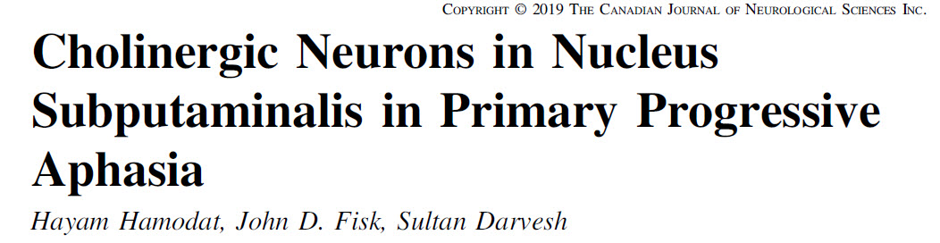
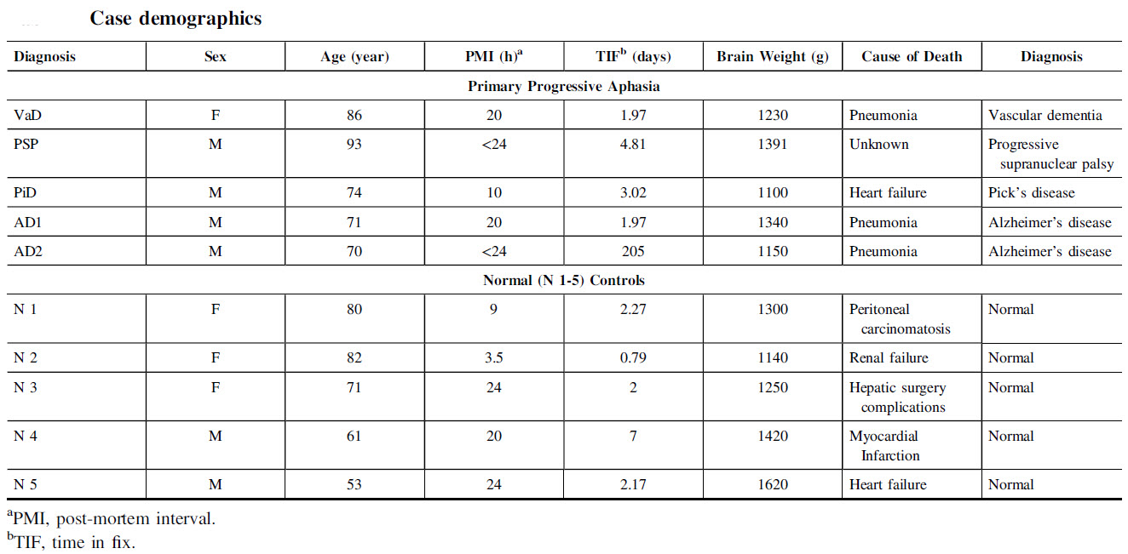

Slide 46
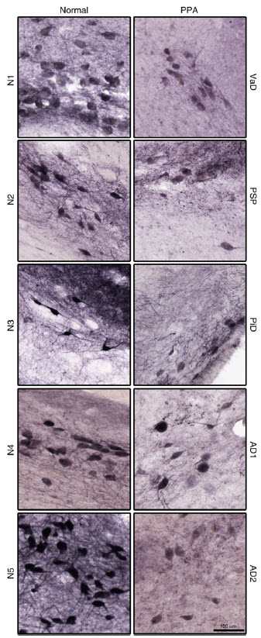
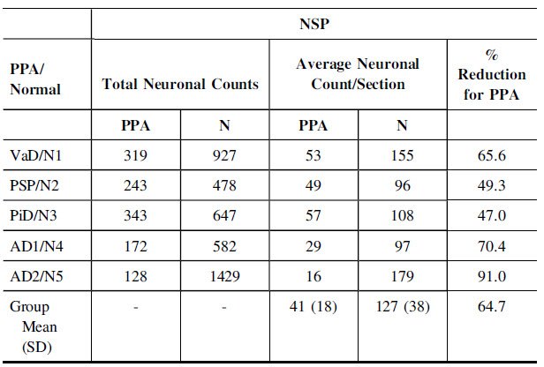

Slide 47
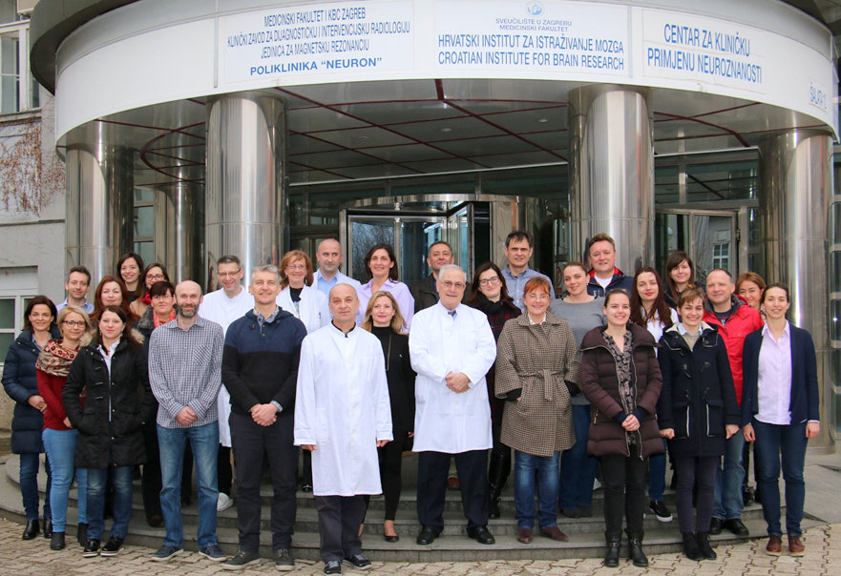



KK.01.1.1.01.0007, ZCI – NEURO
EU Regional Development Fund
IP-2019-04-3584
(2020-2024)

Slide 48
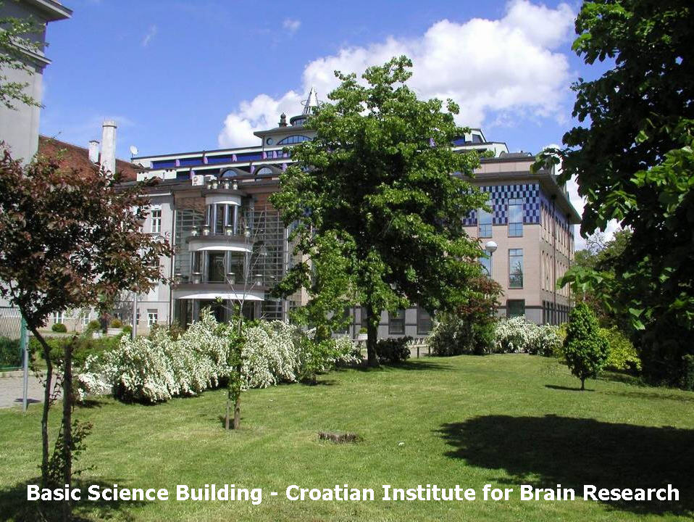

Thank you for your attention!

